Slide 1
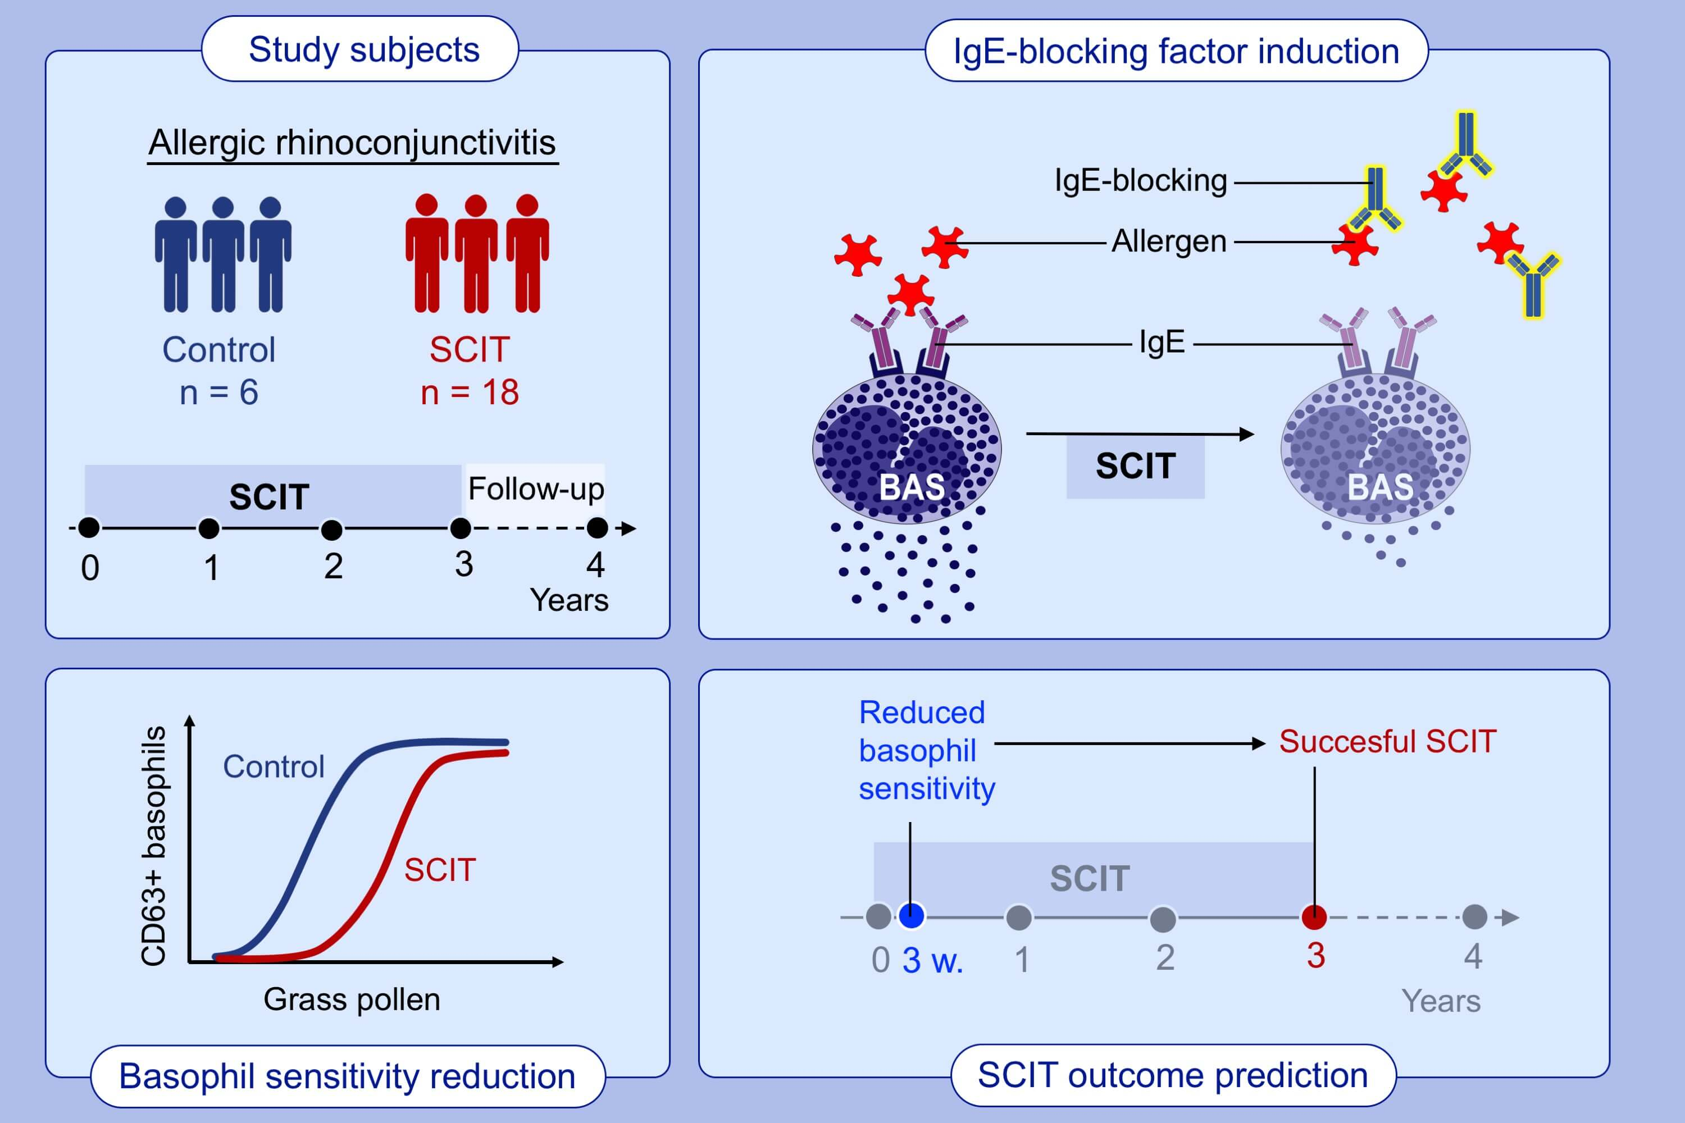
Basophil sensitivity reflects long‐term clinical outcome of subcutaneous immunotherapy in grass pollen‐allergic patients
Johannes M. Schmid, Peter A. Würtzen, Premkumar Siddhuraj, Prajakta Jogdand, Claus G. Petersen, et al.
Allergy. 2021; 1528-1538 https://doi.org/10.1111/all.14264
© 2019 EAACI and John Wiley and Sons A/S. Published by John Wiley and Sons Ltd.
Notes:
HIGHLIGHTS
Grass SCIT leads to a 447-fold decrease in basophil sensitivity during the first treatment year.
AUC of IgE blocking factor correlates to nasal challenge and SPT.
Decrease in basophil sensitivity during the first three weeks predicts the long-term clinical improvement during subcutaneous immunotherapy and may represent the biomarker of choice for recommending continued SCIT treatment.
Abbreviations: AUC, area under the curve; SCIT, subcutaneous immunotherapy; SPT, skin prick test

