Slide 1
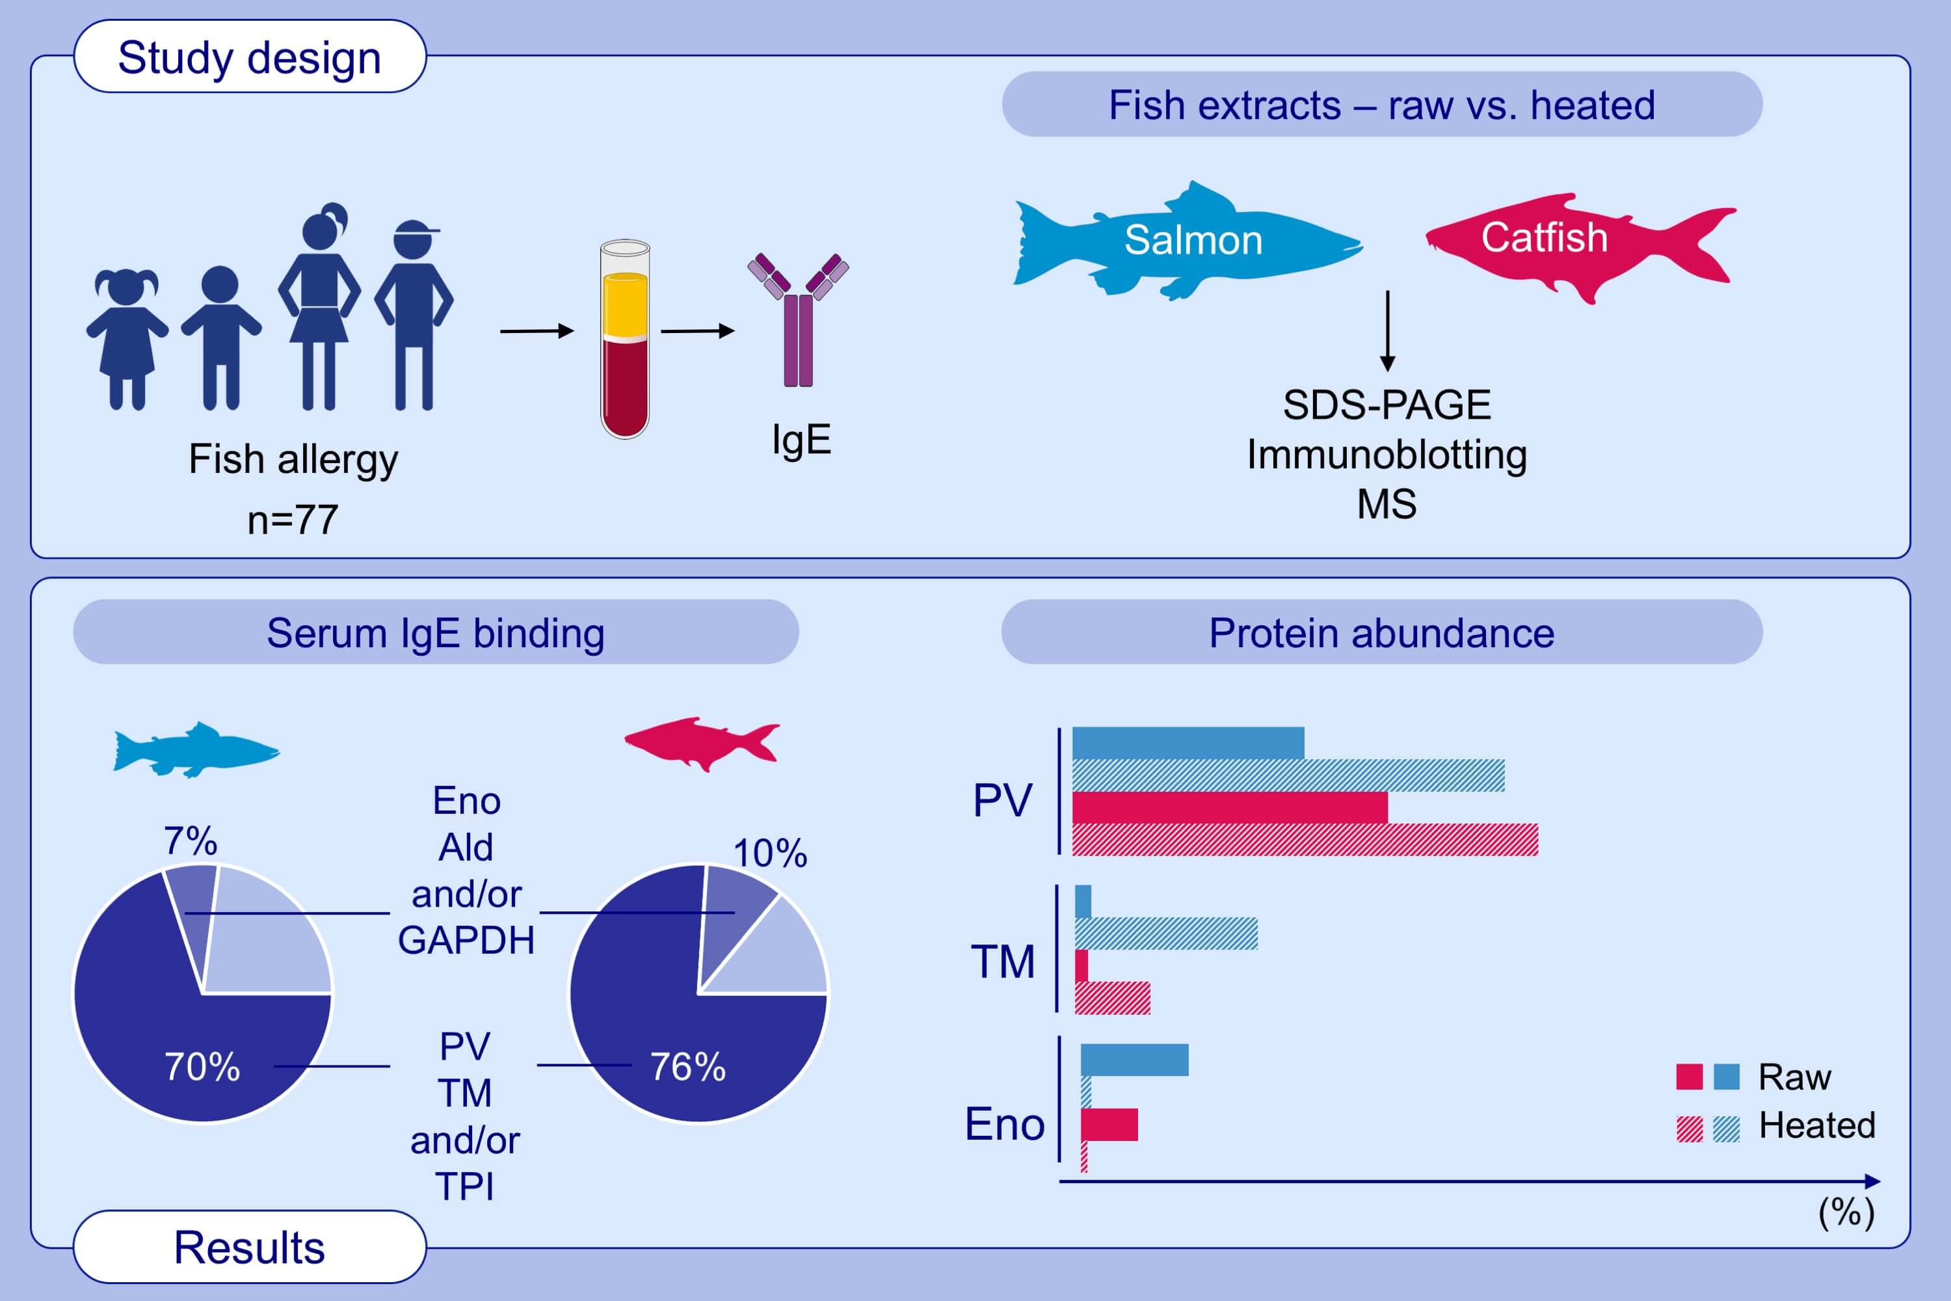
Expanding the allergen repertoire of salmon and catfish
Thimo Ruethers, Aya C. Taki, Shaymaviswanathan Karnaneedi, Shuai Nie, Tanja Kalic, et al.
Allergy. 2021; 1443-1453 https://doi.org/10.1111/all.14574
© 2019 EAACI and John Wiley and Sons A/S. Published by John Wiley and Sons Ltd.
Notes:
HIGHLIGHTS
Catfish raw and heated extracts demonstrate higher prevalence and diversity of IgE-binding as compared to salmon.
PV, TM and TPI are the most prominent IgE-binding fish proteins, followed by Eno, Ald and GAPDH.
TM is the second most abundant protein, after PV, in heated extracts and up to 49% of 77 fish-allergic children demonstrate IgE-binding.
Abbreviations: Ald, aldolase; Eno, enolase; GAPDH, glyceraldehyde‐3‐phosphate dehydrogenase; MS, mass spectrometry, PV, parvalbumin, SDS-PAGE, sodium dodecyl sulphate-polyacrylamide gel electrophoresis; TM, tropomyosin, TPI, triosephosphate isomerase

