Slide 1
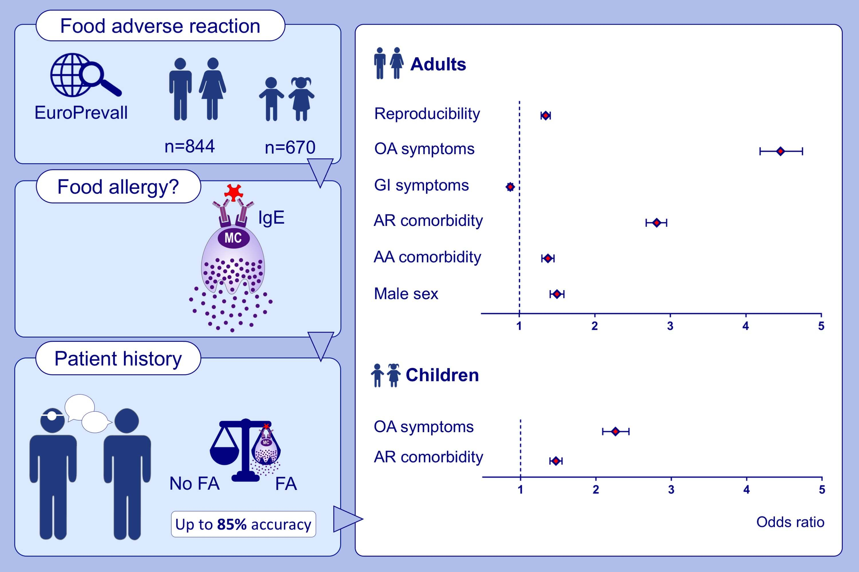
Predicting food allergy: The value of patient history reinforced
Sarah A. Lyons, André C. Knulst, Peter G. J. Burney, Montserrat Fernandez‐Rivas, Barbara K. Ballmer‐Weber, et al.
Allergy. 2021; 1454-1462 https://doi.org/10.1111/all.14583
© 2019 EAACI and John Wiley and Sons A/S. Published by John Wiley and Sons Ltd.
Notes:
HIGHLIGHTS
The European Anaphylaxis Registry data confirmed peanut as one of the major causes of severe allergic reactions in European children and adolescents.
Some characteristic features of peanut anaphylaxis compared to other food triggers were higher presence of asthma comorbidity and more severe symptoms.
Usage of intramuscular adrenaline as first line treatment was low and needs to be improved.
Abbreviations: FIA, food induced anaphylaxis; nP-FA, non-peanut induced food anaphylaxis; P-FA, peanut induced food anaphylaxis

