Slide 1
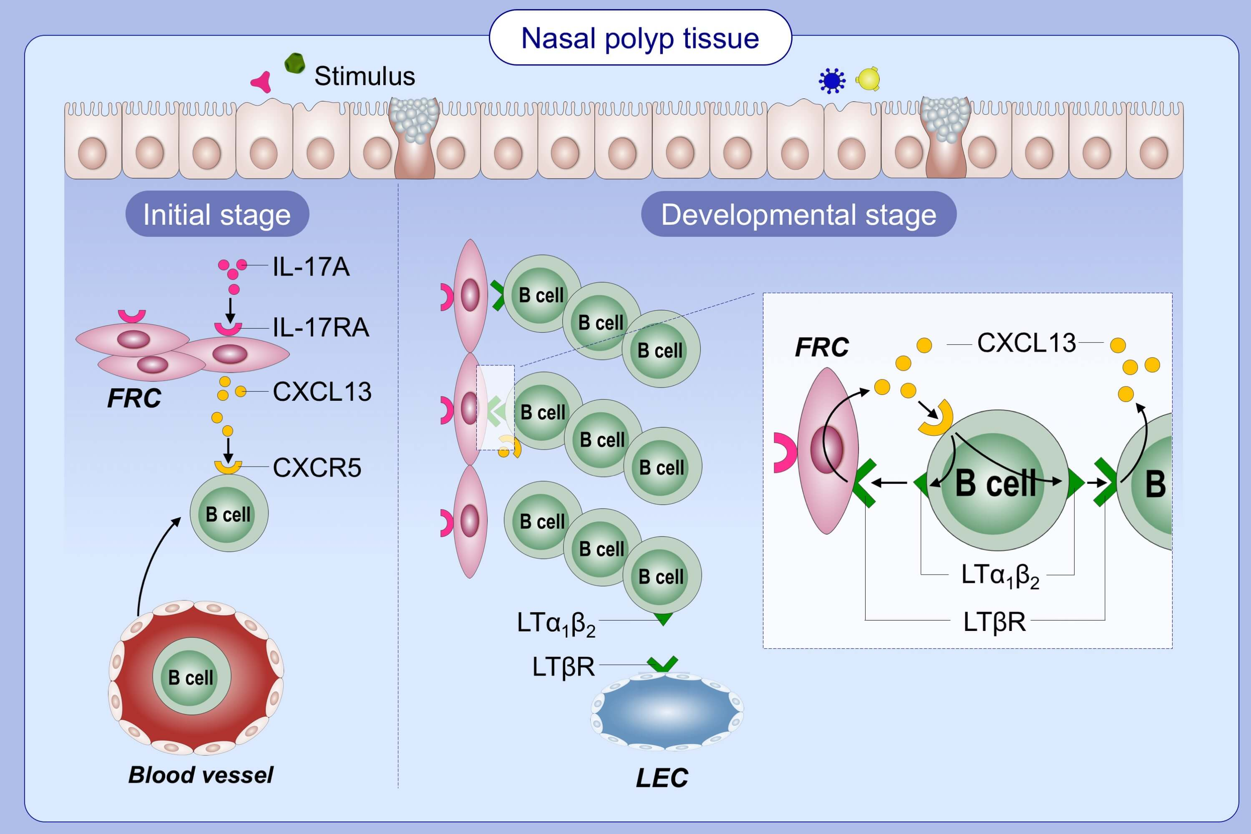
Stromal cells and B cells orchestrate ectopic lymphoid tissue formation in nasal polyps
Zhe‐Zheng Wang, Jia Song, Hai Wang, Jing‐Xian Li, Qiao Xiao, et al.
Allergy. 2021; 1416-1431 https://doi.org/10.1111/all.14612
© 2019 EAACI and John Wiley and Sons A/S. Published by John Wiley and Sons Ltd.
Notes:
HIGHLIGHTS
IL-17A induces FRC expansion and CXCL13 production, leading to B cell recruitment and the initiation of eLT formation.
CXCL13 induces LTα₁β₂ expression on B cells, which in turn promotes CXCL13 production from B cells and stromal cells, and stromal cell remodeling towards FRC and LEC.
The crosstalk between B cells and stromal cells perpetuates the development of eLTs.
Abbreviations: CXCL13, chemokine (C-X-C motif) ligand 13; eLT, ectopic lymphoid tissue; FRC, fibroblastic reticular cell; IL, interleukin; LEC, lymphoid endothelial cell; LT, lymphotoxin.

