Slide 1
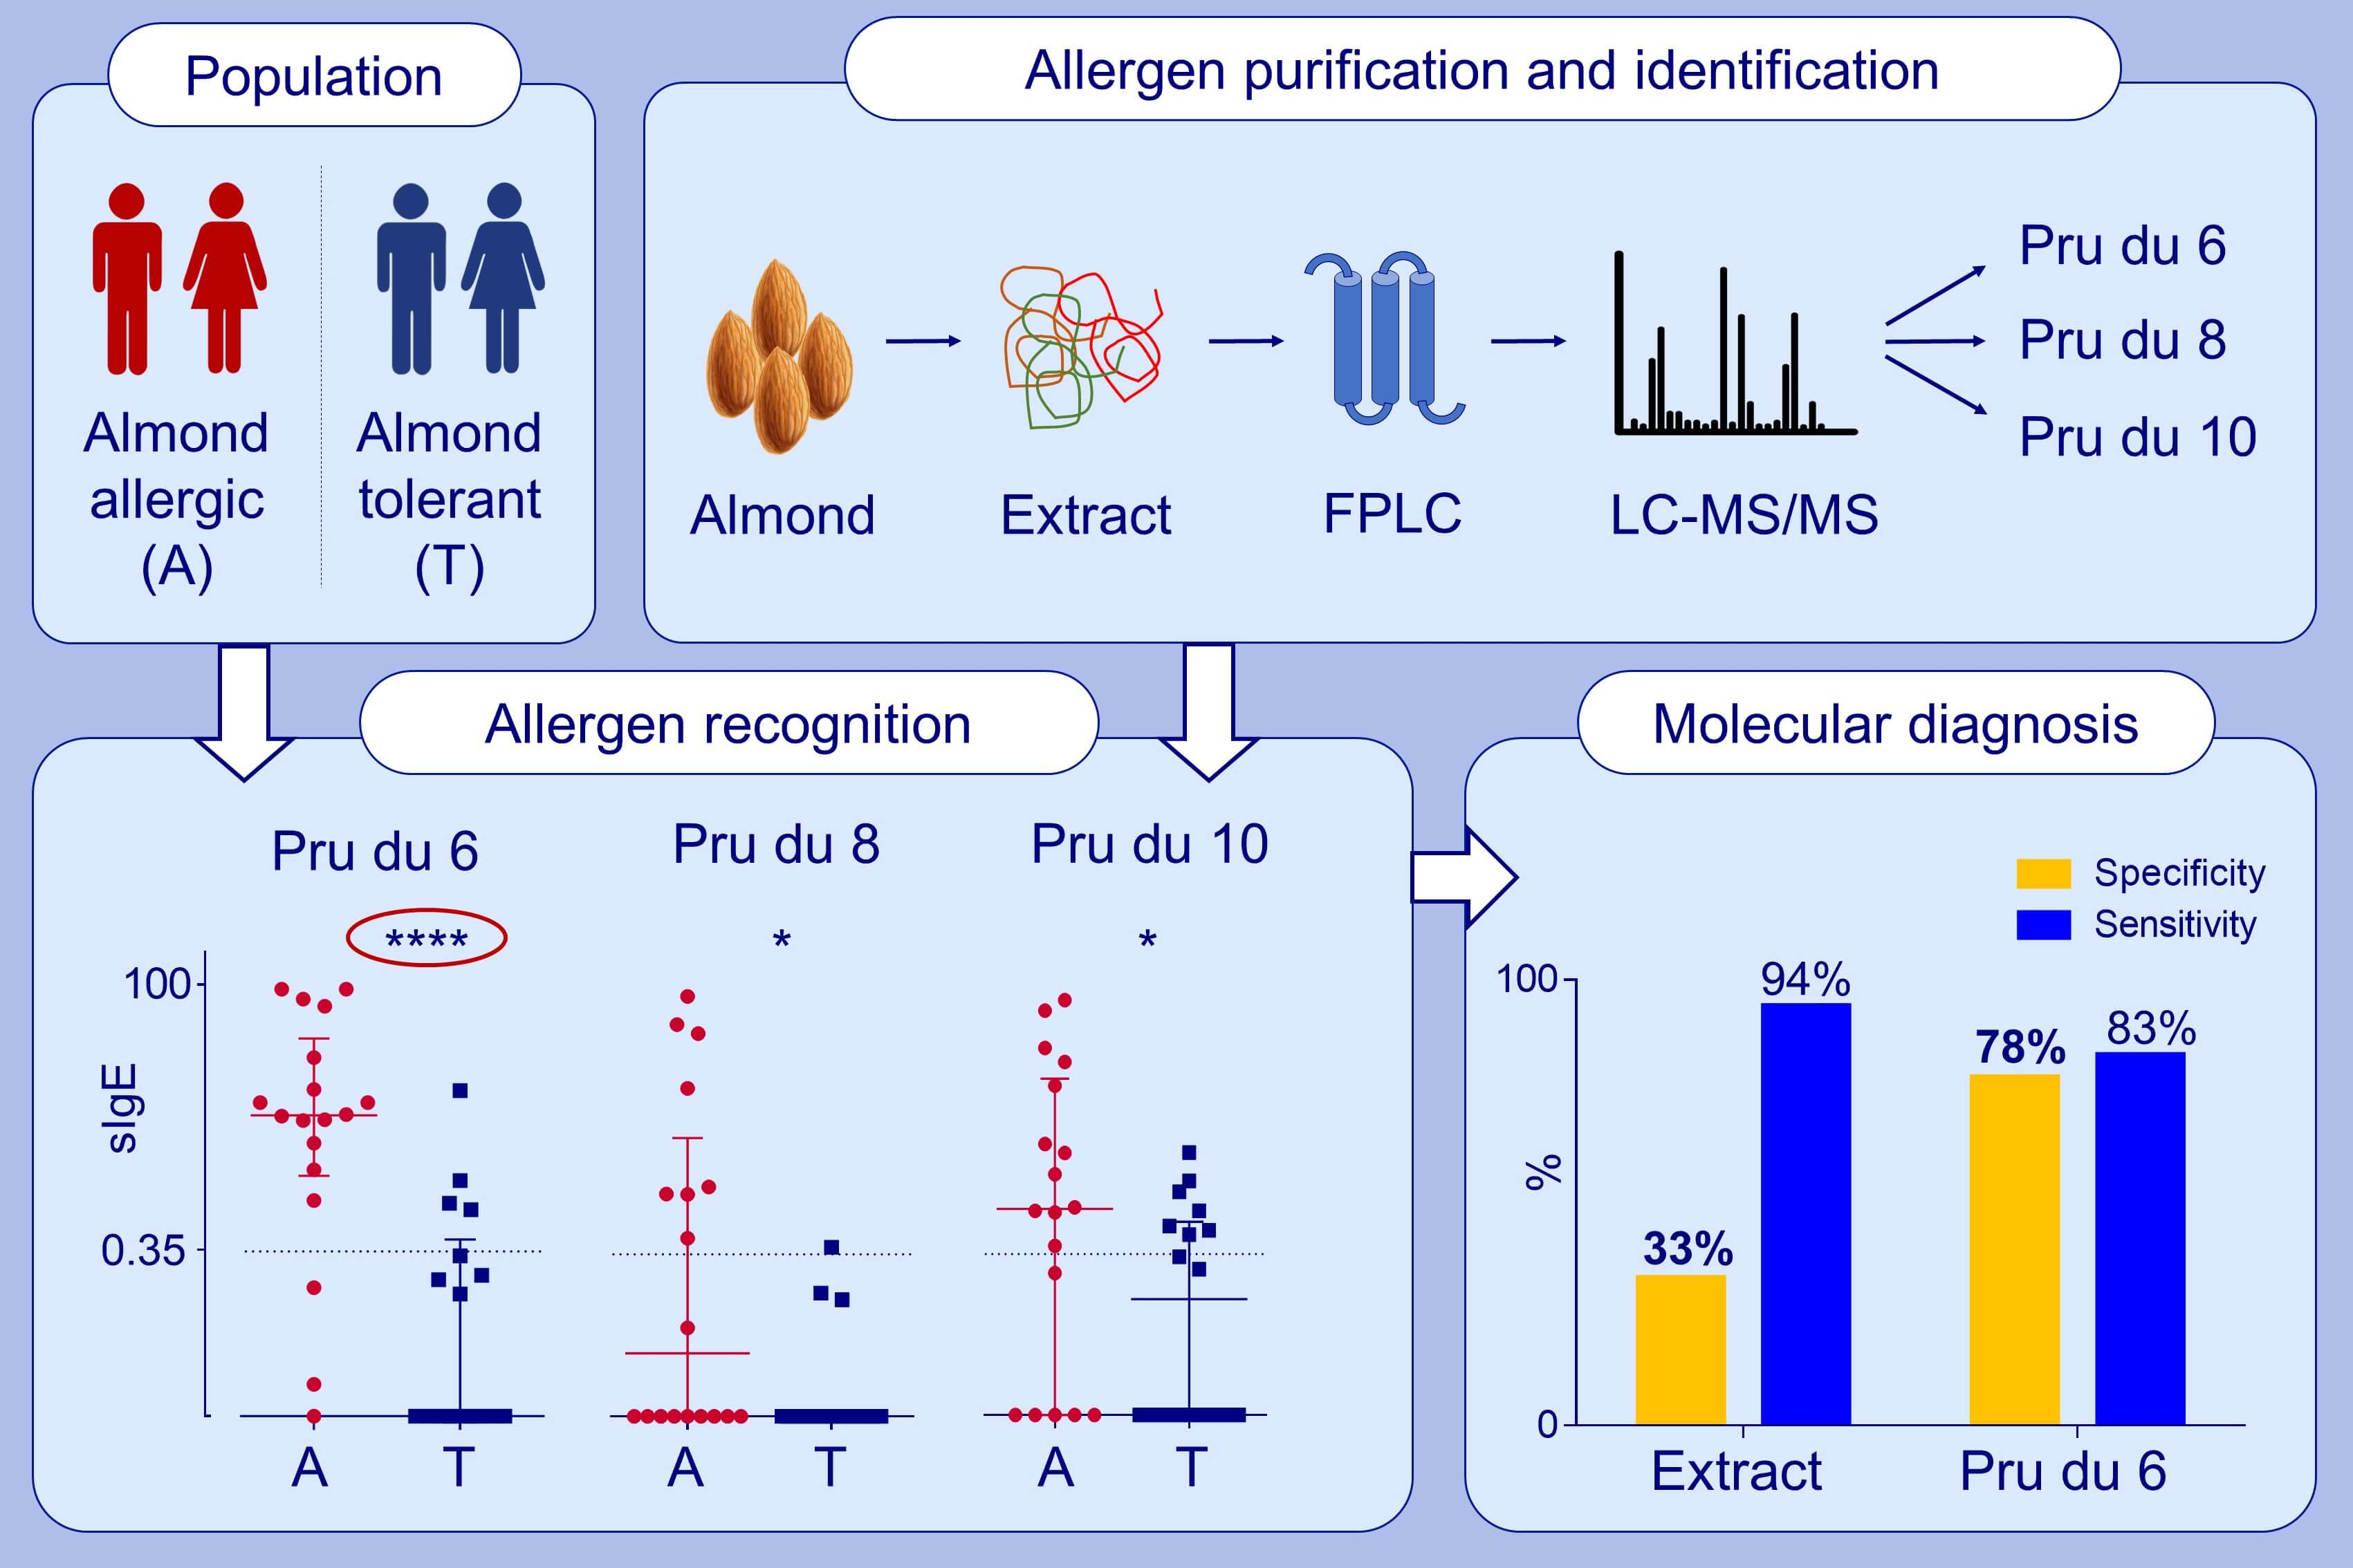
Identification of Pru du 6 as a potential marker allergen for almond allergy
Stefan Kabasser, Christine Hafner, Sharon Chinthrajah, Sayantani B. Sindher, Divya Kumar, et al.
Allergy. 2021; 1463-1472 https://doi.org/10.1111/all.14613
© 2019 EAACI and John Wiley and Sons A/S. Published by John Wiley and Sons Ltd.
Notes:
HIGHLIGHTS
Three allergens were identified in almond kernels: Pru du 6, Pru du 8, and a new allergen, Pru du 10, belonging to a novel family of allergenic proteins.
Sensitization profiles of almond allergic individuals were dominated by almond-specific allergens, particularly Pru du 6.
The use of almond allergens for IgE tests markedly increased the diagnostic specificity compared to the extract.
Abbreviations: FPLC, fast protein liquid chromatography; LC-MS/MS: liquid chromatography tandem mass spectrometry; sIgE: specific IgE

