Slide 1
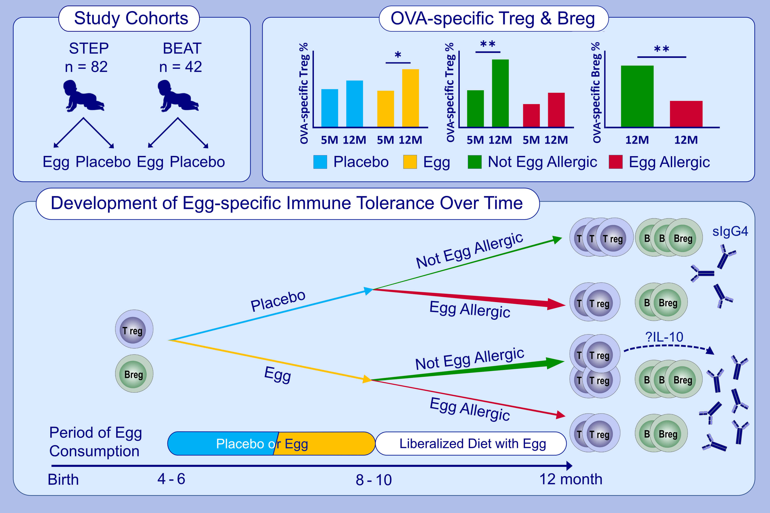
Longitudinal egg‐specific regulatory T‐ and B‐cell development: Insights from primary prevention clinical trials examining the timing of egg introduction
Catherine L. Lai, Dianne E. Campbell, Debra J. Palmer, Maria Makrides, Brigitte Santner‐Nanan, et al.
Allergy. 2021; 1385-1397 https://doi.org/10.1111/all.14621
© 2019 EAACI and John Wiley and Sons A/S. Published by John Wiley and Sons Ltd.
Notes:
HIGHLIGHTS
Early egg consumption in infants is associated with expansion of ovalbumin-specific Tregs over time.
Egg allergic infants had blunted expansion of ovalbumin-specific Tregs and lower ovalbumin-specific Bregs compared to those not egg allergic.
Early egg consumption was associated with increased egg specific IgG4, which correlated with IL-10 producing ovalbumin specific Treg in non-egg allergic infants.
Abbreviations: BEAT, Beating Egg Allergy Trial; OVA, ovalbumin; STEP, Start Time of Egg Protein to Prevent Egg Allergy

