Slide 1
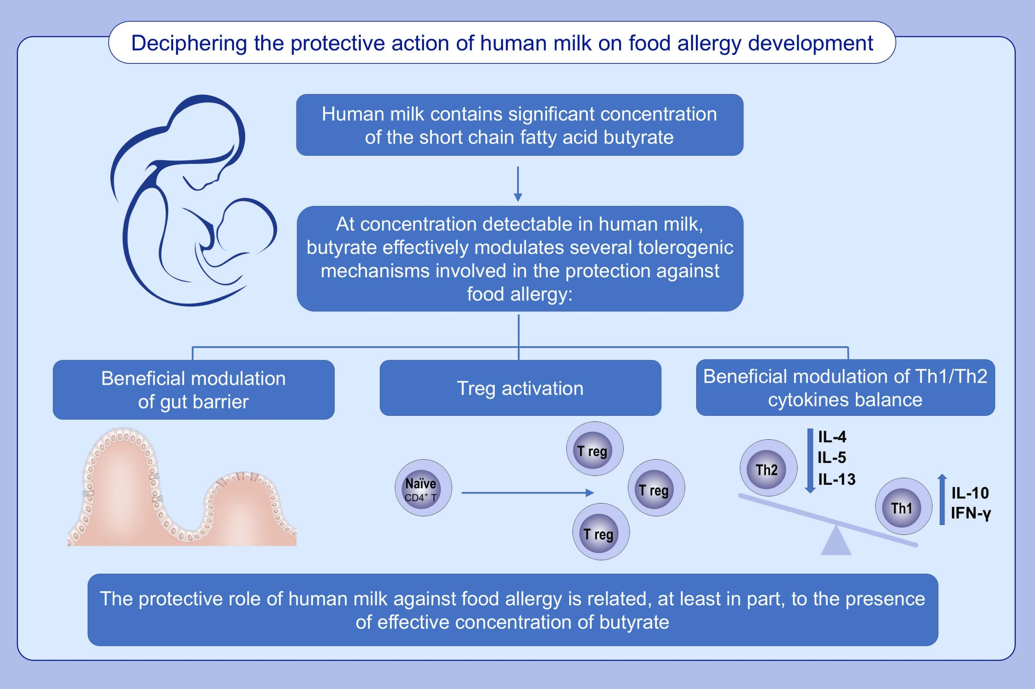
Butyrate as a bioactive human milk protective component against food allergy
Lorella Paparo, Rita Nocerino, Elena Ciaglia, Carmen Di Scala, Carmen De Caro, et al.
Allergy. 2021; 1398-1415 https://doi.org/10.1111/all.14625
© 2019 EAACI and John Wiley and Sons A/S. Published by John Wiley and Sons Ltd.
Notes:
HIGHLIGHTS
Human milk contains significant level of the short chain fatty acid butyrate.
At concentration detectable in human milk, butyrate effectively modulates several tolerogenic mechanisms involved in the protection against food allergy.
The protective role of human milk against food allergy could be related, at least in part, to the presence of effective concentration of butyrate.

