Slide 1
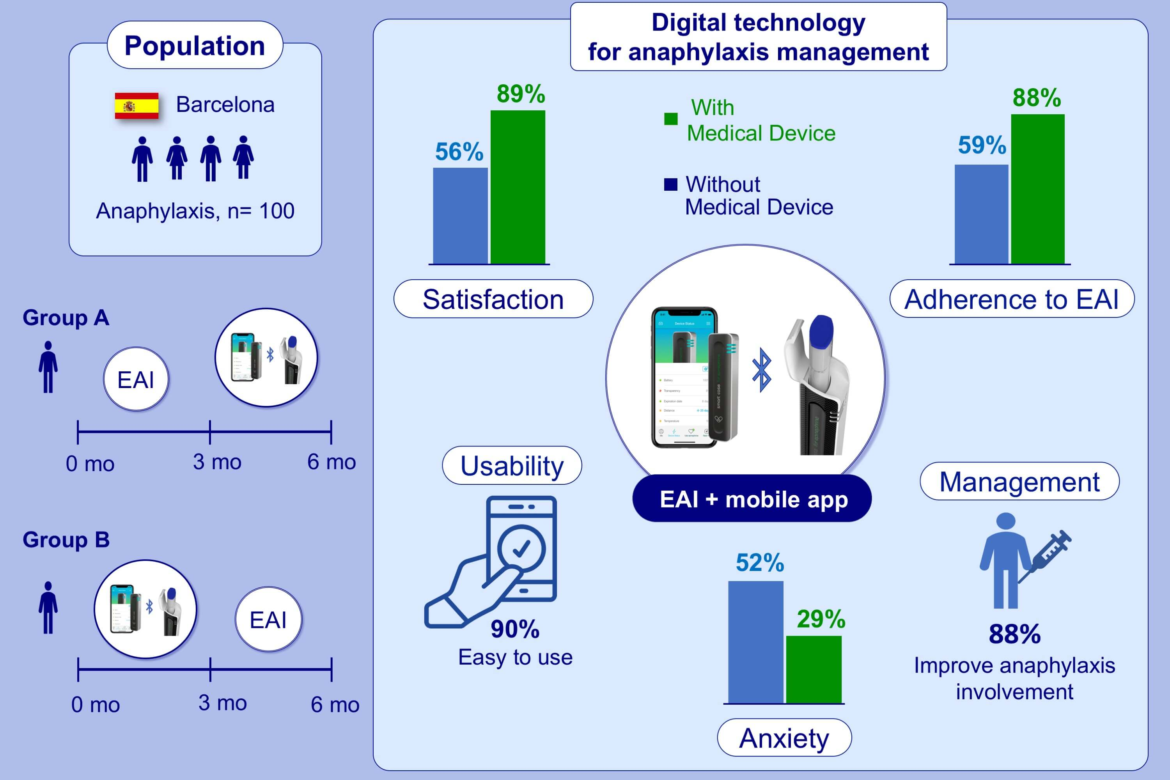
Digital technology for anaphylaxis management impact on patient behaviour: A randomized clinical trial
Anna Sala‐Cunill, Olga Luengo, Adrian Curran, Nuria Moreno, Moises Labrador‐Horrillo, et al.
Allergy. 2021; 1507-1516 https://doi.org/10.1111/all.14626
© 2019 EAACI and John Wiley and Sons A/S. Published by John Wiley and Sons Ltd.
Notes:
HIGHLIGHTS
The study evaluates a medical device for EAI (digital technology comprising an EAI smart case connected to a mobile APP).
After using the medical device, satisfaction and adherence with the EAI increased significantly and anxiety decreased while carrying the medical device.
Almost all patients felt more involved in anaphylaxis management when using the medical device.
Abbreviations: EAI, epinephrine autoinjector; mo, months; APP, application

