Slide 1
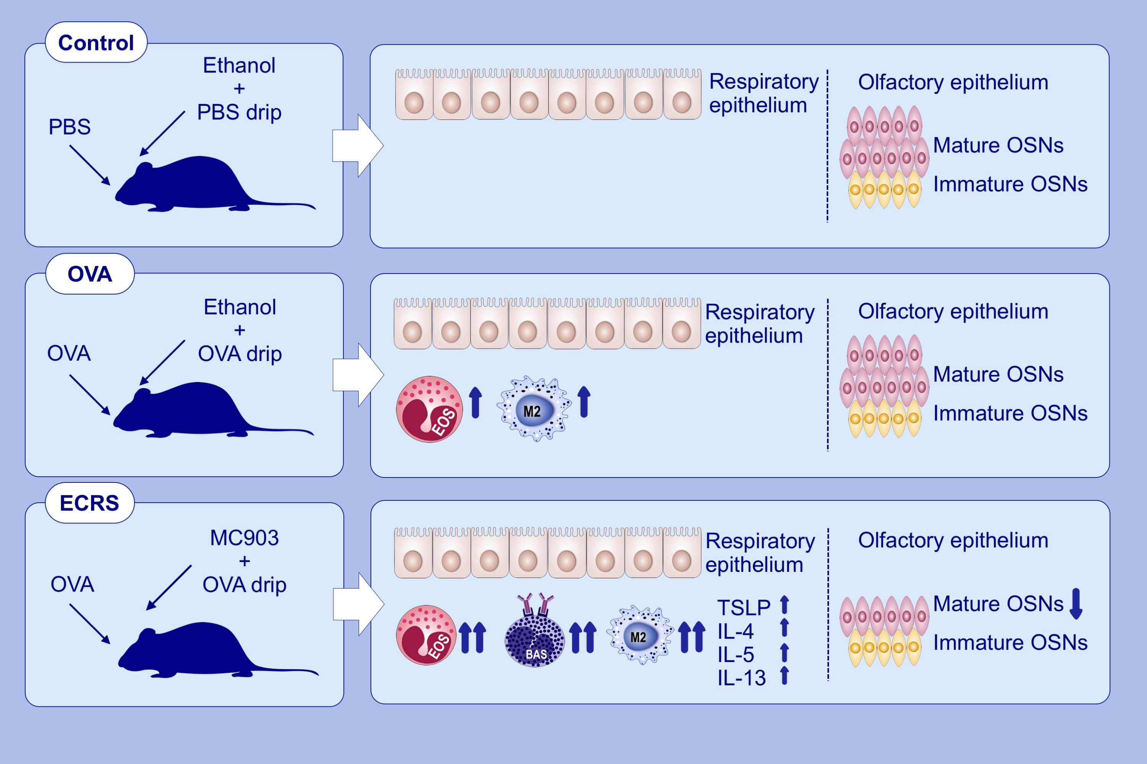
A murine model of eosinophilic chronic rhinosinusitis using the topical application of a vitamin D3 analog
Ryoji Kagoya, Kenji Kondo, Megumi Kishimoto‐Urata, Yuya Shimizu, Shu Kikuta, et al.
Allergy. 2021; 1432-1442 https://doi.org/10.1111/all.14627
© 2019 EAACI and John Wiley and Sons A/S. Published by John Wiley and Sons Ltd.
Notes:
HIGHLIGHTS
A murine model of ECRS is established, in which skin treatment with MC903 and OVA followed by intranasal OVA challenges cause severe eosinophilia in paranasal sinuses.
Infiltration of basophils and M2 macrophages accompanied by increased levels of Th2 cytokines and TSLP in the nasal mucosa are demonstrated.
Thinned olfactory epithelium and decreased mature OSNs are also observed.
Abbreviations: ECRS, eosinophilic chronic rhinosinusitis; IL, interleukin; MC903, vitamin D3 analog; OSNs, olfactory sensory neurons; OVA, ovalbumin; PBS, phosphate buffered saline; TSLP, thymic stromal lymphopoietin

