Slide 1
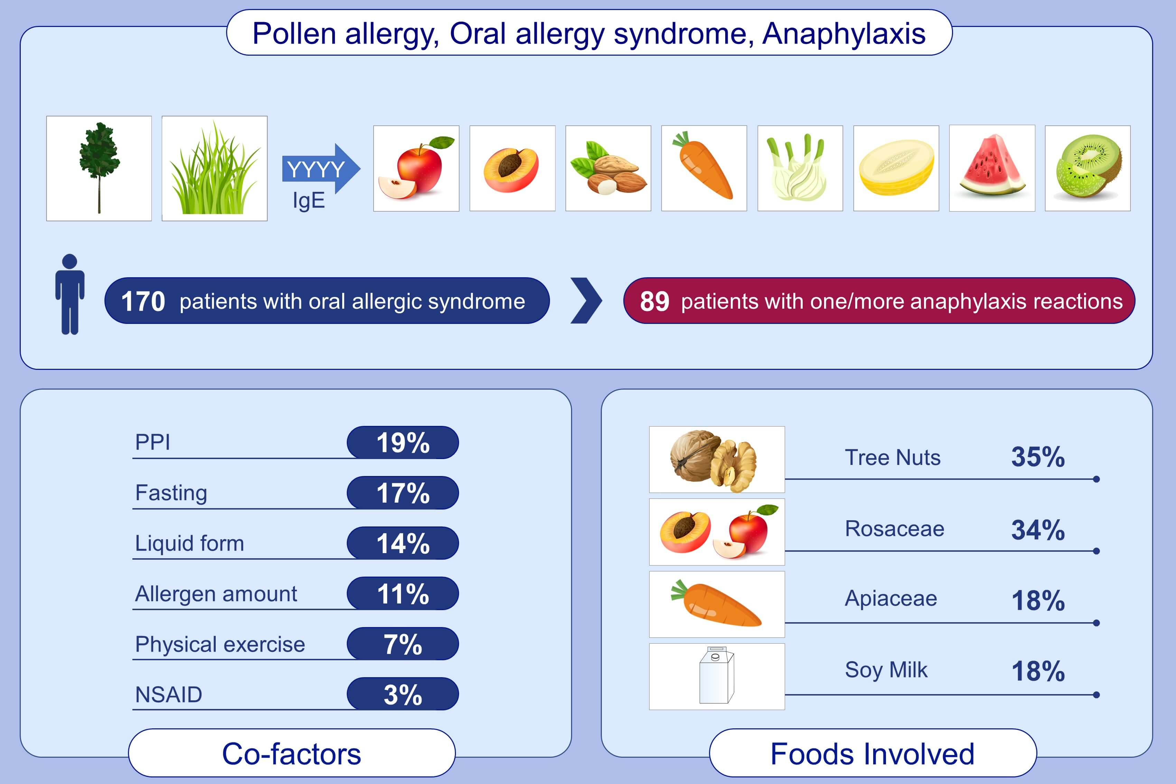
Systemic allergic reactions induced by labile plant‐food allergens: Seeking potential cofactors. A multicenter study
Riccardo Asero, Renato Ariano, Arianna Aruanno, Claudio Barzaghi, Paolo Borrelli, et al.
Allergy. 2021; 1473-1479 https://doi.org/10.1111/all.14634
© 2019 EAACI and John Wiley and Sons A/S. Published by John Wiley and Sons Ltd.
Notes:
HIGHLIGHTS
Hypersensitivity to labile plant food allergens (PR-10 and profilin) secondary to pollen allergy frequently causes oral allergy syndrome.
Labile allergens may become dangerous when the raw foods are ingested in excessive amounts or in liquid form. Other co-factors include therapy with proton pump inhibitors and fasting.
The most frequently involved foods are: tree nuts, Rosaceae, Apiaceae, soy milk.
Abbreviations: NSAID, nonsteroidal anti-inflammatory drugs; PPI, proton pump inhibitors; PR-10, pathogenesis-related proteins group 10

