Slide 1
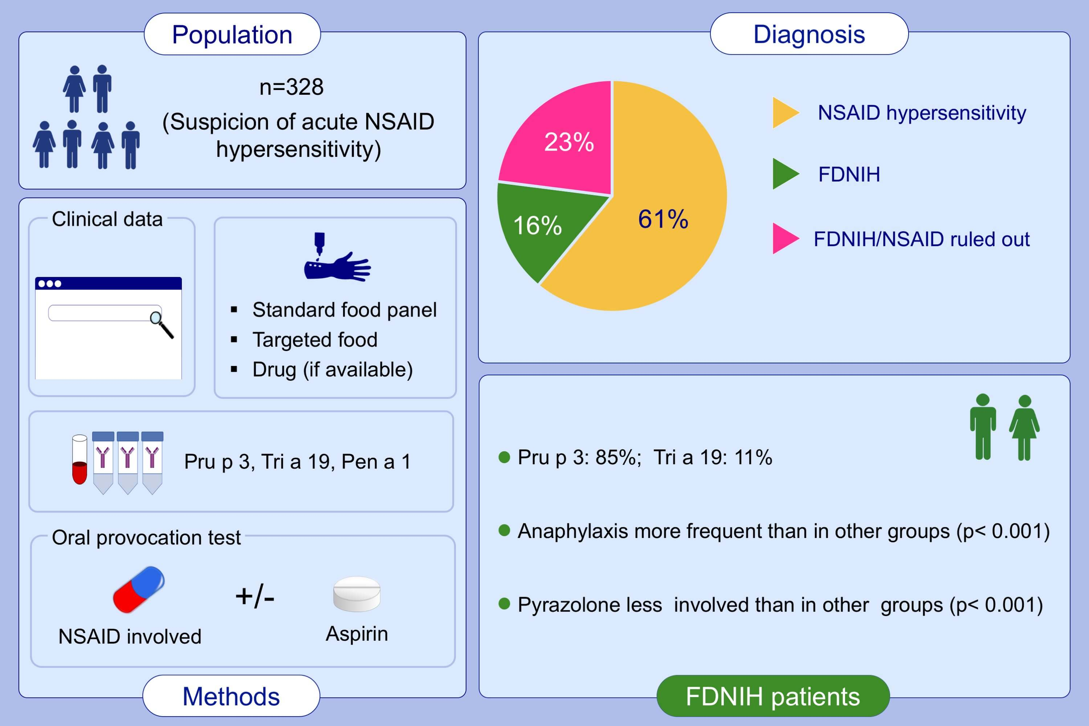
Food‐dependent NSAID‐induced hypersensitivity (FDNIH) reactions: Unraveling the clinical features and risk factors
Jaime Sánchez‐López, Giovanna Araujo, Victoria Cardona, Alba García‐Moral, Rocío Casas‐Saucedo, et al.
Allergy. 2021; 1480-1492 https://doi.org/10.1111/all.14689
© 2019 EAACI and John Wiley and Sons A/S. Published by John Wiley and Sons Ltd.
Notes:
HIGHLIGHTS
16% of patients with suspicion of acute NSAID hypersensitivity were diagnosed as FDNIH reactions being lipid transfer protein (Pru p 3) the main food allergen involved.
With four variables (Pru p 3 or Tri a 19 sensitization, anaphylactic reaction and any NSAID involved different from a Pyrazolone), FDNIH is correctly diagnosed in 95.3% of cases (92% of sensitivity, 96% of specificity).
These observations support the relevance of individualized assessment of both NSAID hypersensitivity and food allergy in patients with suspected acute NSAID hypersensitivity.
Abbreviations: FDNIH, food-dependent NSAID-Induced hypersensitivity; NSAID, non-steroidal anti-inflammatory drug
.

