Slide 1
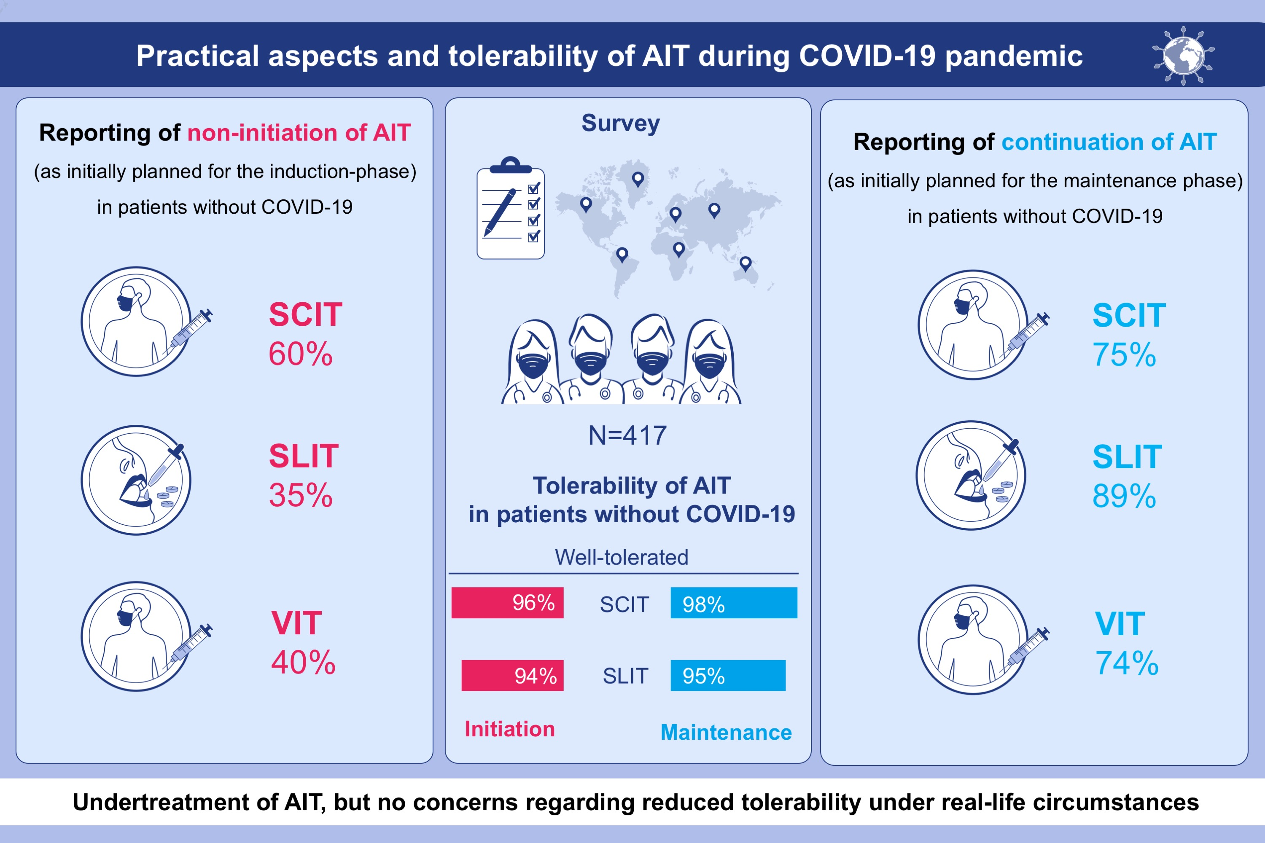
COVID-19 pandemic and allergen immunotherapy—an EAACI survey
Oliver Pfaar,, Ioana Agache,, Matteo Bonini,, Helen Annaruth Brough,, Tomás Chivato,, et al.
Allergy. 2021; 3504-3516 https://doi.org/10.1111/all.14793
© 2019 EAACI and John Wiley and Sons A/S. Published by John Wiley and Sons Ltd.
Notes:
HIGHLIGHTS
This is the first report of an international retrospective survey in atopic diseases investigating practical aspects and tolerability of AIT during the COVID-19 pandemic.
For patients (without any current symptoms to suspect COVID-19), 60% of the respondents informed of not having initiated SCIT, 35% SLIT and 40% venom AIT in the induction phase of AIT though planned. For the maintenance phase of AIT, SCIT was performed by 75%, SLIT by 89% and venom AIT by 74% of the respondents as regularly planned.
Data indicate a (temporary) undertreatment of AIT, but gave no concerns regarding reduced tolerability under real-life circumstances­­­.
Abbreviations: AIT, allergen immunotherapy; COVID-19, coronavirus disease 2019; SCIT, subcutaneous immunotherapy; SLIT, sublingual immunotherapy; VIT, venom immunotherapy

