Slide 1
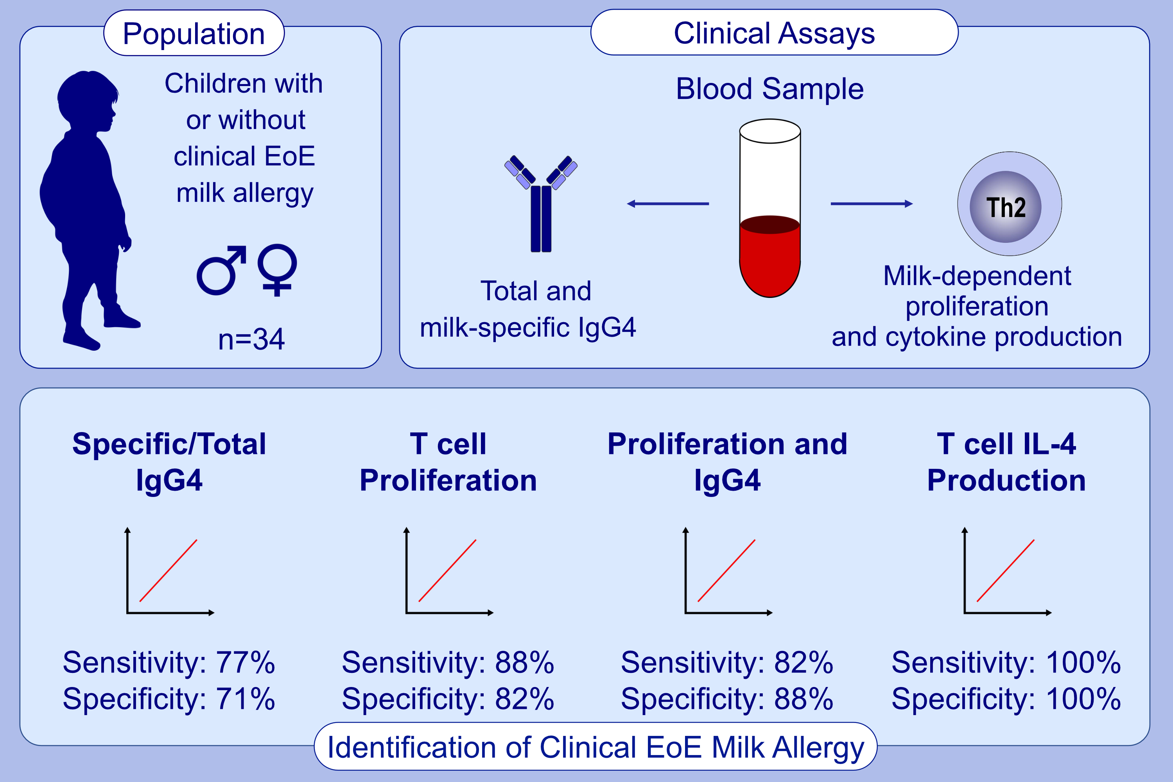
Peripheral markers of allergen-specific immune activation predict clinical allergy in eosinophilic esophagitis
Julianna Dilollo,, Eric M. Rodríguez-López,, Leah Wilkey,, Elizabeth K. Martin,, Jonathan M. Spergel,, et al.
Allergy. 2021; 3470-3478 https://doi.org/10.1111/all.14854
© 2019 EAACI and John Wiley and Sons A/S. Published by John Wiley and Sons Ltd.
Notes:
HIGHLIGHTS
There is critical needs for minimally-invasive diagnostic tests that accurately identify allergenic foods in eosinophilic esophagitis patients.
We show that milk-activated memory Th2 cells circulate in the blood of milk-allergic EoE patients.
Measuring the proliferation and cytokine production of these cells predicts clinical EoE allergy to milk with high sensitivity, high specificity, and minimal risk to the patient.
Abbreviation: EoE, eosinophilic esophagitis

