Slide 1
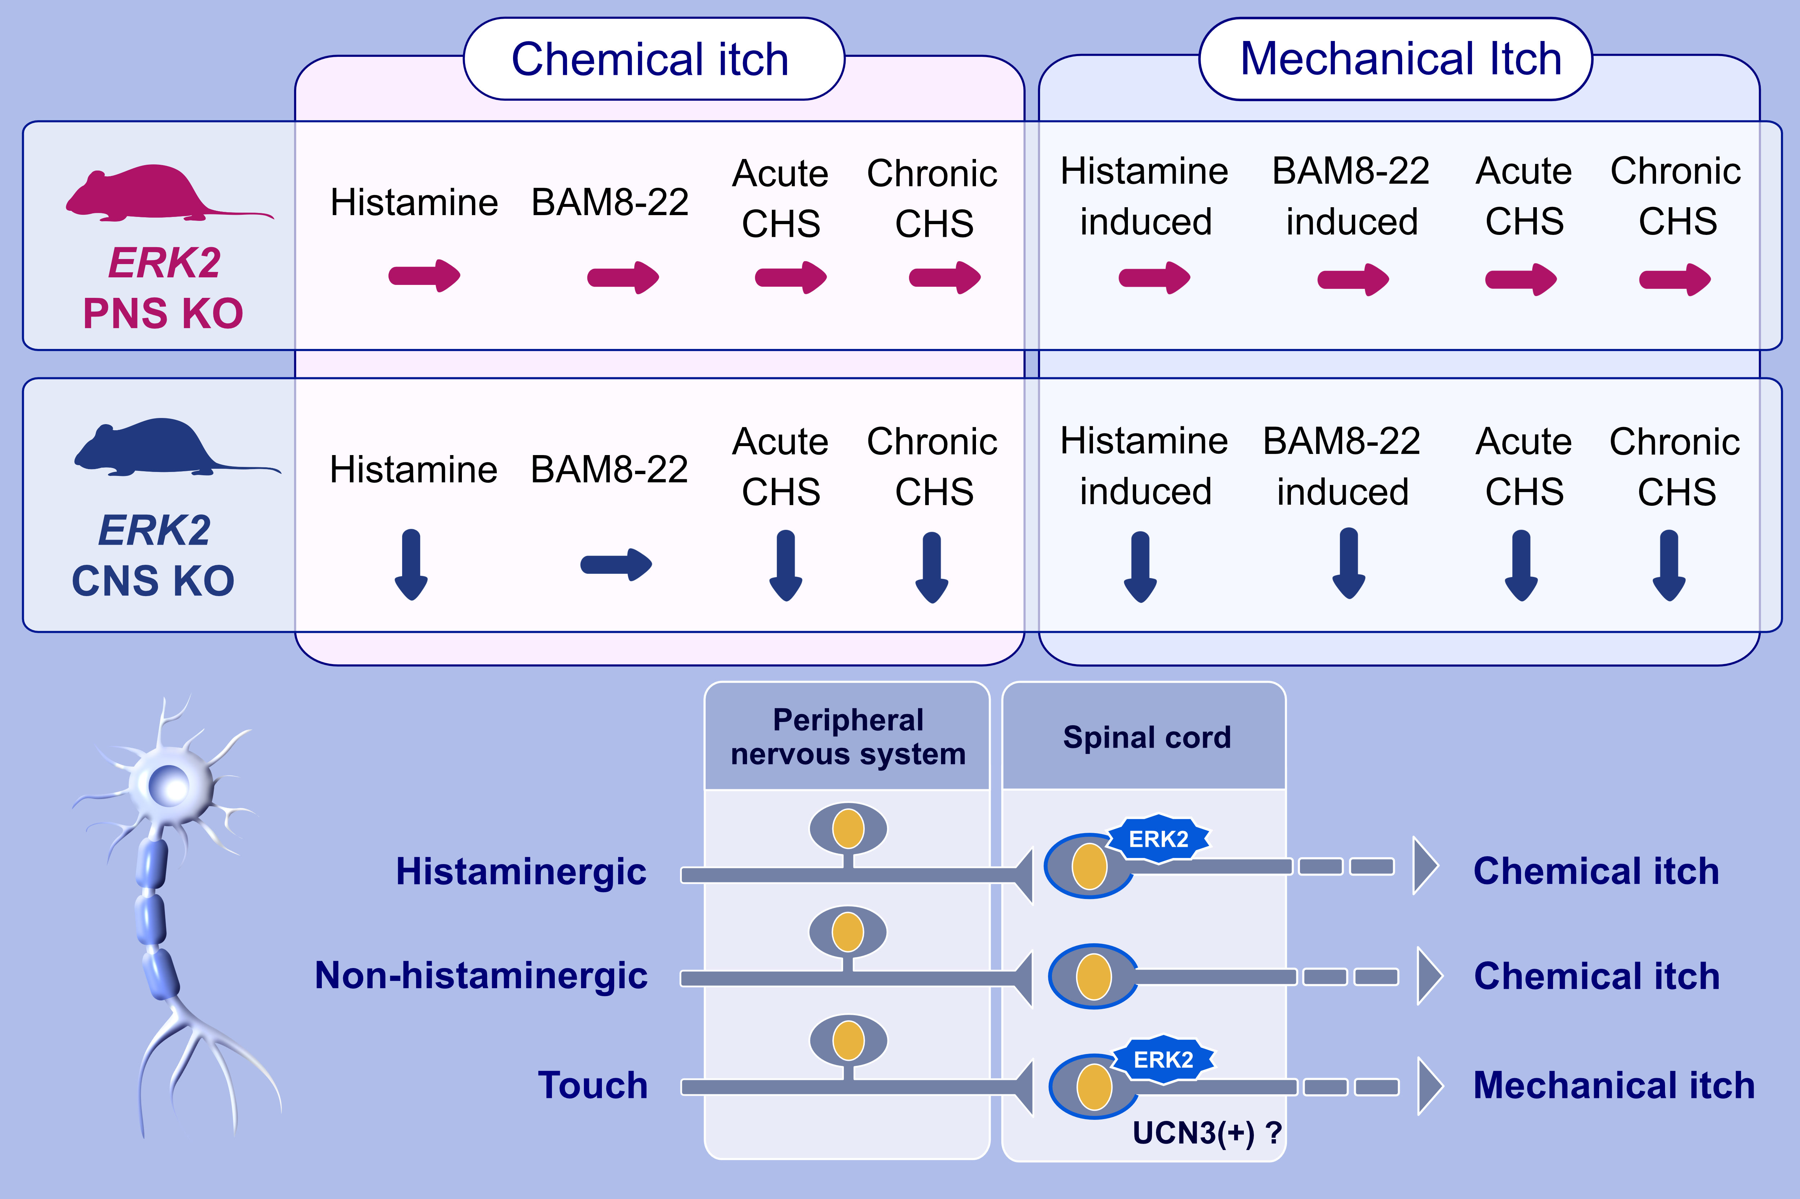
Central, but not peripheral, nervous system ERK2 is essential for itch signals in murine allergic skin inflammation
Shinsuke Matsuo,, Takashi Hashimoto,, Fumhiro Matsuura,, Osamu Imamura,, Shogo Endo,, et al.
Allergy. 2021; 3422-3432 https://doi.org/10.1111/all.14867
© 2019 EAACI and John Wiley and Sons A/S. Published by John Wiley and Sons Ltd.
Notes:
HIGHLIGHTS
ERK2 deficiency in the central nervous systems resulted in the alleviated chemical itch responses to histamine.
Mechanical itch responses induced by pruritogens (histamine, BAM8-22, and IL-31) and skin inflammations were also alleviated in central nervous system ERK2-deficient mice.
Neither chemical itch nor mechanical itch was affected by peripheral nervous system ERK2 deficiency.
Abbreviations: BAM8-22, bovine adrenal medulla 8-22; CHS, contact hypersensitivity reactions; CNS, central nervous system; ERK2, extracellular signal-regulated kinase 2; KO, knock-out; PNS, peripheral nervous system; UCN3, urocortin 3

