Slide 1
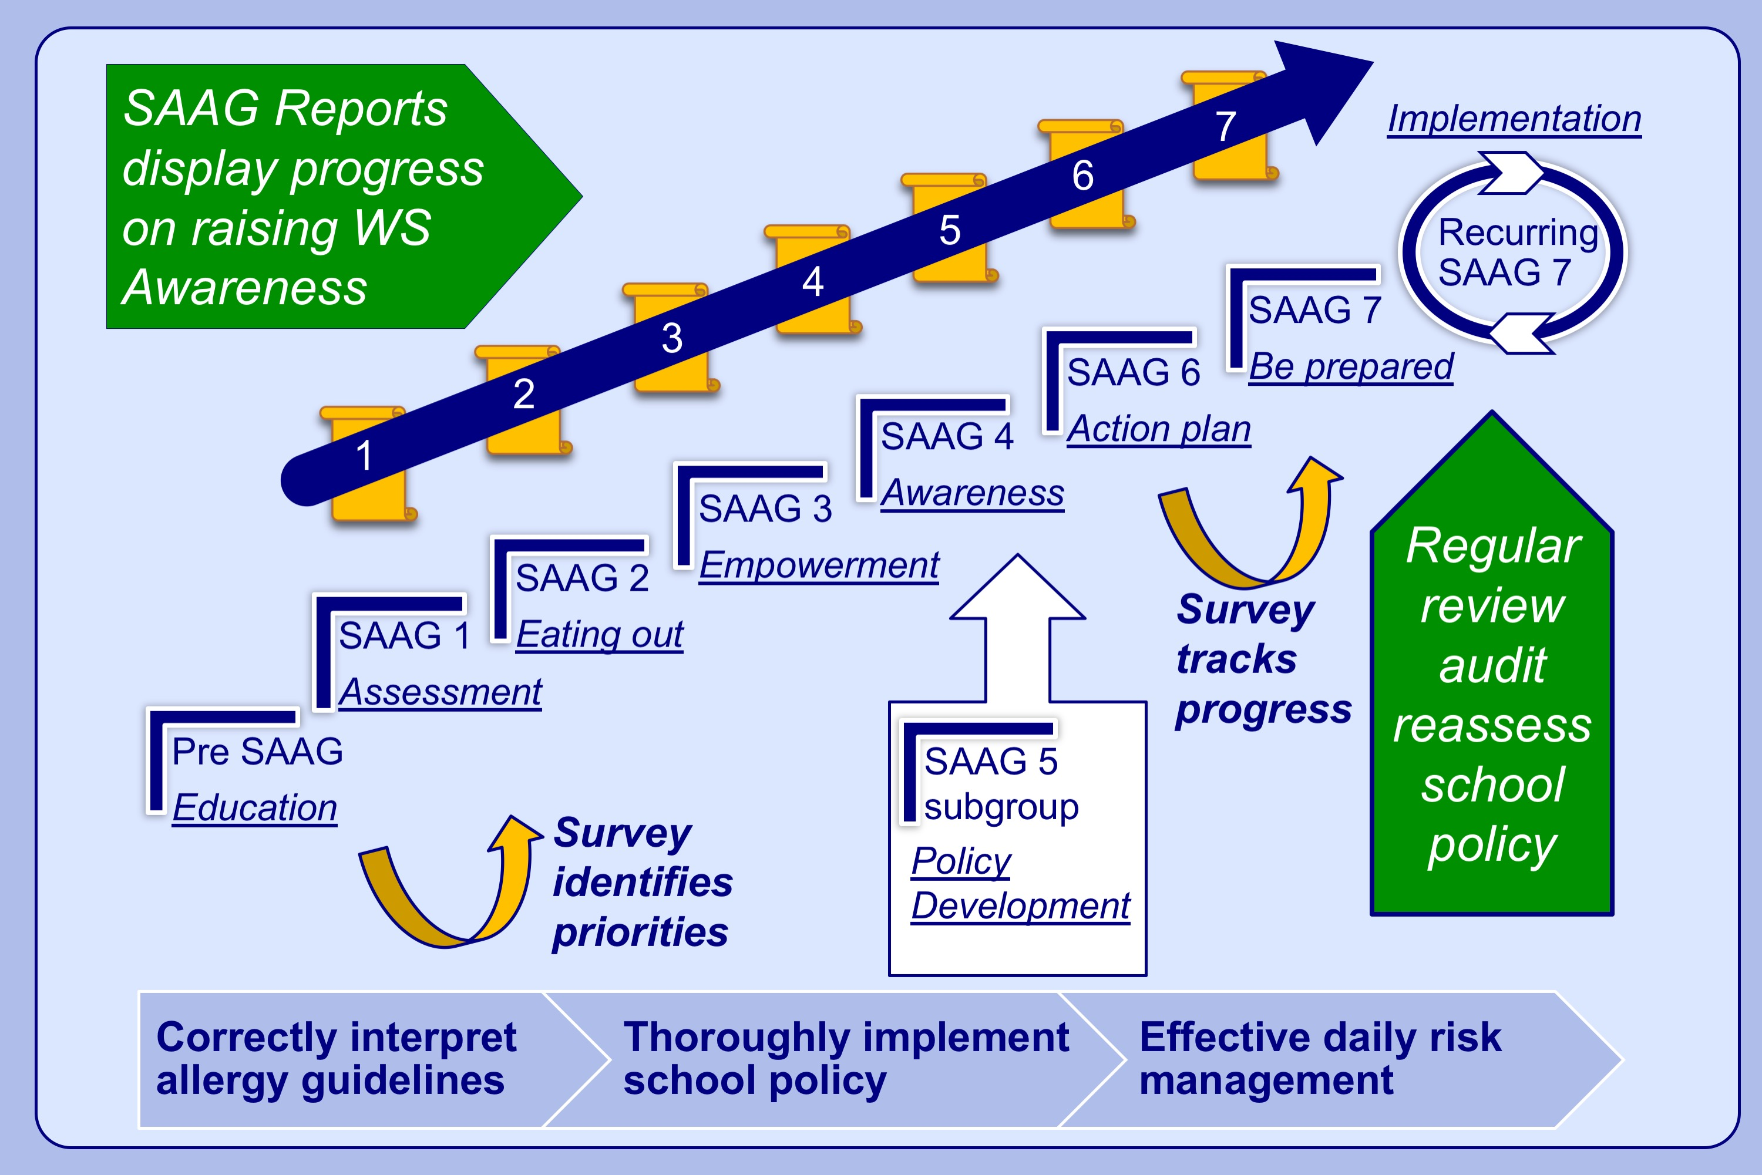
Dissemination of EAACI food allergy guidelines using a flexible, practical, whole school allergy awareness toolkit
Jennette Higgs,, Kathryn Styles,, Sarah Bowyer,, Amena Warner,, Audrey Dunn Galvin, et al.
Allergy. 2021; 3479-3488 https://doi.org/10.1111/all.14871
© 2019 EAACI and John Wiley and Sons A/S. Published by John Wiley and Sons Ltd.
Notes:
HIGHLIGHTS
Complementary to staff training, appropriate WS tools are urgently needed to embed policy and practices for minimising risk.
Stepwise toolkit (SAAG) now available following development and retesting using multidisciplinary, participatory action research.
Full stakeholder involvement encourages usage, so improves confidence and WS community awareness; reduces risk; fosters a more accepting societal attitude; and empowers pupils with/without allergies to self-manage effectively.
Abbreviations: SAAG, school allergy action group; WS, whole school

