Slide 1
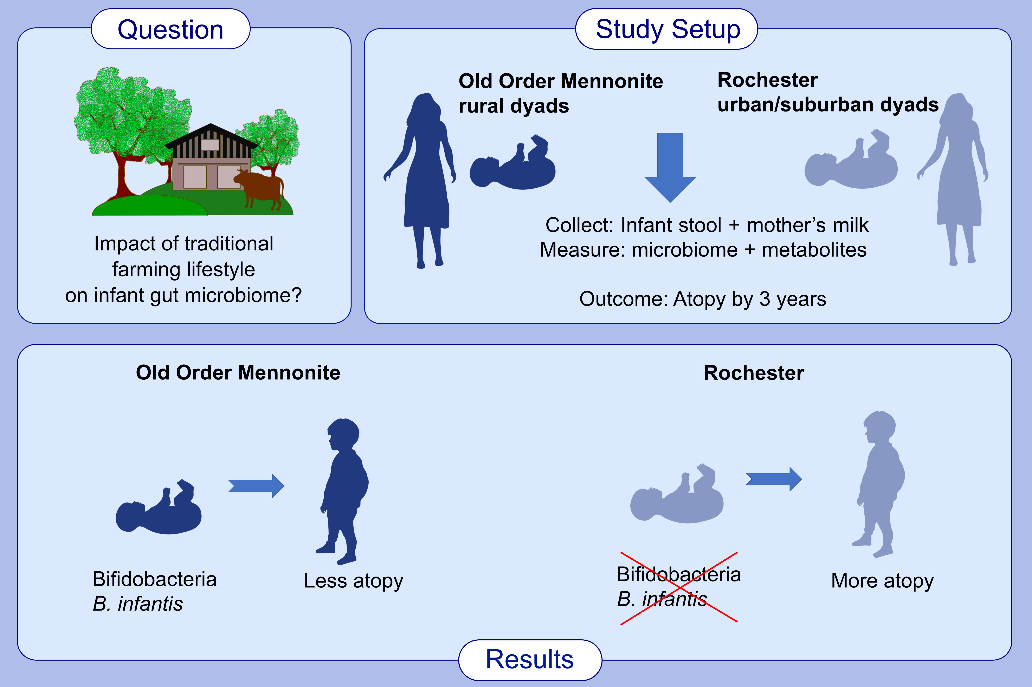
Infant gut microbiome is enriched with Bifidobacterium longum ssp. infantis in Old Order Mennonites with traditional farming lifestyle
Antti E. Seppo,, Kevin Bu,, Madina Jumabaeva,, Juilee Thakar,, Rakin A. Choudhury,, et al.
Allergy. 2021; 3489-3503 https://doi.org/10.1111/all.14877
© 2019 EAACI and John Wiley and Sons A/S. Published by John Wiley and Sons Ltd.
Notes:
HIGHLIGHTS
This study investigates the impact of traditional farming lifestyle on infant gut microbiome.
Infant stool and milk sample analyses of microbiome composition and fatty acids concentrations were perfomed in a cohort of Old Order Mennonite infants at low risk and Rochester urban/suburban infants at high risk for atopic diseases.
Microbiome of Old Order Mennonite infants is enriched in B. infantis compared
to Rochester infants, which may be beneficial in prevention of atopic diseases.

