Slide 1
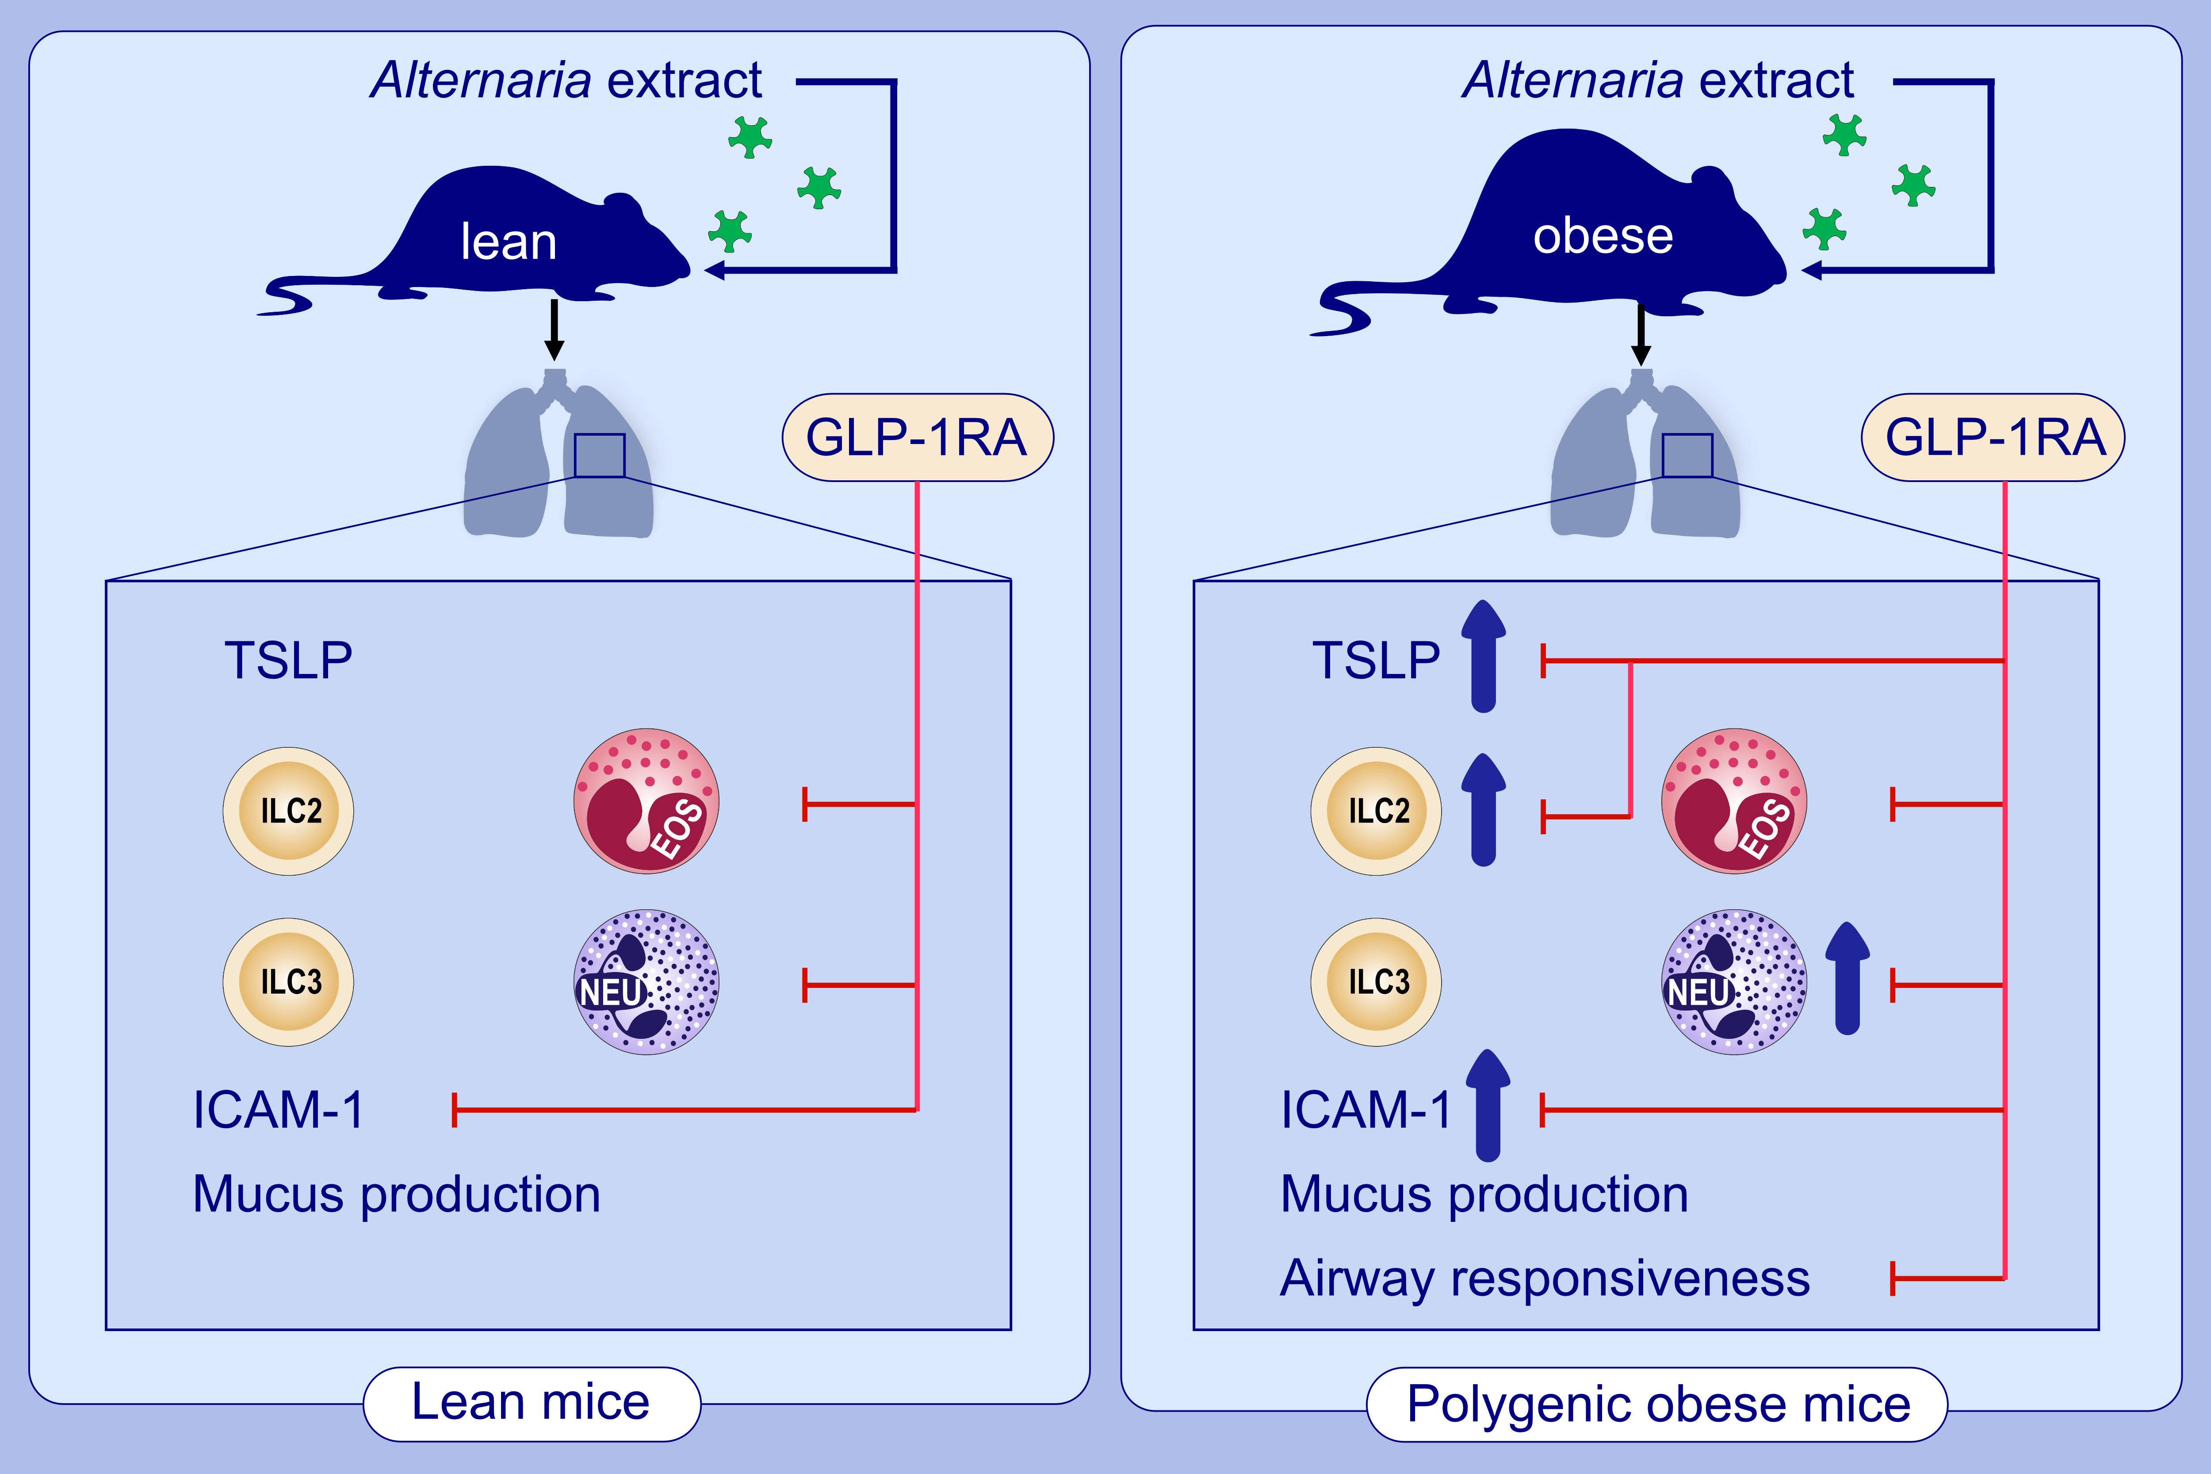
Glucagon-like peptide-1 receptor agonist inhibits aeroallergen-induced activation of ILC2 and neutrophilic airway inflammation in obese mice
Shinji Toki,, Dawn C. Newcomb,, Richard L. Printz,, Katherine N. Cahill,, Kelli L. Boyd,, et al.
Allergy. 2021; 3433-3445 https://doi.org/10.1111/all.14879
© 2019 EAACI and John Wiley and Sons A/S. Published by John Wiley and Sons Ltd.
Notes:
HIGHLIGHTS
Polygenic obese mice have larger level of Altrernaria-extract-induced TSLP, the number of lung ILC2, neutrophils in the airway, and ICAM-1 on lung epithelial cells compared with lean mice.
GLP-1RA decreases the Altrernaria-extract-induced IL-33 and TSLP release, type-2 inflammation mediated by ILC2, eosinophilia and neutrophilia in the airway, and airway responsiveness in polygenic obese mice.
Our findings indicate the potential for a new pharmacological therapeutic strategy to patients with asthma in the setting of obesity.
Abbreviations: ICAM-1, intercellular adhesion molecule 1; ILC2, group 2 innate lymphoid cells; GLP-1RA, glucagon-like peptide-1 agonist

