Slide 1
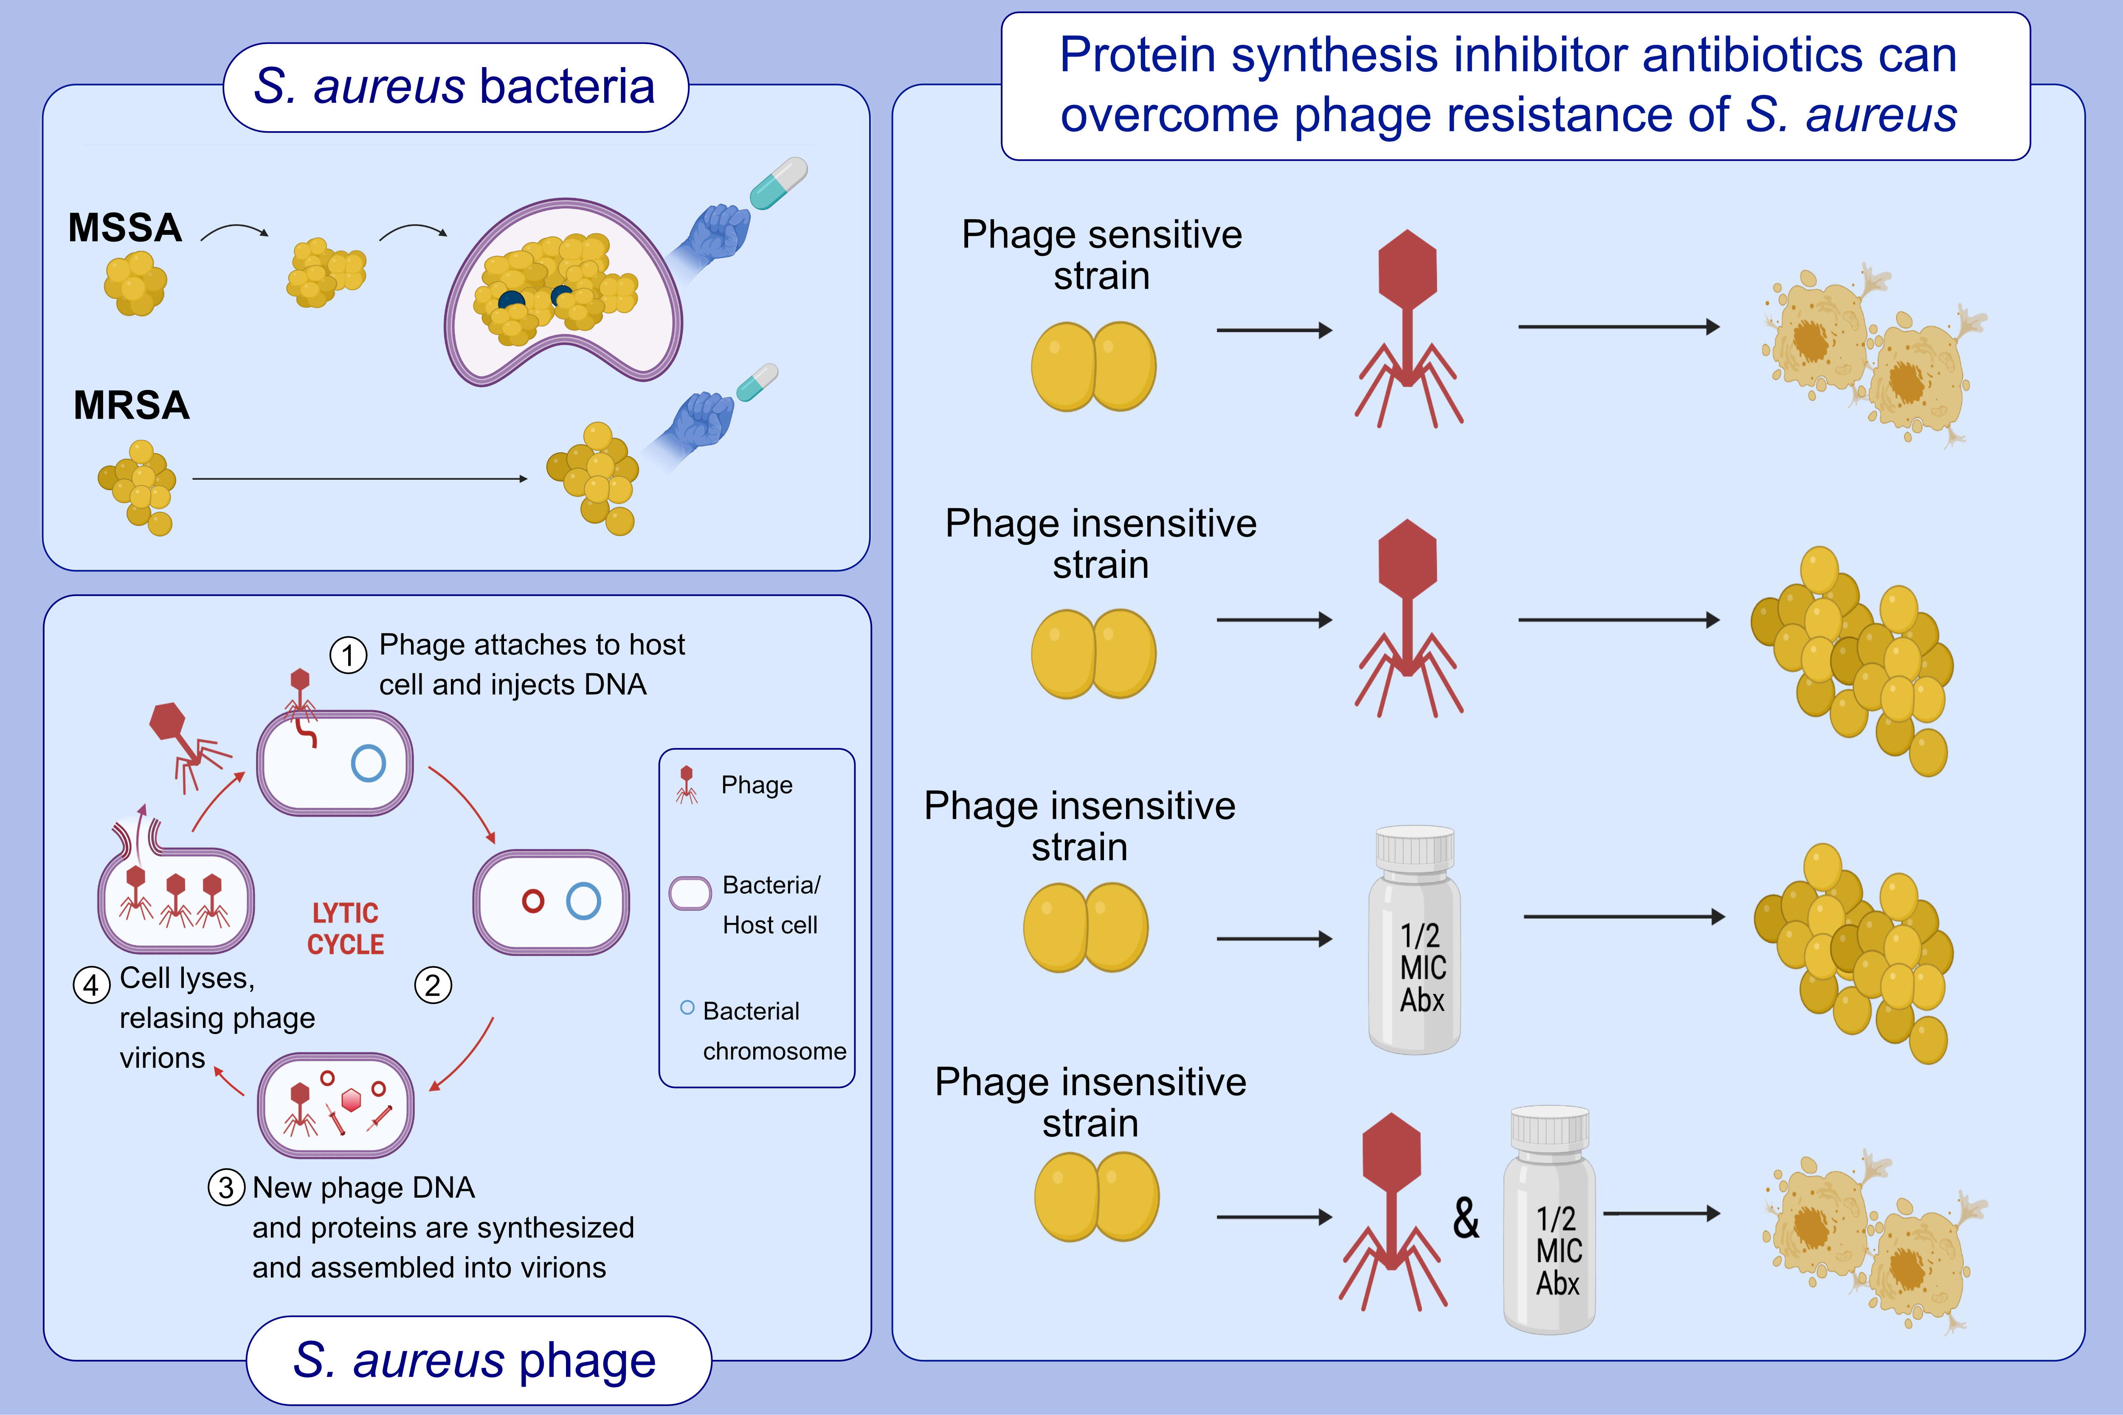
Overcoming bacteriophage insensitivity in Staphylococcus aureus using clindamycin and azithromycinat subinhibitory concentrations
Sha Liu,, Yin Zhao,, Andrew Hayes,, Karen Hon,, Guimin Zhang,, et al.
Allergy. 2021; 3446-3458 https://doi.org/10.1111/all.14883
© 2019 EAACI and John Wiley and Sons A/S. Published by John Wiley and Sons Ltd.
Notes:
HIGHLIGHTS
MSSA and MRSA biofilms have reduced sensitivity to antibiotics
Phage can lyse phage sensitive MSSA and MRSA strains but not phage insensitive strains.
Subinhibitory protein synthesis inhibitor antibiotics can sensitise phage insensitive S. aureus strains to become sensitive to phage infection resulting in eradication of S. aureus infection in vitro and in vivo.
Abbreviations: MSSA, methicillin-susceptible Staphylococcus aureus; MRSA, methicillin-resistant Staphylococcus aureus; MIC, minimum inhibitory concentration; Abx, antibiotic

