Slide 1
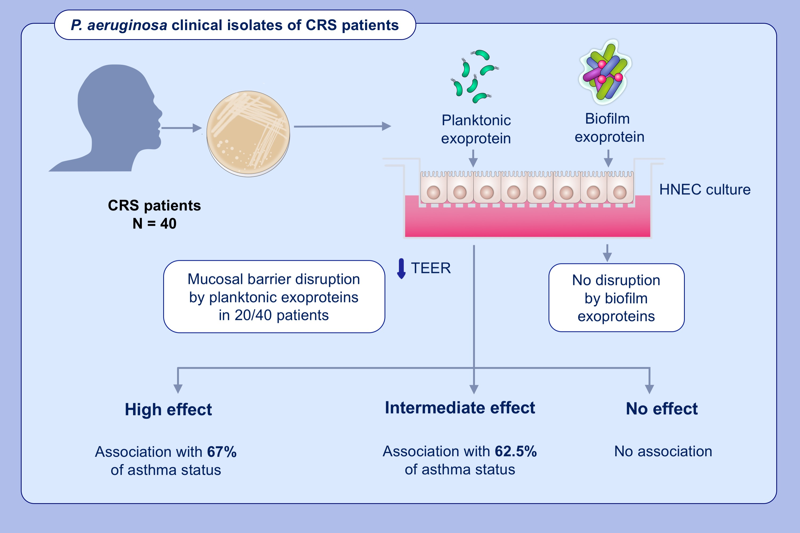
Association between mucosal barrier disruption by Pseudomonas aeruginosa exoproteins and asthma in patients with chronic rhinosinusitis
Jannatul Ferdoush Tuli,, Mahnaz Ramezanpour,, Clare Cooksley,, Alkis James Psaltis,, Peter-John Wormald,, et al.
Allergy. 2021; 3459-3469 https://doi.org/10.1111/all.14959
© 2019 EAACI and John Wiley and Sons A/S. Published by John Wiley and Sons Ltd.
Notes:
HIGHLIGHTS
Exoproteins from 40 P. aeruginosa isolates of CRS patients were applied on ALI culture
in planktonic and biofilm form.
Planktonic but not biofilm exoproteins show disruption of epithelial barrier (decreased TEER).
The isolates that reduce TEER (high and intermediate effect) are associated with asthma
in corresponding patients.
Abbreviations: ALI, air-liquid interface; CRS, chronic rhinosinusitis; HNEC, human nasal epithelial cells; IL-6, interleukin -6; TEER, transepithelial electrical resistance; ZO-1, zonula occludens 1

