Slide 1
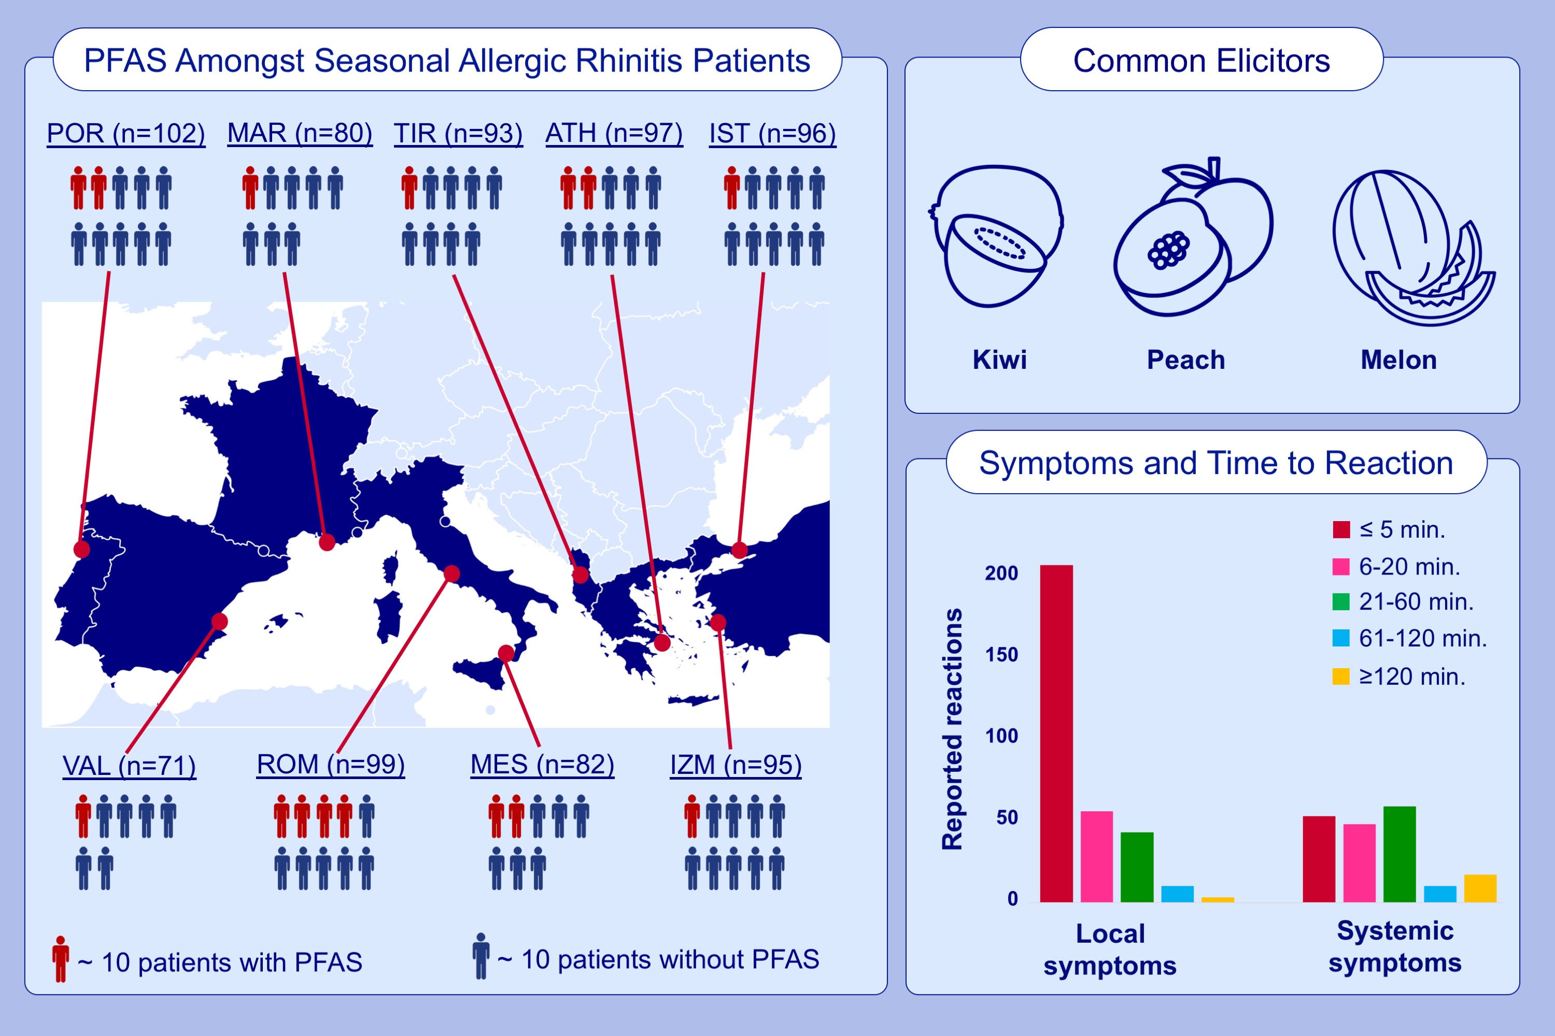
Heterogeneity of pollen food allergy syndrome in seven Southern European countries: The @IT.2020 multicenter study
Theresa Lipp,, Aydan Acar Şahin,, Xenophon Aggelidis,, Stefania Arasi,, Andrea Barbalace,, et al.
Allergy. 2021; 3041-3052 https://doi.org/10.1111/all.14742
© 2019 EAACI and John Wiley and Sons A/S. Published by John Wiley and Sons Ltd.
Notes:
HIGHLIGHTS
In Southern Europe, there is a high heterogeneity in clinical characteristics of pollen food allergy syndrome amongst patients with seasonal allergic rhinitis.
Patients frequently report reactions to kiwi, peach, and melon.
Most patients report early localized reactions.
Abbreviations: ATH, Athens; IST, Istanbul; IZM, Izmir; MAR, Marseille; MES, Messina; PFAS, pollen food allergy syndrome; POR, Porto; ROM, Rome; SAR, seasonal allergic rhinitis; TIR, Tirana; VAL, Valencia

