Slide 1
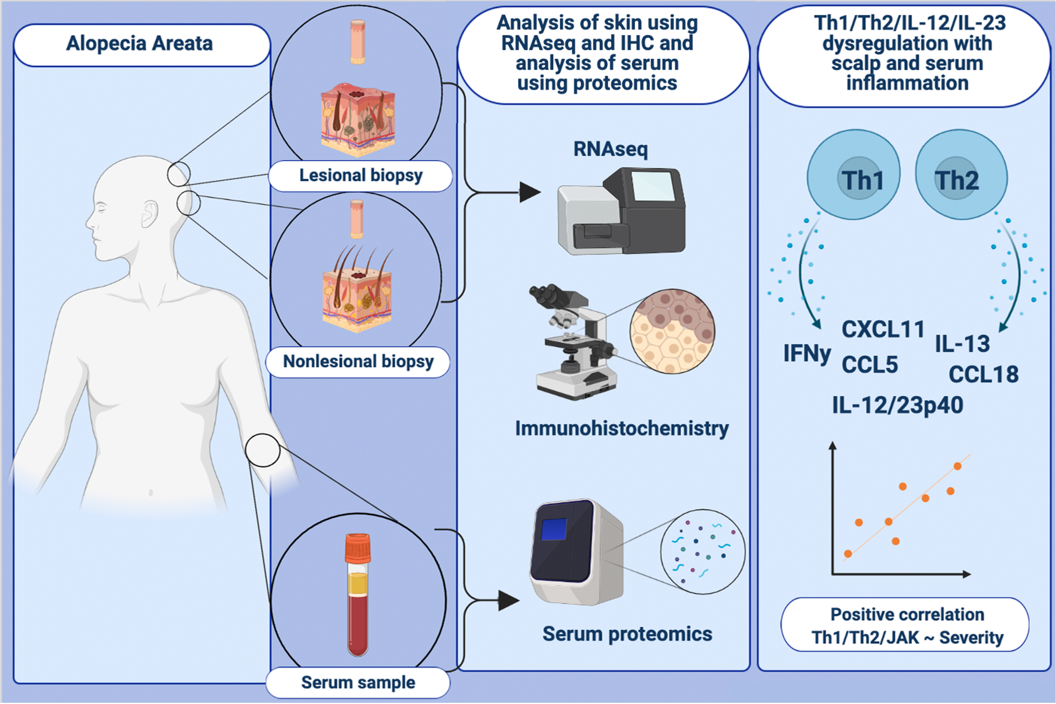
An integrated scalp and blood biomarker approach suggests the systemic nature of alopecia areata
Jacob W. Glickman,, Celina Dubin,, Dante Dahabreh,, Joseph Han,, Ester Del Duca,, et al.
Allergy. 2021; 3053-3065 https://doi.org/10.1111/all.14814
© 2019 EAACI and John Wiley and Sons A/S. Published by John Wiley and Sons Ltd.
Notes:
HIGHLIGHTS
Our study contributes a unique understanding of the phenotypic profile of moderate-to-severe alopecia areata, suggesting that alopecia areata is a scalp, tissue-based inflammatory disease, with primarily Th1/Th2/IL-12/IL-23 dysregulation.
An integrated scalp and serum biomarker model highlight the systemic nature of alopecia areata.
Our findings advocate for more targeted therapeutics and emphasize the importance of immune based systemic treatments.
Abbreviations: CCL, C-C motif chemokine ligand; CXCL, C-X-C motif chemokine ligand; IHC, immunohistochemistry; JAK, Janus kinase; RNAseq, RNA sequencing

