Slide 1
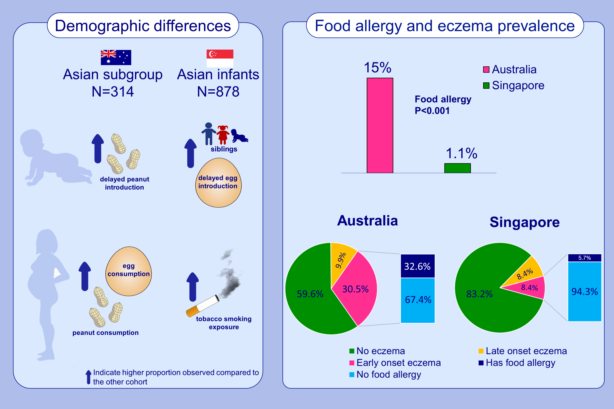
Children of Asian ethnicity in Australia have higher risk of food allergy and early-onset eczema than those in Singapore
Noor H. A. Suaini,, Evelyn Xiu-Ling Loo,, Rachel L. Peters,, Gaik Chin Yap,, Katrina J. Allen,, et al.
Allergy. 2021; 3171-3182 https://doi.org/10.1111/all.14823
© 2019 EAACI and John Wiley and Sons A/S. Published by John Wiley and Sons Ltd.
Notes:
HIGHLIGHTS
Prevalence of food allergy and early onset eczema is lower in Singaporean Asian children than Australian Asian children.
Only 5.7% of Singaporean children with early onset eczema also have food allergy compared to 32.6% of Australian children of Asian descent.
More Australian Asian children have delayed peanut consumption and higher maternal consumption of egg and peanut during pregnancy while more Singaporean Asians had siblings, exposure to tobacco and delayed egg consumption.

