Slide 1
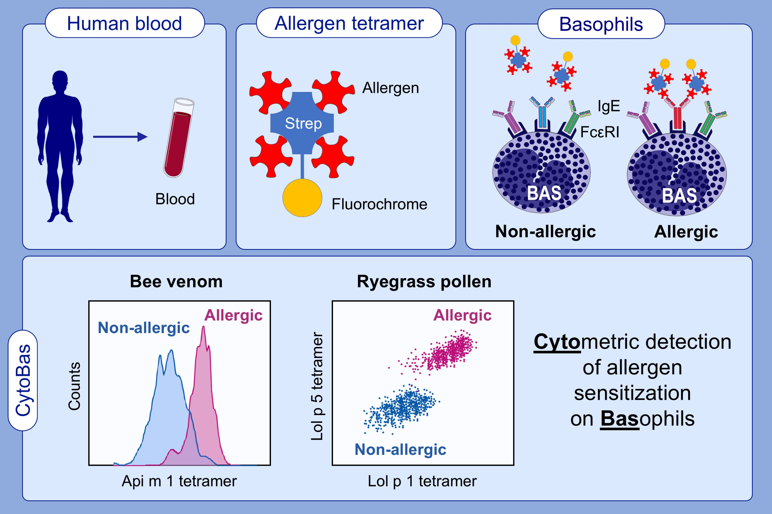
CytoBas: Precision component-resolved diagnostics for allergy using flow cytometric staining of basophils with recombinant allergen tetramers
Craig I. McKenzie,, Nirupama Varese,, Pei M. Aui,, Bruce D. Wines,, Philip Mark Hogarth,, et al.
Allergy. 2021; 3028-3040 https://doi.org/10.1111/all.14832
© 2019 EAACI and John Wiley and Sons A/S. Published by John Wiley and Sons Ltd.
Notes:
HIGHLIGHTS
Fluorescent recombinant allergen tetramers specifically bind to and activate basophils from patients allergic to bee venom (Api m 1) and ryegrass pollen (Lol p 1 and Lol p 5).
Staining intensities of recombinant Api m 1 and Lol p 1 tetramers have greater positive predictive values for allergy than basophil activation.
A single flow cytometric stain with multiple allergen tetramers can be applied as a rapid component-resolved and differential diagnostic test for allergy.
Abbreviation: Strep, streptavidin

