Slide 1
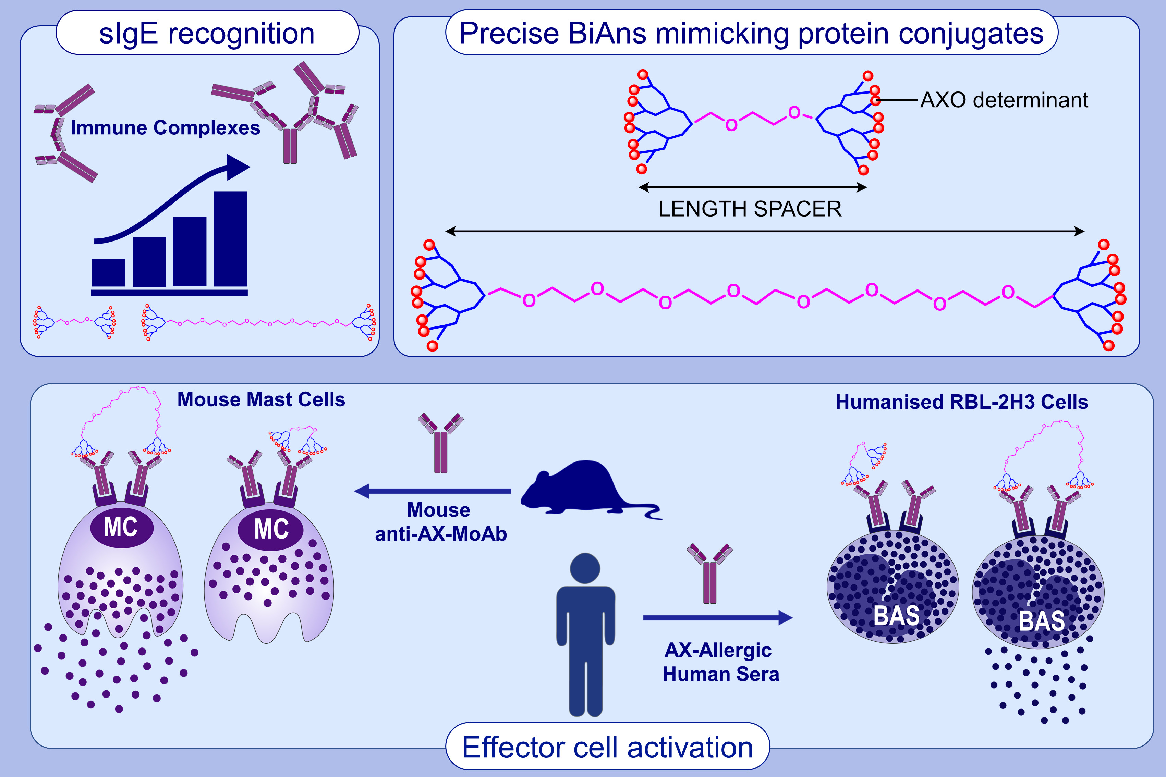
Nanoarchitectures for efficient IgE cross-linking on effector cells to study amoxicillin allergy
Amene Tesfaye,, Alba Rodríguez-Nogales,, Sara Benedé,, Tahía D. Fernández,, Juan L. Paris,, et al.
Allergy. 2021; 3183-3193 https://doi.org/10.1111/all.14834
© 2019 EAACI and John Wiley and Sons A/S. Published by John Wiley and Sons Ltd.
Notes:
HIGHLIGHTS
The use of BiAns demonstrates the importance of adduct size and distance between determinants to promote effector cell activation in AX allergy.
Optimal effector cell activation is showed with the biggest BiAns, which involves a greater number of immunocomplex and antibodies.
BiAns are versatile nano-platforms that can be applied to different allergies, valuable for improving in vitro allergy tests.
Abbreviations: AX, amoxicillin; AXO, amoxicilloyl; BiAn, bidendron antigen; MoAb, monoclonal antibody; RBL, rat basophilic leukemia cell
.

