Slide 1
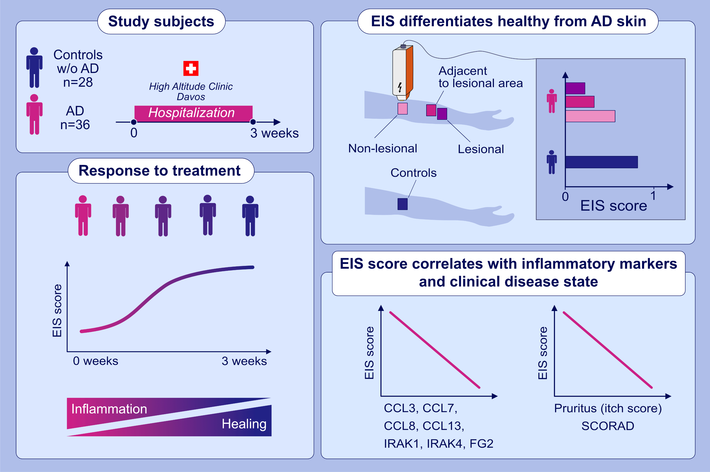
Electrical impedance spectroscopy for the characterization of skin barrier in atopic dermatitis
Arturo O. Rinaldi,, Angelica Korsfeldt,, Siobhan Ward,, Daniel Burla,, Anita Dreher,, et al.
Allergy. 2021; 3066-3079 https://doi.org/10.1111/all.14842
© 2019 EAACI and John Wiley and Sons A/S. Published by John Wiley and Sons Ltd.
Notes:
HIGHLIGHTS
EIS differentiates between AD patients and controls.
EIS can characterize lesional and non-lesional skin of patients. During hospitalization, lesions showed a significant increase in EIS that correlated with healing.
EIS scores showed a significant inverse correlation with serum biomarkers associated with inflammatory response, particularly chemokines such as CCL13, CCL3, CCL7, CXCL8, and other molecules such as IRAK1, IRAK4 and FG2.
Abbreviations: AD, atopic dermatitis; CCL, C-C motif chemokine ligand; CXCL, C-X-C motif chemokine ligand; IRAK, interleukin 1 receptor associated kinase; FG2, fibroblast growth factor 2; EIS, electrical impedance spectroscopy; EIS score, the score given to a measurement by the artificial intelligence model based on EIS measurements

