Slide 1
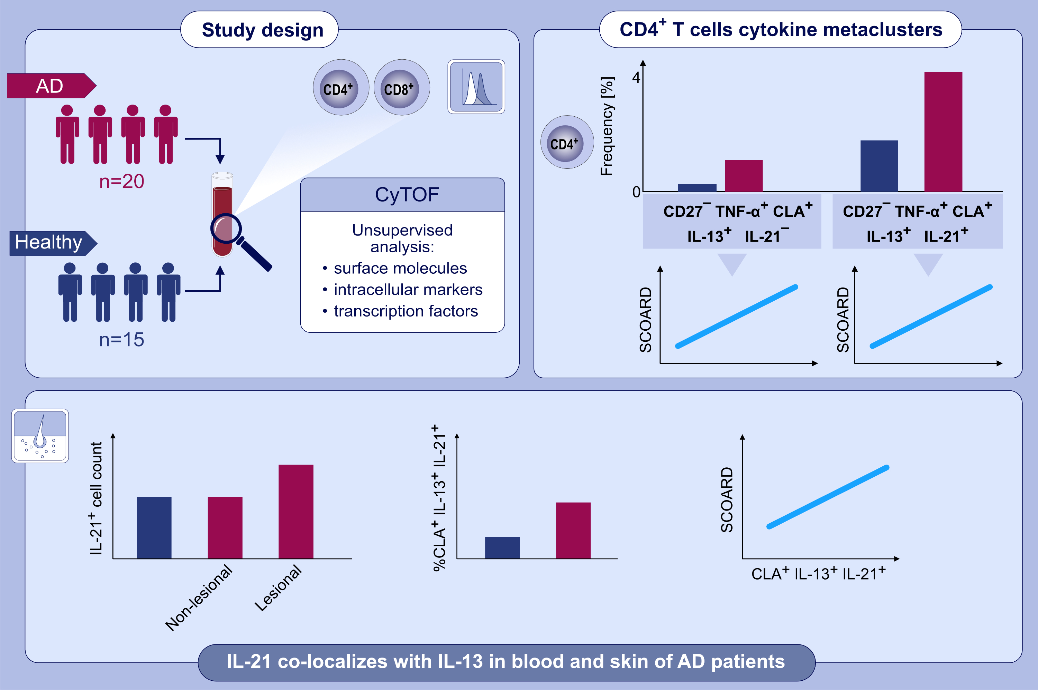
High-dimensional analysis defines multicytokine T-cell subsets and supports a role for IL-21 in atopic dermatitis
Tali Czarnowicki,, Hyun Je Kim,, Axel P. Villani,, Jacob Glickman,, Ester Del Duca,, et al.
Allergy. 2021; 3080-3093 https://doi.org/10.1111/all.14845
© 2019 EAACI and John Wiley and Sons A/S. Published by John Wiley and Sons Ltd.
Notes:
HIGHLIGHTS
We used CyTOF analysis to measure CD4⁺/CD8⁺ T-cells in the blood of 20 AD patients and 15 controls. Immunohistochemistry, immunofluorescence and qRT-PCR are used to analyze skin samples.
Immunohistochemistry and immunofluorescence display increased IL-21⁺ cell counts and colocalization with IL-13 in AD skin, respectively.
A CD4⁺ skin-homing/CLA⁺ IL-13⁺ and a novel IL-13⁺IL-21⁺ metaclusters are increased in AD patients, compared to controls, and correlate with disease severity.
Abbreviations: AD, atopic dermatitis; CLA, cutaneous lymphocyte antigen; CyTOF, cytometry by time-of-flight; SCORAD, scoring atopic dermatitis; TNF, tumor necrosis factor

