Slide 1
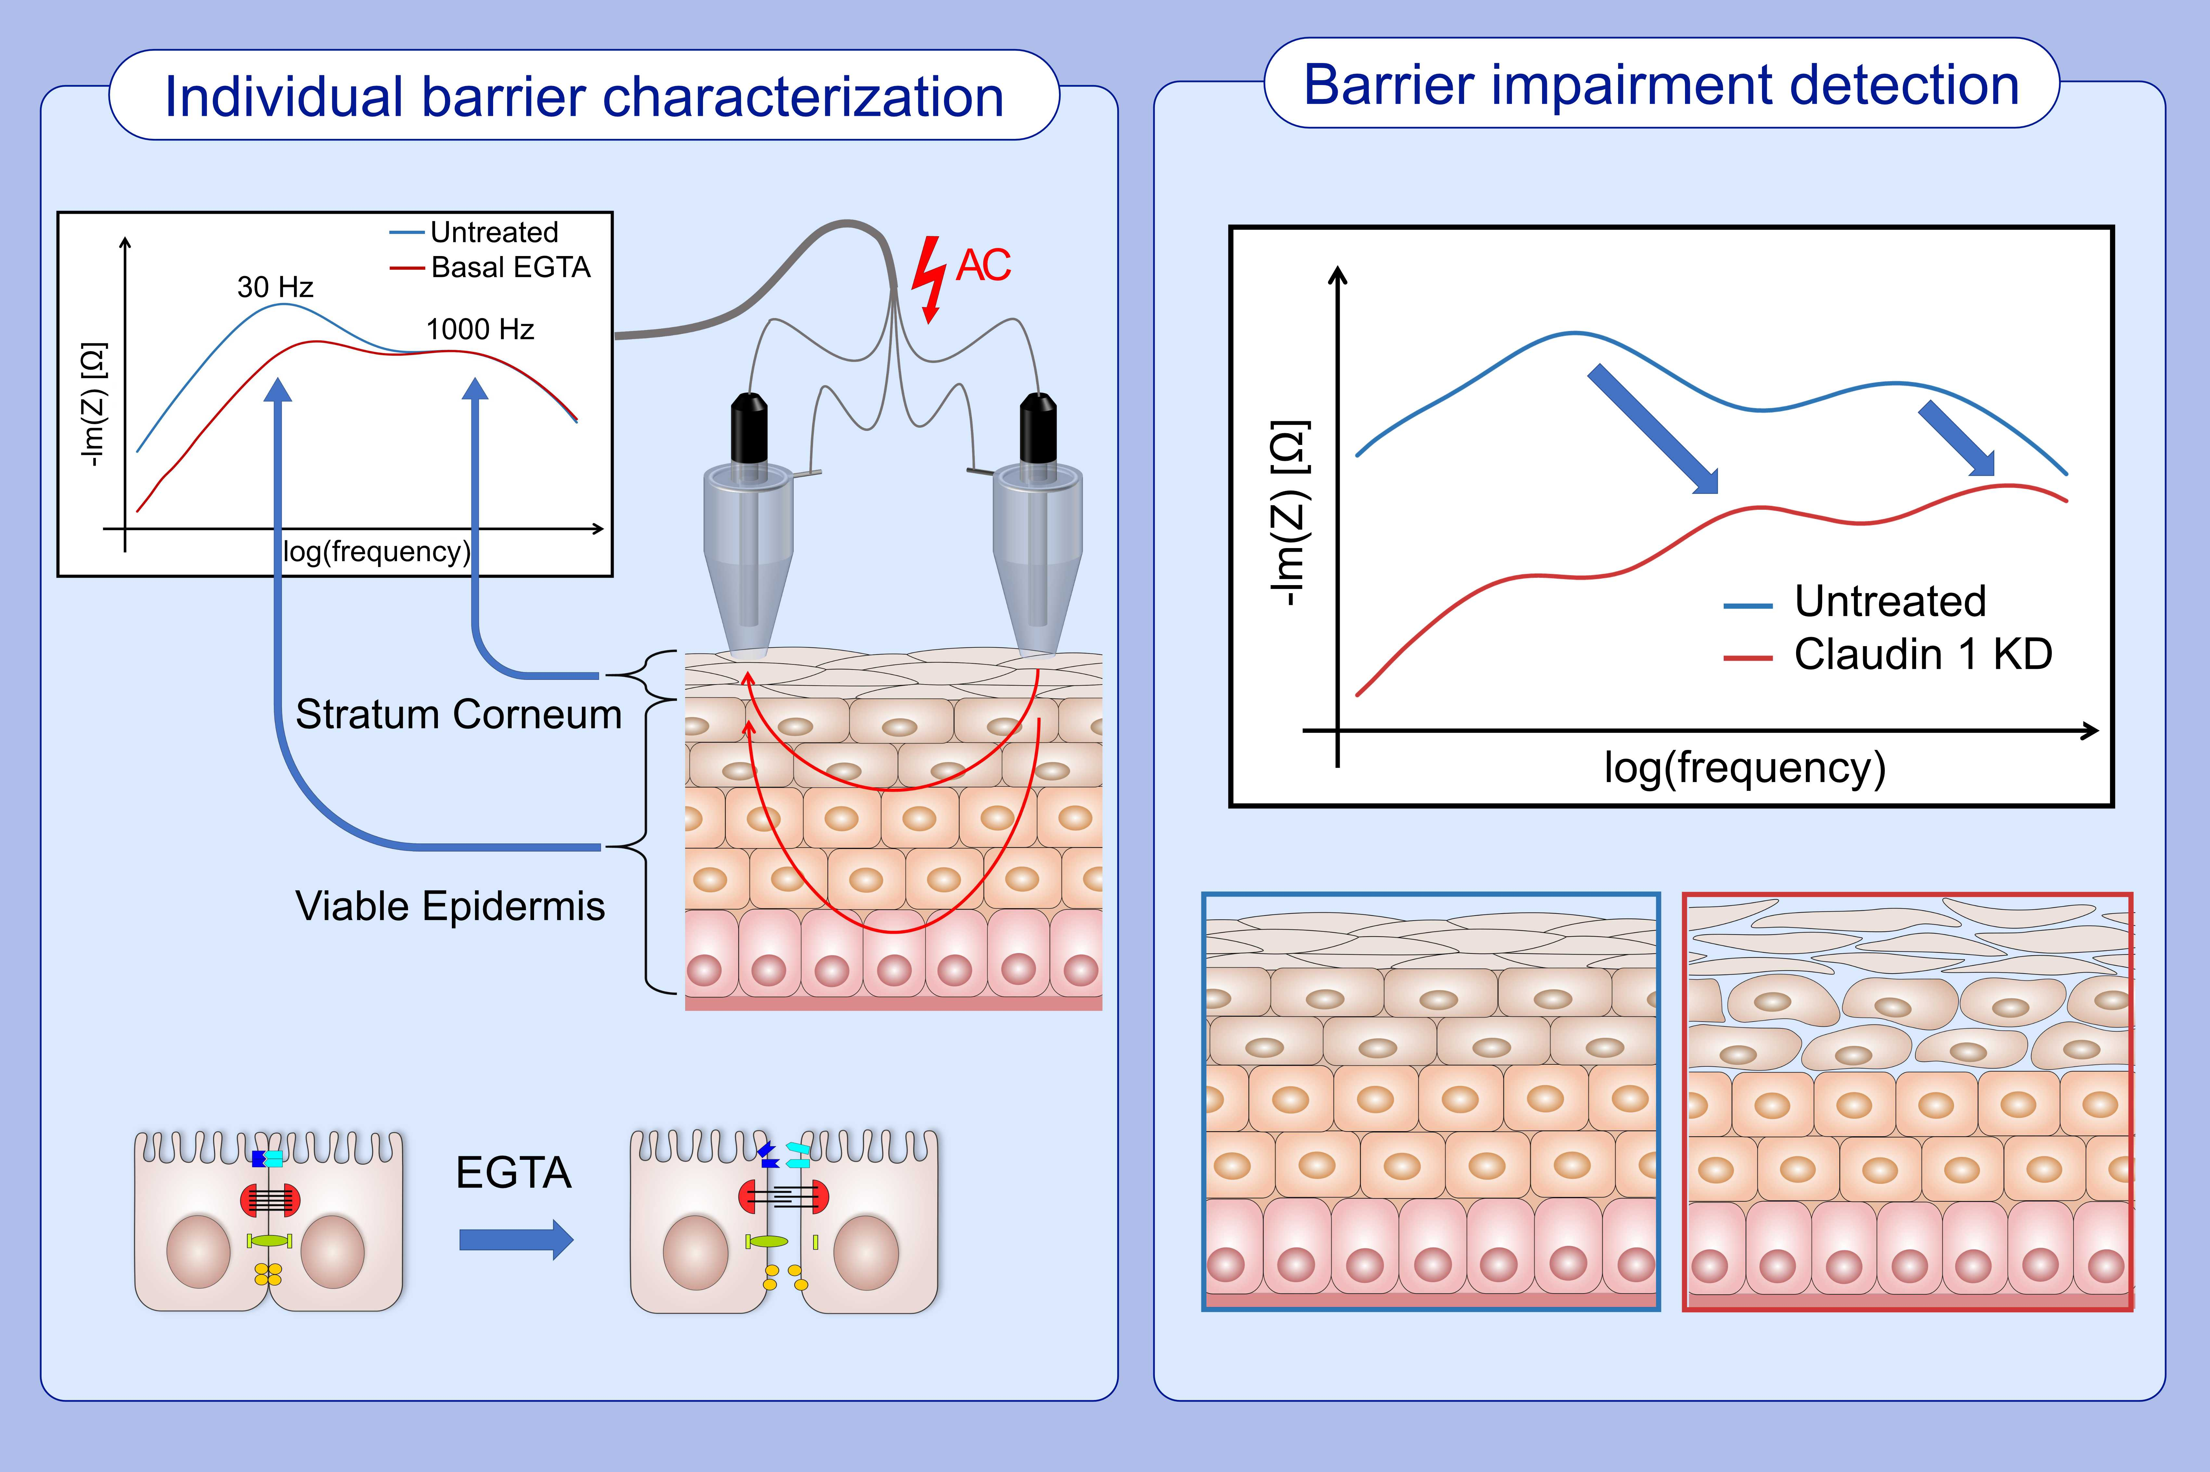
Direct assessment of individual skin barrier components by electrical impedance spectroscopy
Roman Mannweiler,, Sophia Bergmann,, Sabine Vidal-y-Sy,, Johanna M. Brandner,, Dorothee Günzel,, et al.
Allergy. 2021; 3094-3106 https://doi.org/10.1111/all.14851
© 2019 EAACI and John Wiley and Sons A/S. Published by John Wiley and Sons Ltd.
Notes:
HIGHLIGHTS
Impedance spectroscopy reveals optimum frequency ranges to measure the Stratum Corneum and Viable Epidermis barrier properties separately and non-invasively.
EGTA induces resistance drop proofs that the viable epidermis contributes significantly to the overall epidermal barrier.
The presented methods can detect barrier defects non-invasively ex vivo.
Abbreviations: AC, alternating current­­; EGTA, ethyleneglycol-bis(β-aminoethyl)-N,N,Nʹ,Nʹ-tetraacetic acid; Hz, hertz; KD, knock-down

