Slide 1
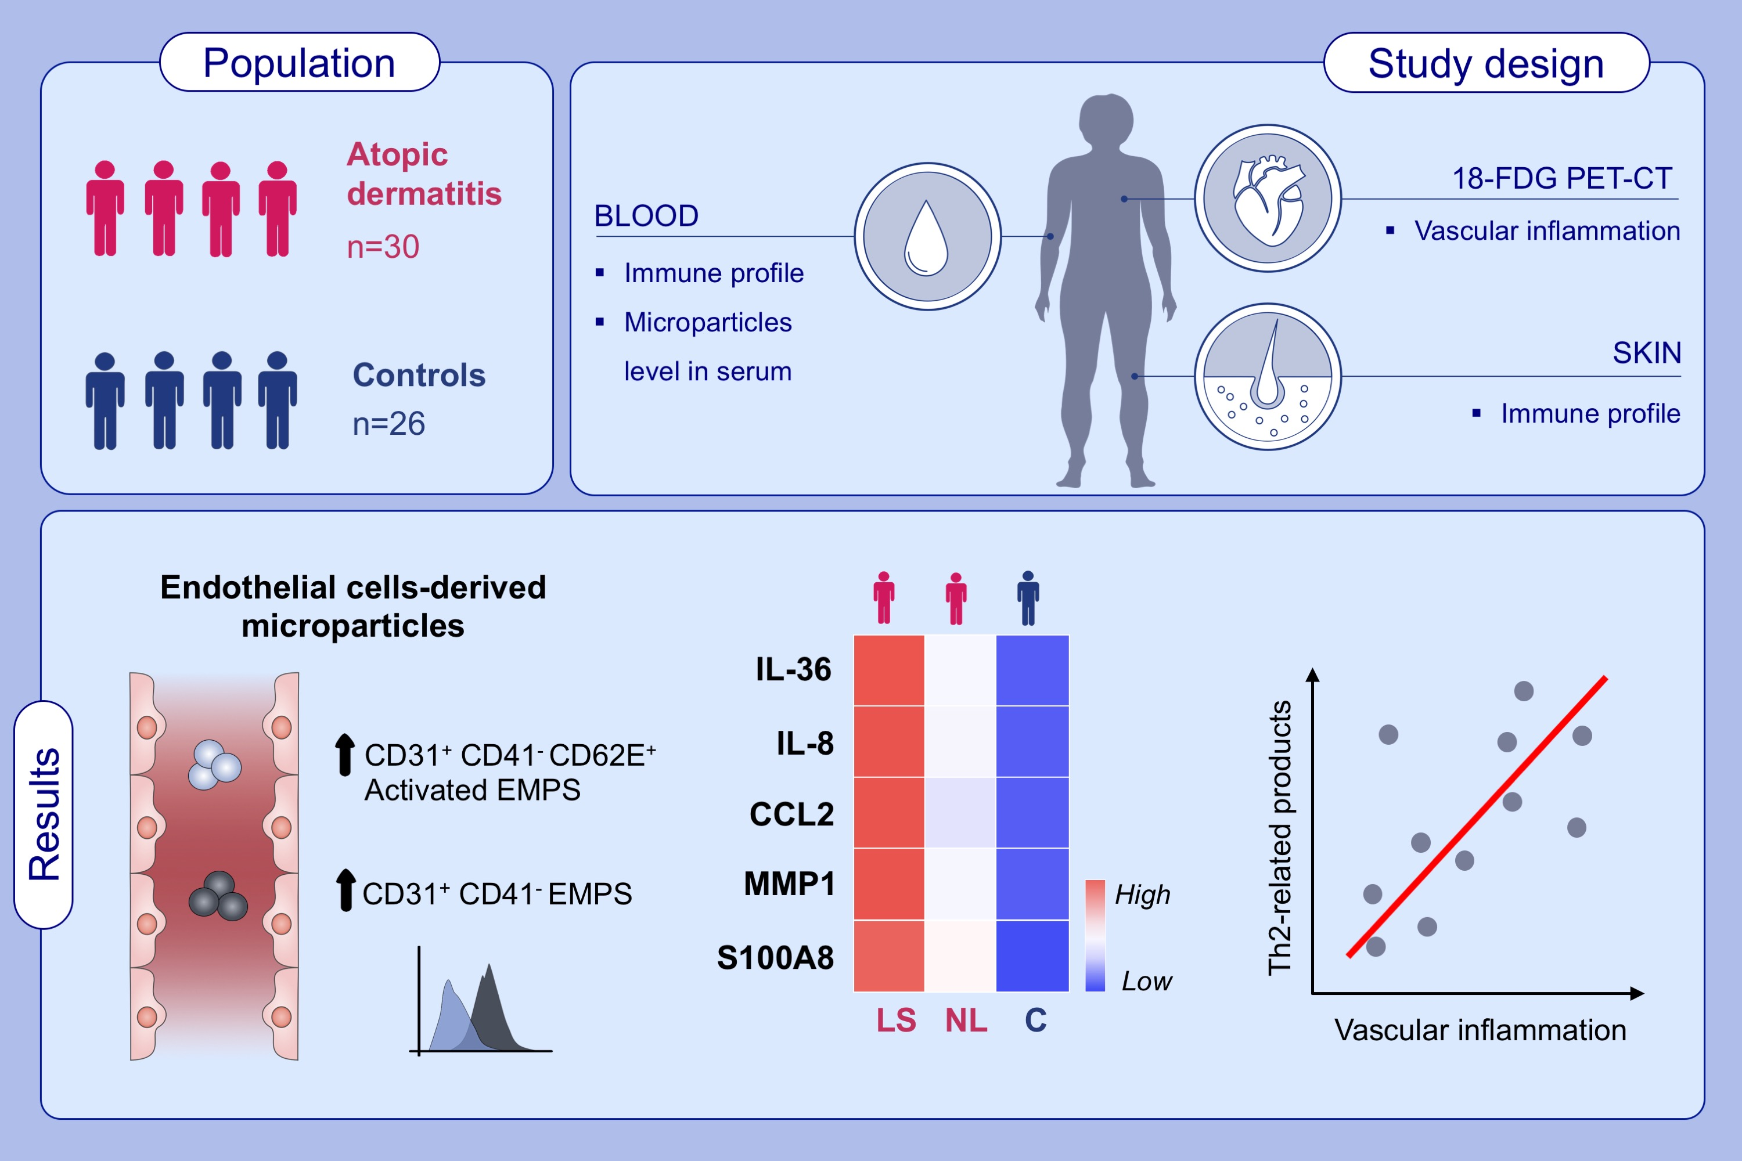
Vascular inflammation in moderate-to-severe atopic dermatitis is associated with enhanced Th2 response
Axel P. Villani,, Ana B. Pavel,, Jianni Wu,, Marie Fernandes,, Catherine Maari,, et al.
Allergy. 2021; 3107-3121 https://doi.org/10.1111/all.14859
© 2019 EAACI and John Wiley and Sons A/S. Published by John Wiley and Sons Ltd.
Notes:
HIGHLIGHTS
In 26 healthy controls and 30 atopic dermatitis patients, we evaluated their skin and blood immune profiles and characterized vascular inflammation using 18-FDG-PET-CT and levels of circulating microparticles.
Significant correlations between vascular inflammation and Th2 products in atopic dermatitis were identified.
Circulating levels of endothelial microparticles were significantly higher in severe AD and showed correlation trends with vascular inflammation assessed by PET-CT.
Abbreviations: 18-FDG-PET-CT 18-fluorodeoxyglucose-positron emission tomography-computed tomography; C, control; CCL2, C-C motif chemokine ligand 2; EMPS, endothelial-derived microparticles; LS, lesional skin; NL, non-lesional skin

