Slide 1
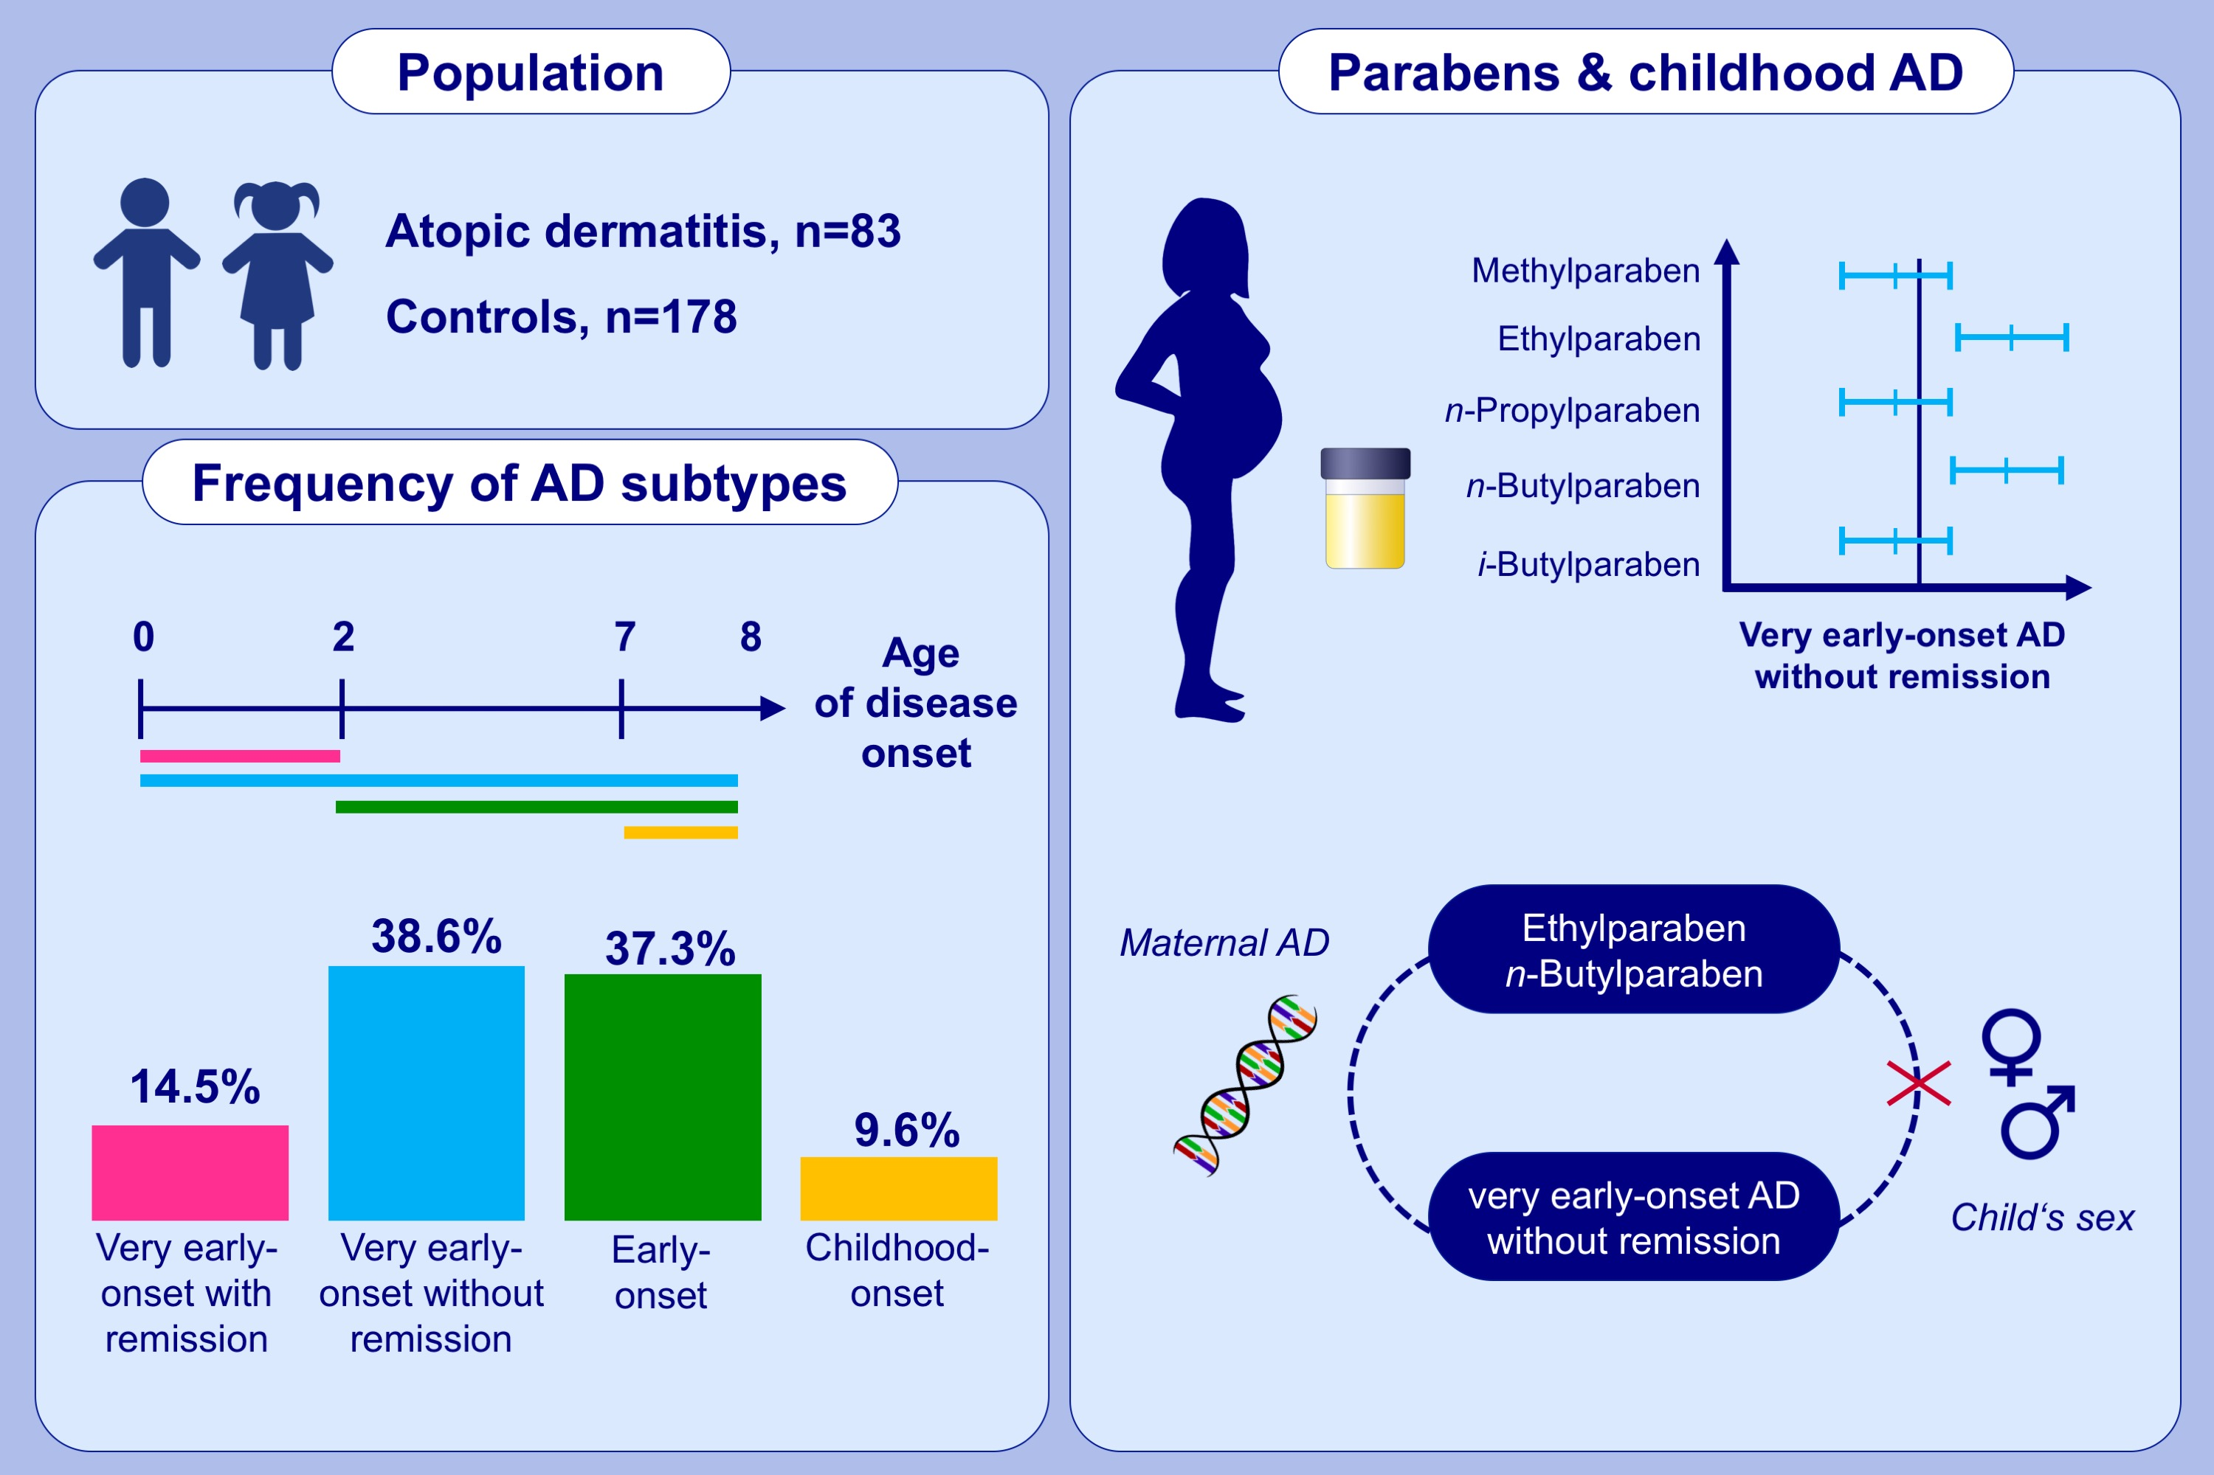
Prenatal paraben exposure and atopic dermatitis-related outcomes among children
Loreen Thürmann,, Gunda Herberth,, Bettina Seiwert,, Linda Schlittenbauer,, Ulrike Rolle-Kampczyk,, et al.
Allergy. 2021; 3122-3132 https://doi.org/10.1111/all.14890
© 2019 EAACI and John Wiley and Sons A/S. Published by John Wiley and Sons Ltd.
Notes:
HIGHLIGHTS
Different paraben species, widely used as preservatives in consumer products, were detected in the urine of pregnant women.
Prenatal ethylparaben and n-butylparaben exposure is associated with an increased risk for very early-onset atopic dermatitis without remission independent of the child’s sex.
This risk increase predominantly affects children without a history of maternal atopic dermatitis.
Abbreviation: AD, atopic dermatitis

