Slide 1
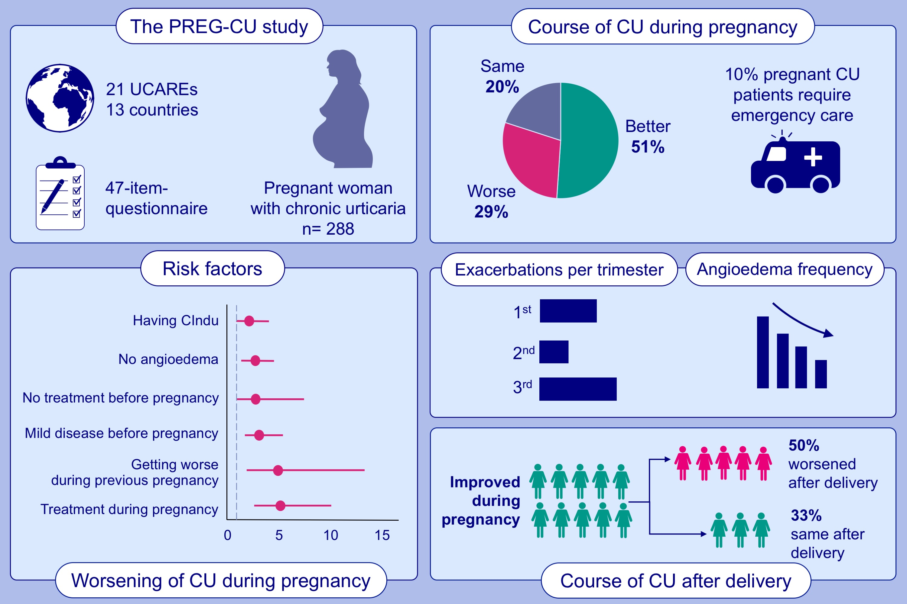
Effects of pregnancy on chronic urticaria: Results of the PREG-CU UCARE study
Emek Kocatürk,, Mona Al-Ahmad,, Karoline Krause,, Ana M. Gimenez-Arnau,, Simon Francis Thomsen,, et al.
Allergy. 2021; 3133-3144 https://doi.org/10.1111/all.14950
© 2019 EAACI and John Wiley and Sons A/S. Published by John Wiley and Sons Ltd.
Notes:
HIGHLIGHTS
During pregnancy, 51.1% of patients rated their CU as improved, 28.9% as worse and 20.0% as unchanged; rate of angioedema decreased from 38.2% to 17.4%.
CU exacerbations occurred most commonly in the third trimester (27.6%) or in the first trimester (22.8%).
Of the patients whose urticaria improved during pregnancy, 50% experienced worsening after giving birth, whereas 33.6% and 16.4% reported no change.
Abbreviations: CIndU, chronic inducible urticaria; CU, chronic urticaria; PREG-CU, Pregnancy and Chronic Urticaria; UCARE, Urticaria Centers of Reference and Excellence

