Slide 1
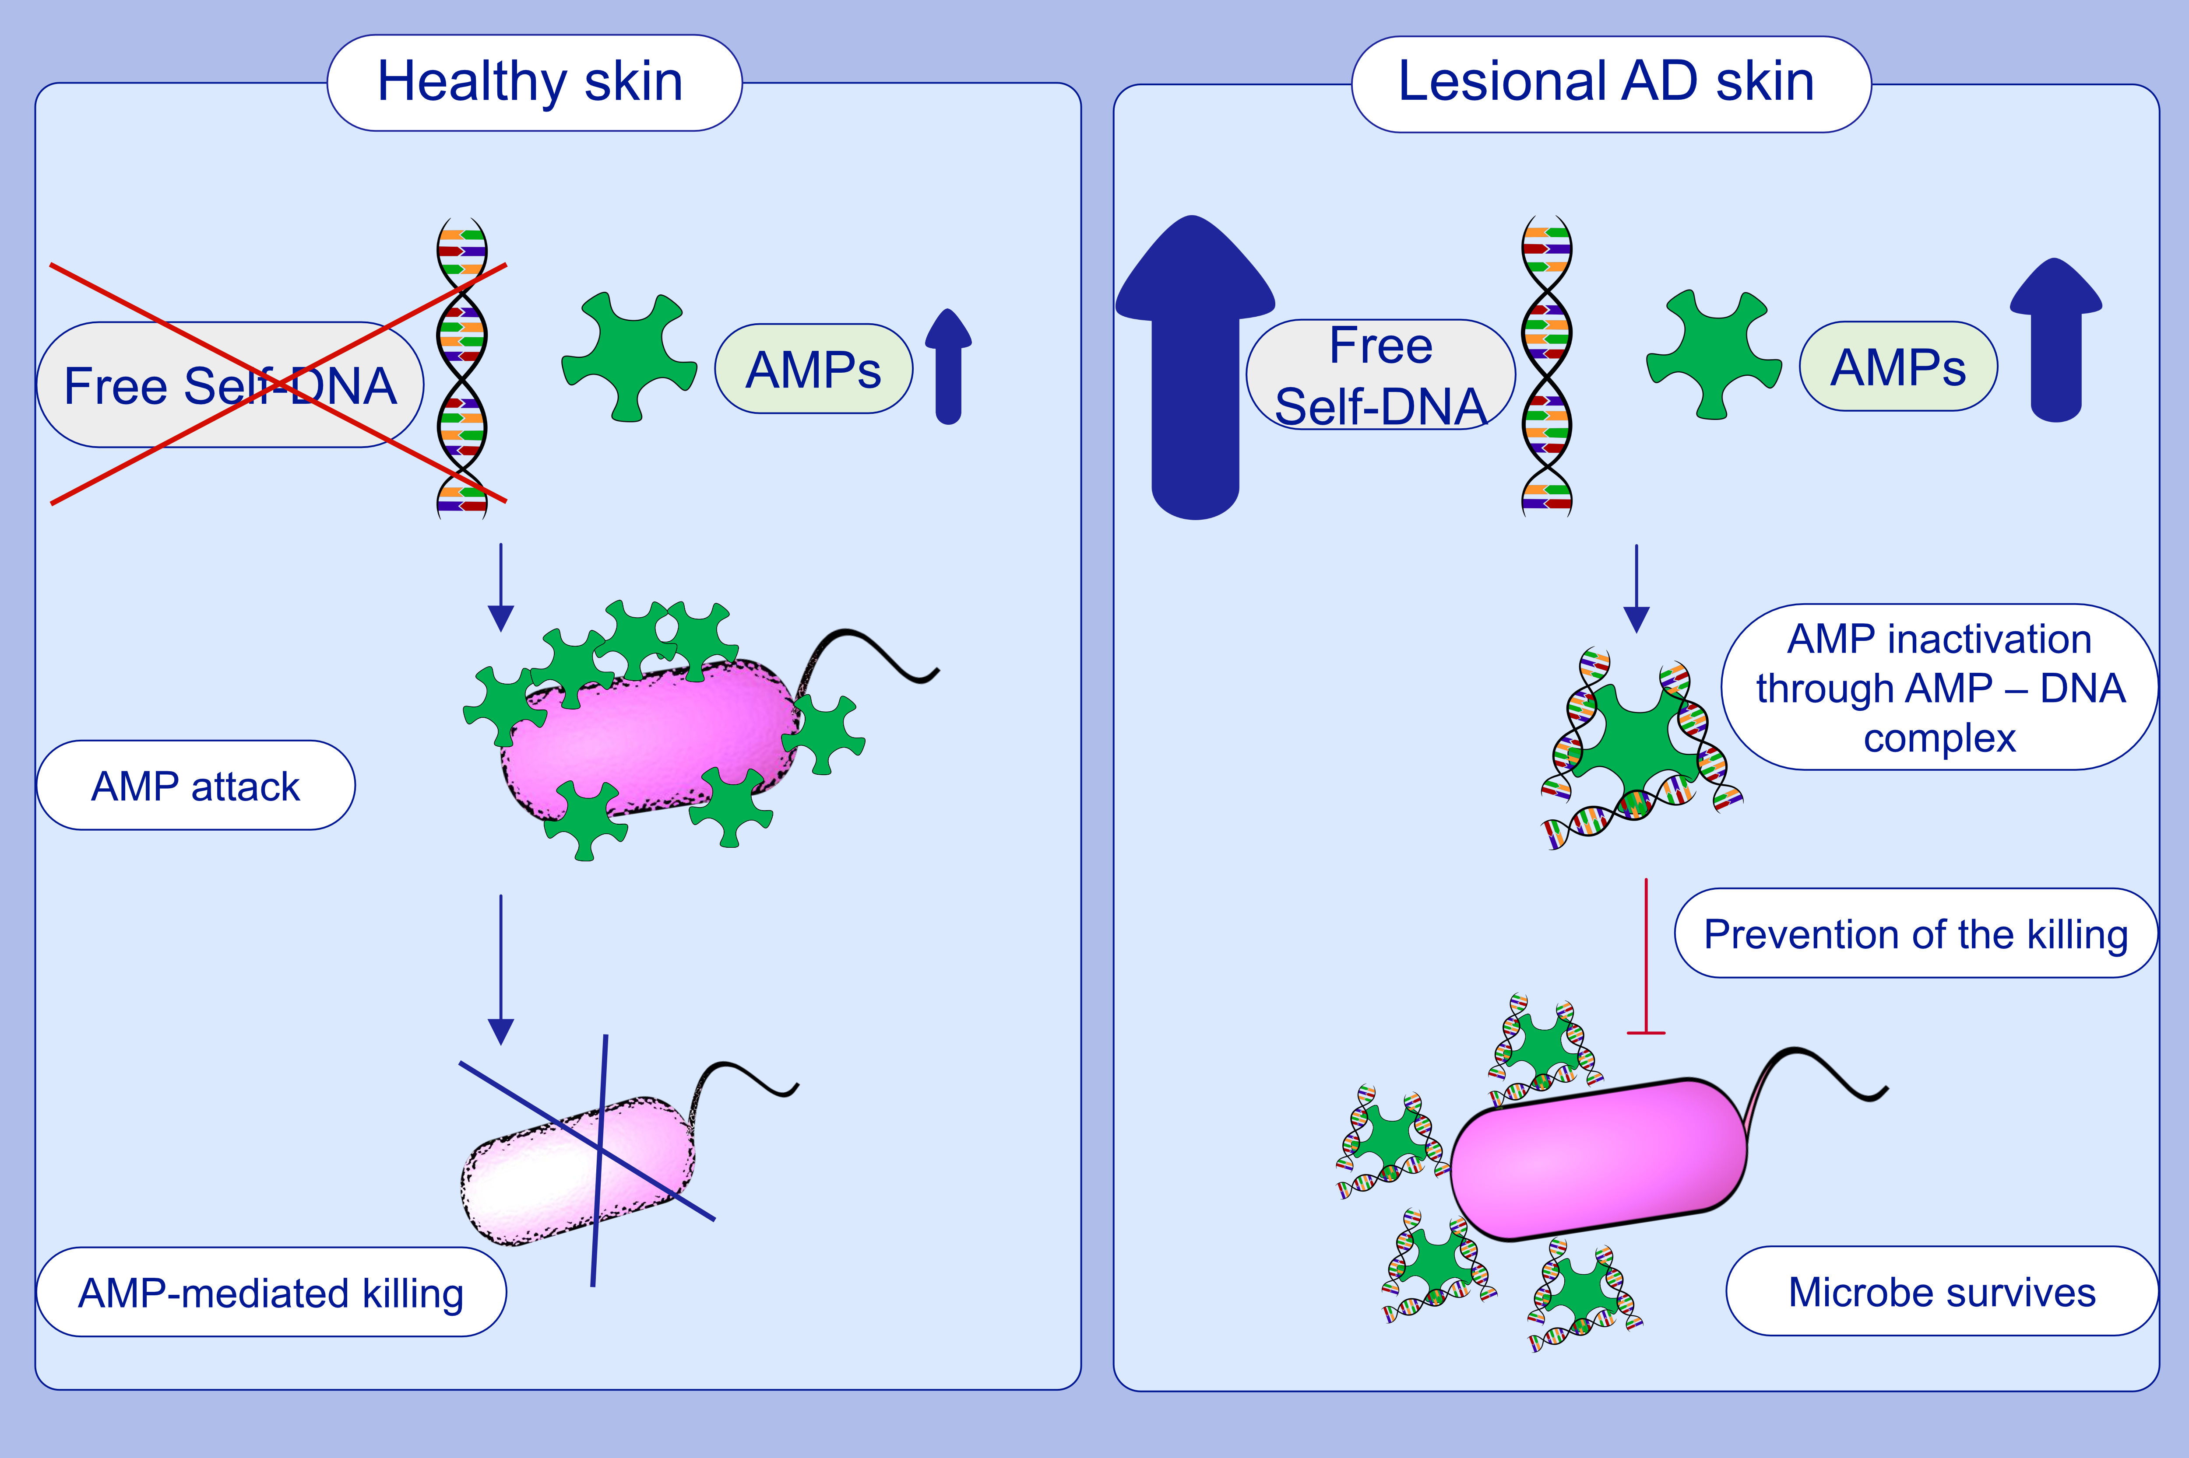
Free human DNA attenuates the activity of antimicrobial peptides in atopic dermatitis
Verena Kopfnagel,, Sylvia Dreyer,, Jana Zeitvogel,, Dietmar H. Pieper,, Anna Buch,, et al.
Allergy. 2021; 3145-3154 https://doi.org/10.1111/all.14992
© 2019 EAACI and John Wiley and Sons A/S. Published by John Wiley and Sons Ltd.
Notes:
HIGHLIGHTS
AMP-DNA complex formation impairs antimicrobial activities of AMPs.
Inhibitory effect of DNA depends on the amount of DNA not on the length of the molecule.
Analyses from skin rinses reveales a significantly higher amount of free self-DNA in lesional AD skin compared to non-lesional or healthy skin.
Abbreviations: AD, atopic dermatitis; AMP, antimicrobial peptide

