Slide 1
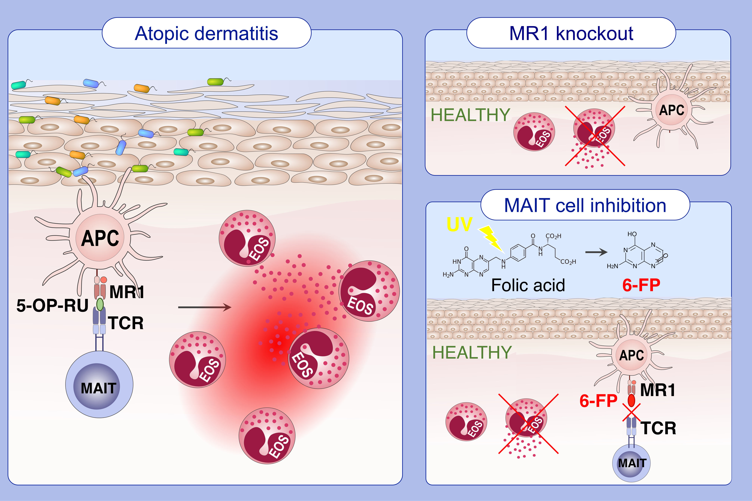
MR1-dependent immune surveillance of the skin contributes to pathogenesis and is a photobiological target of UV light therapy in a mouse model of atopic dermatitis
Karmella Naidoo,, Katherine Woods,, Christophe Pellefigues,, Alissa Cait,, David O'Sullivan,, et al.
Allergy. 2021; 3155-3170 https://doi.org/10.1111/all.14994
© 2019 EAACI and John Wiley and Sons A/S. Published by John Wiley and Sons Ltd.
Notes:
HIGHLIGHTS
MR1-restricted presentation of skin-penetrating bacterial antigens and subsequent MAIT cell activation is a driver of AD.
MAIT cell activation is an immunological checkpoint which precedes eosinophil activation. MAIT cell-deficient MR1 knockout mice are protected from disease.
The therapeutic activity of phototherapy (i.e. narrowband UV-B light therapy) against AD is MR1- and folic acid-dependent.
Abbreviations: 5-OP-RU, 5-(2-oxopropylideneamino)-6-D-ribitylaminouracil; 6-FP, 6-formylpterin; AD, atopic dermatitis; APC, antigen-presenting cell; EOS, eosinophil; MAIT, mucosal-associated invariant T; MR1, major histocompatibility complex class I-related molecule; TCR, T cell receptor; UV, ultraviolet light.

