Slide 1
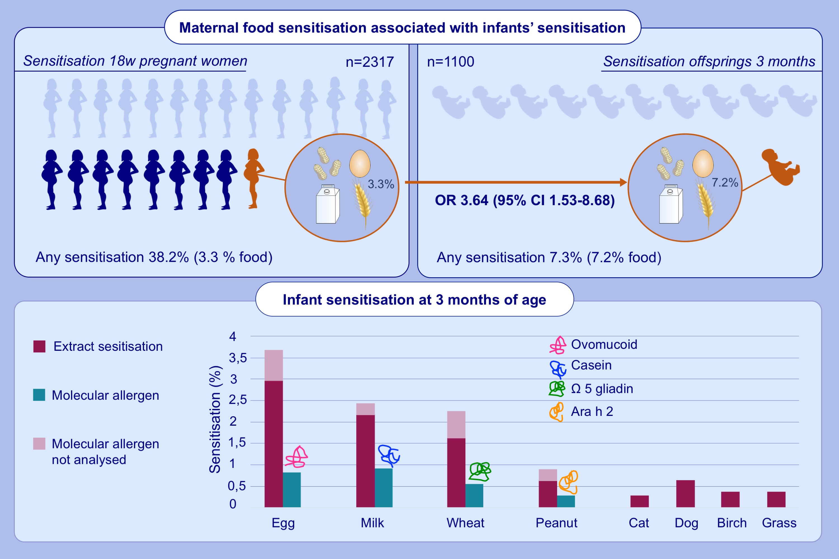
Extract and molecular-based early infant sensitization and associated factors—A PreventADALL study
Sandra G. Tedner,, Cilla Söderhäll,, Jon R. Konradsen,, Karen E. S. Bains,, Magnus P. Borres,, et al.
Allergy. 2021; 2730-2739 https://doi.org/10.1111/all.14805
© 2019 EAACI and John Wiley and Sons A/S. Published by John Wiley and Sons Ltd.
Notes:
HIGHLIGHTS
At three months of age, 7% of the infants are sensitised to food, few of them have detectable s-IgE to food allergen molecules.
Very few infants, <1%, are sensitised to inhalant allergens.
Maternal food sensitisation is associated with infants’ sensitisation, odds ratio 3.64 (95% CI 1.53-8.68).
Abbreviations: OR, odds ratio; 95 % CI, 95% confidence interval

