Slide 1
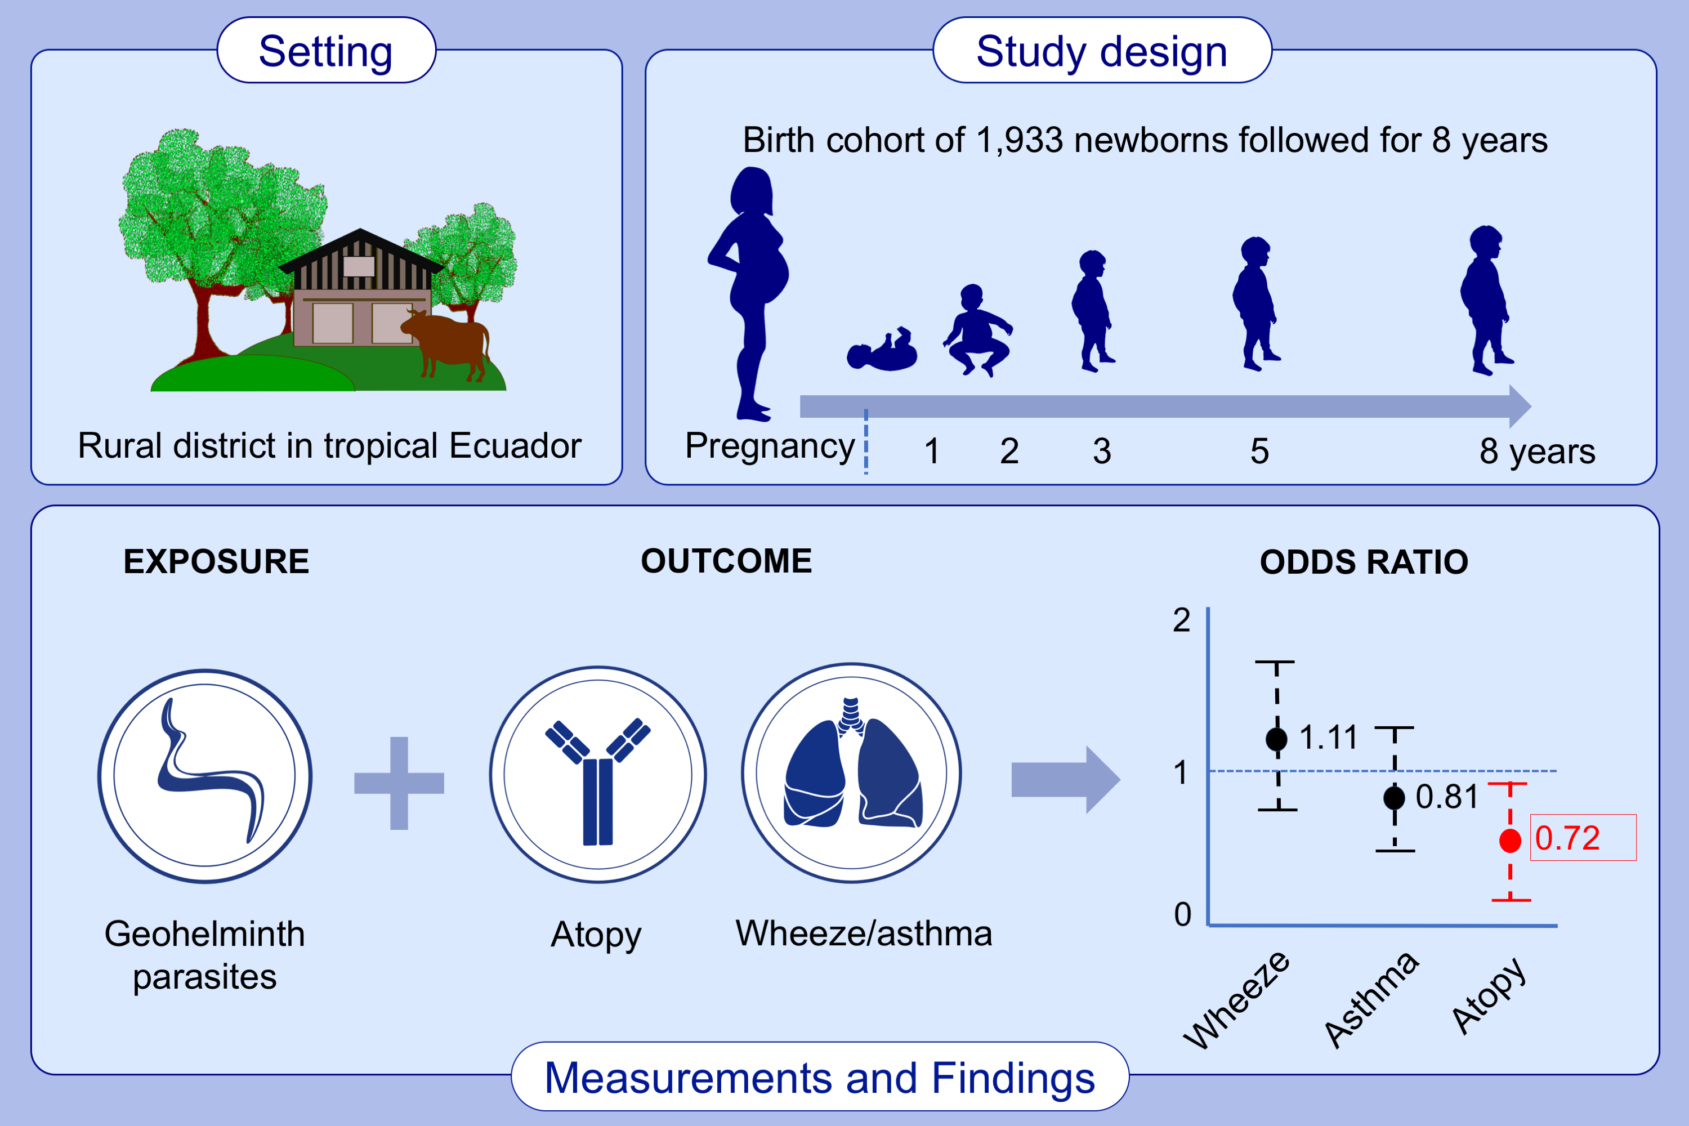
Impact of early life geohelminths on wheeze, asthma and atopy in Ecuadorian children at 8 years
Philip J. Cooper,, Irina Chis Ster,, Martha E. Chico,, Maritza Vaca,, Yisela Oviedo,, et al.
Allergy. 2021; 2765-2775 https://doi.org/10.1111/all.14821
© 2019 EAACI and John Wiley and Sons A/S. Published by John Wiley and Sons Ltd.
Notes:
HIGHLIGHTS
Maternal geohelminths protect 8 years-old children from development of allergen skin prick test reactivity with strongest effects observed in infected children of infected mothers.
Early childhood infections with Trichuris trichiura protect against wheeze at 8 years.
Effects of geohelminths on wheeze/asthma and airways reactivity and inflammation at 8 years varies by parasite species and atopy.

