Slide 1
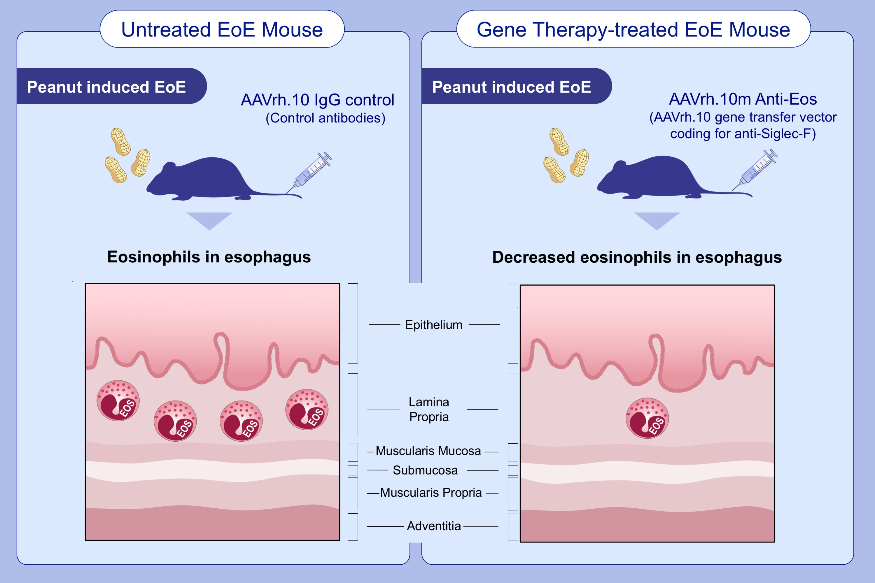
Gene therapy for a murine model of eosinophilic esophagitis
Anna E. Camilleri,, Saparja Nag,, Anthony R. Russo,, Katie M. Stiles,, Ronald G. Crystal,, et al.
Allergy. 2021; 2740-2752 https://doi.org/10.1111/all.14822
© 2019 EAACI and John Wiley and Sons A/S. Published by John Wiley and Sons Ltd.
Notes:
HIGHLIGHTS
A murine model of eosinophilic esophagitis was developed, which reproduces the human EoE phenotype.
Administration of an AAV vector (AAVrh.10mAnti-Eos) results in sustained antibody expression, clearance of eosinophils from the esophagus and blood, and protection from associated parameters.
To our knowledge our study is the first gene therapy platform for EoE which could be applied to other eosinophilic disorders.
Abbreviations: AAVrh10, adeno-associated virus serotype rh.10; EoE, eosinophilic esophagitis; EOS, eosinophil

