Slide 1
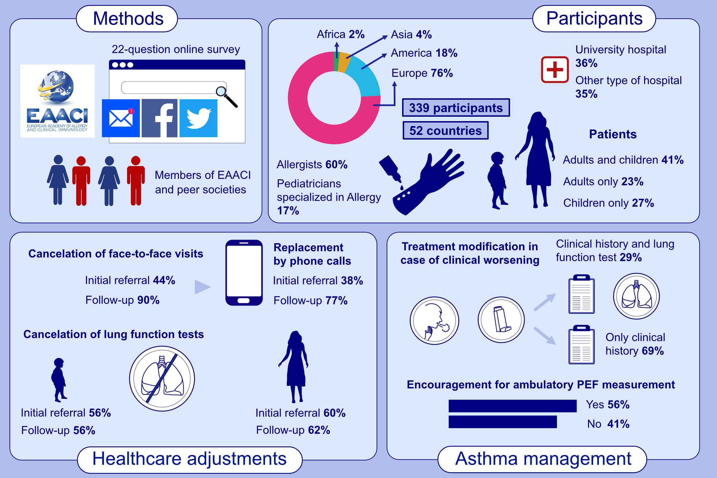
Real-life impact of COVID-19 pandemic lockdown on the management of pediatric and adult asthma: A survey by the EAACI Asthma Section
Ibon Eguiluz-Gracia,, Maarten van den Berge,, Cristina Boccabella,, Matteo Bonini,, Cristiano Caruso,, et al.
Allergy. 2021; 2776-2784 https://doi.org/10.1111/all.14831
© 2019 EAACI and John Wiley and Sons A/S. Published by John Wiley and Sons Ltd.
Notes:
HIGHLIGHTS
During the first wave of COVID-19 pandemic, 38% of new and 77% of follow-up consultations for pediatric and adult asthma patients were performed by phone calls. In 10% of cases, both types of consultations continued as face-to-face visits, whereas in 6% of cases all consultations were cancelled.
Forced spirometry was not conducted during the initial assessment and subsequent monitoring of 56-62% of pediatric and adult asthma patients. Only 56% of HCP encouraged asthma patients to perform regular ambulatory peak expiratory flow measurement.
Lung function tests were conducted in only 29% of children and adults with asthma who reported a worsening of their clinical condition. Using a 1 (nothing) to 5 (very much) scale, HCP scored with 2.8 the deleterious impact of COVID-19 lockdown on the health status of children and adults with asthma.
Abbreviations: COVID-19, coronavirus disease 2019; HCP, health care providers; PEF, peak expiratory flow

