Slide 1
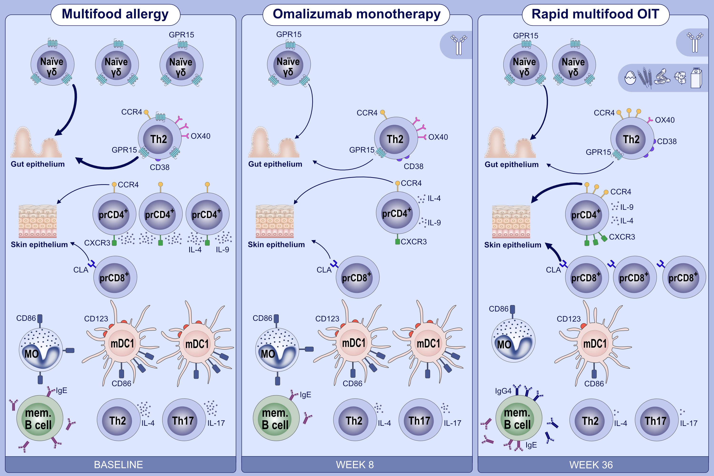
Immune changes beyond Th2 pathways during rapid multifood immunotherapy enabled with omalizumab
Monali Manohar,, Diane Dunham,, Sheena Gupta,, Zheng Yan,, Wenming Zhang,, et al.
Allergy. 2021; 2809-2826 https://doi.org/10.1111/all.14833
© 2019 EAACI and John Wiley and Sons A/S. Published by John Wiley and Sons Ltd.
Notes:
HIGHLIGHTS
Omalizumab (anti-IgE) treatment alone for 8 weeks: decreased GPR15 in naïve γδ and effector memory Th2, decreased frequency of IL-4⁺ pr CD4⁺ cells.
Desensitization at week 36 post-omalizumab-adjunctive multifood OIT: decrease in Th2 features: IL-4, OX40, basophil activation, increase in IgG4/IgE.
Also at week 36: increase in skin-homing receptors CCR4 and CLA, decreased CD86 on antigen presenting cells, decreased IL-17 and pro-inflammatory cytokines.
Abbreviations: CCR4, chemokine receptor 4; CLA, cutaneous lymphocyte-associated antigen; GPR15, G protein-coupled receptor 15; OIT, oral immunotherapy; pr, peanut-reactive (CD69⁺CD40L⁺)

