Slide 1
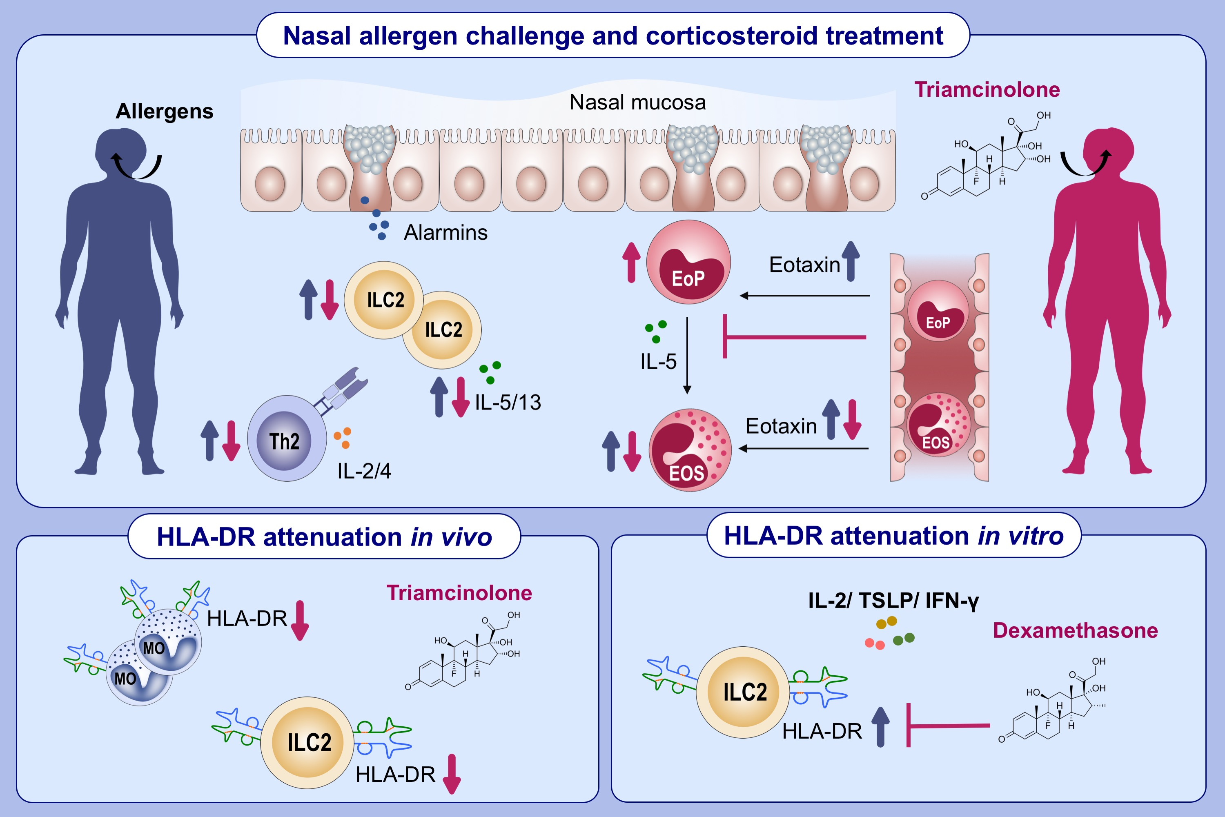
Effect of intranasal corticosteroid treatment on allergen-induced changes in group 2 innate lymphoid cells in allergic rhinitis with mild asthma
Yanqing Xie,, Xiaotian Ju,, Suzanne Beaudin,, Lesley Wiltshire,, John Paul Oliveria,, et al.
Allergy. 2021; 2797-2808 https://doi.org/10.1111/all.14835
© 2019 EAACI and John Wiley and Sons A/S. Published by John Wiley and Sons Ltd.
Notes:
HIGHLIGHTS
In mild allergic rhinitis with asthma, pre-treatment with intranasal corticosteroids attenuates allergen-induced increases in IL-5/IL-13⁺ILC2s, CD4⁺ T cells and terminal differentiation of EoP in the nasal mucosa with consequent reduction in eosinophilic inflammation.
Mucosal ILC2s express HLA-DR following allergen inhalation challenge; this is reduced by pre-treatment with intranasal corticosteroid treatment.
Overnight culture with IL-2, TSLP or IFN-γ up-regulates HLA-DR expression on ILC2s, in vitro; an effect that is inhibited in the presence of steroids.
Abbreviations: EoP, eosinophilic progenitor cell; HLA-DR, human leukocytes antigen DR; ILCs, innate lymphoid cells

