Slide 1
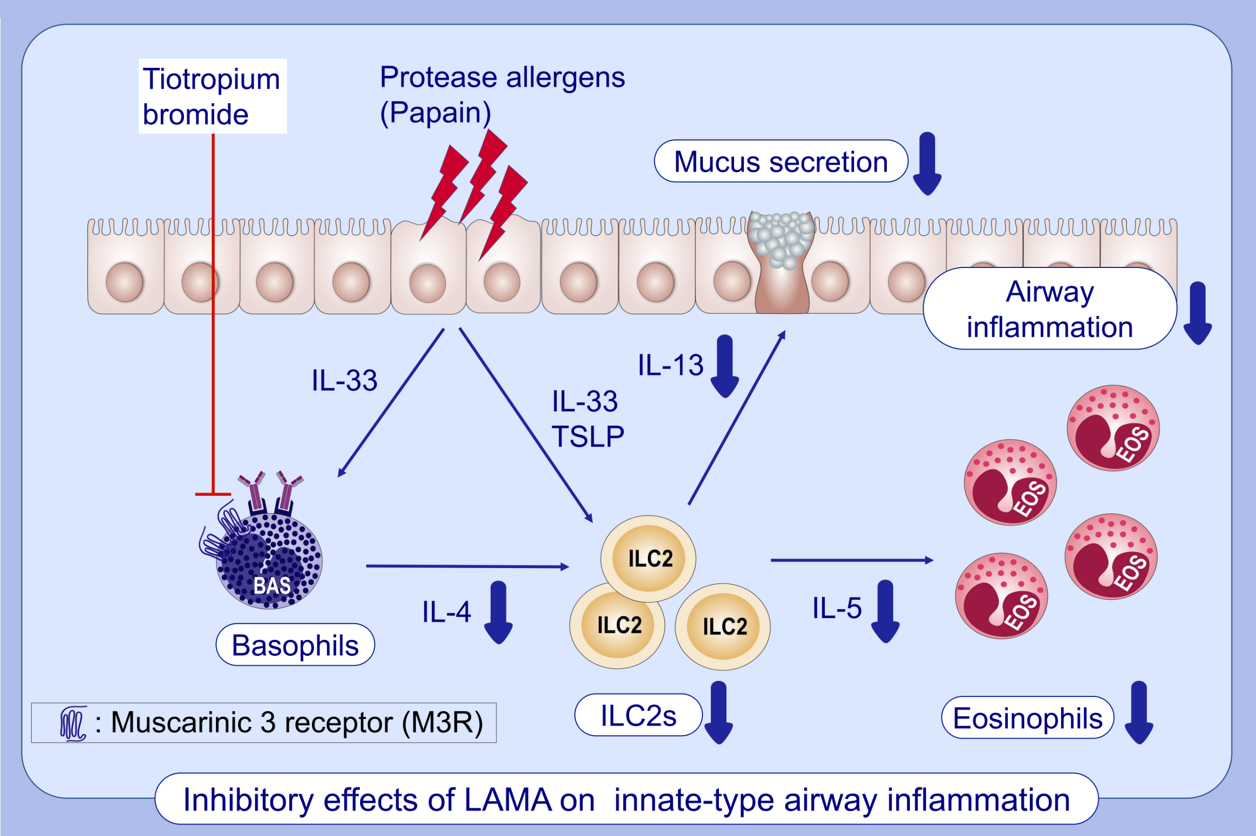
Long-acting muscarinic antagonist regulates group 2 innate lymphoid cell-dependent airway eosinophilic inflammation
Takahiro Matsuyama,, Kentaro Machida,, Yasutaka Motomura,, Koichi Takagi,, Yoichi Doutake,, et al.
Allergy. 2021; 2785-2796 https://doi.org/10.1111/all.14836
© 2019 EAACI and John Wiley and Sons A/S. Published by John Wiley and Sons Ltd.
Notes:
HIGHLIGHTS
In a papain-induced model, tiotropium bromide decreases the production of type-2 cytokines and the numbers of eosinophils and ILC2s in the airways.
M3R is highly expressed in basophils.
Tiotropium suppresses the production of IL-4 from basophils, and subsequently regulates ILC2 activation.
Abbreviations: ILC2, group 2 innate lymphoid cell; LAMA, long-acting muscarinic antagonist; M3R, muscarinic 3 receptor

