Slide 1
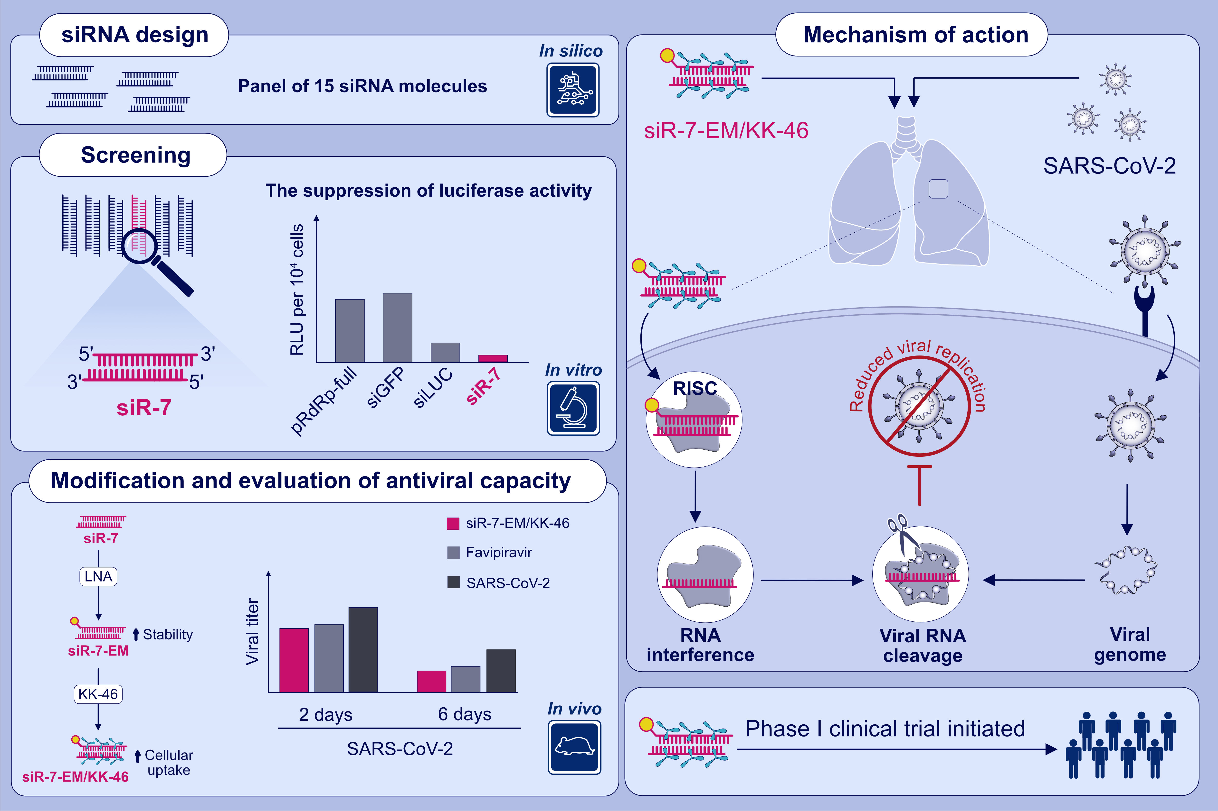
Silencing of SARS-CoV-2 with modified siRNA-peptide dendrimer formulation
Musa Khaitov,, Alexandra Nikonova,, Igor Shilovskiy,, Ksenia Kozhikhova,, Ilya Kofiadi,, et al.
Allergy. 2021; 2840-2854 https://doi.org/10.1111/all.14850
© 2019 EAACI and John Wiley and Sons A/S. Published by John Wiley and Sons Ltd.
Notes:
HIGHLIGHTS
siR-7, targeting SARS-CoV-2 RdRp inhibits viral replication in vitro.
LNA-modification and complexation with peptide dendrimer KK-46 enhanced the antiviral capacity of siR-7 in vitro.
Inhalation exposure of SARS-CoV-2-infected Syrian Hamsters with siR-7-EM/KK-46 reduces the virus titer and lung inflammation.
Abbreviations: GFP, green fluorescent protein; LNA, locked nucleic acid; LUC, luciferase; RISC, RNA-induced silencing complex; RdRp, RNA-dependent RNA polymerase; SARS-CoV-2, severe acute respiratory syndrome coronavirus 2; siRNA, small interfering RNA; siR-7-EM, LNA-modified small interfering RNA -7

