Slide 1
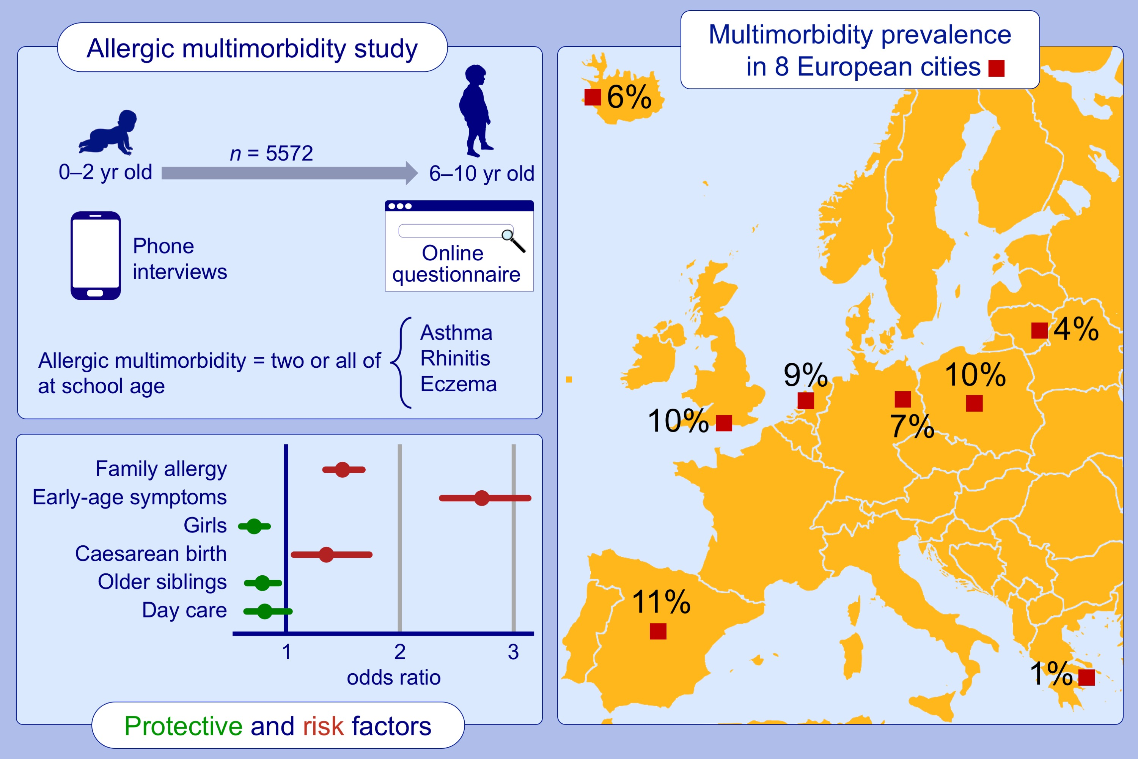
Prevalence and early-life risk factors of school-age allergic multimorbidity: The EuroPrevall-iFAAM birth cohort
Sigurveig T. Sigurdardottir,, Kristjan Jonasson,, Michael Clausen,, Kristin Lilja Bjornsdottir,, Sigridur Erla Sigurdardottir,, et al.
Allergy. 2021; 2855-2865 https://doi.org/10.1111/all.14857
© 2019 EAACI and John Wiley and Sons A/S. Published by John Wiley and Sons Ltd.
Notes:
HIGHLIGHTS
Allergic multimorbidity (coexistence of asthma, eczema, and allergic rhinitis) is common among European children at primary school age, with 7% of study participants affected.
Protective factors identified in the study include female sex, having older siblings, and attending day care.
Risk factors include history of allergic diseases in first-degree family members, early-age symptoms, and caesarean birth.

