Slide 1
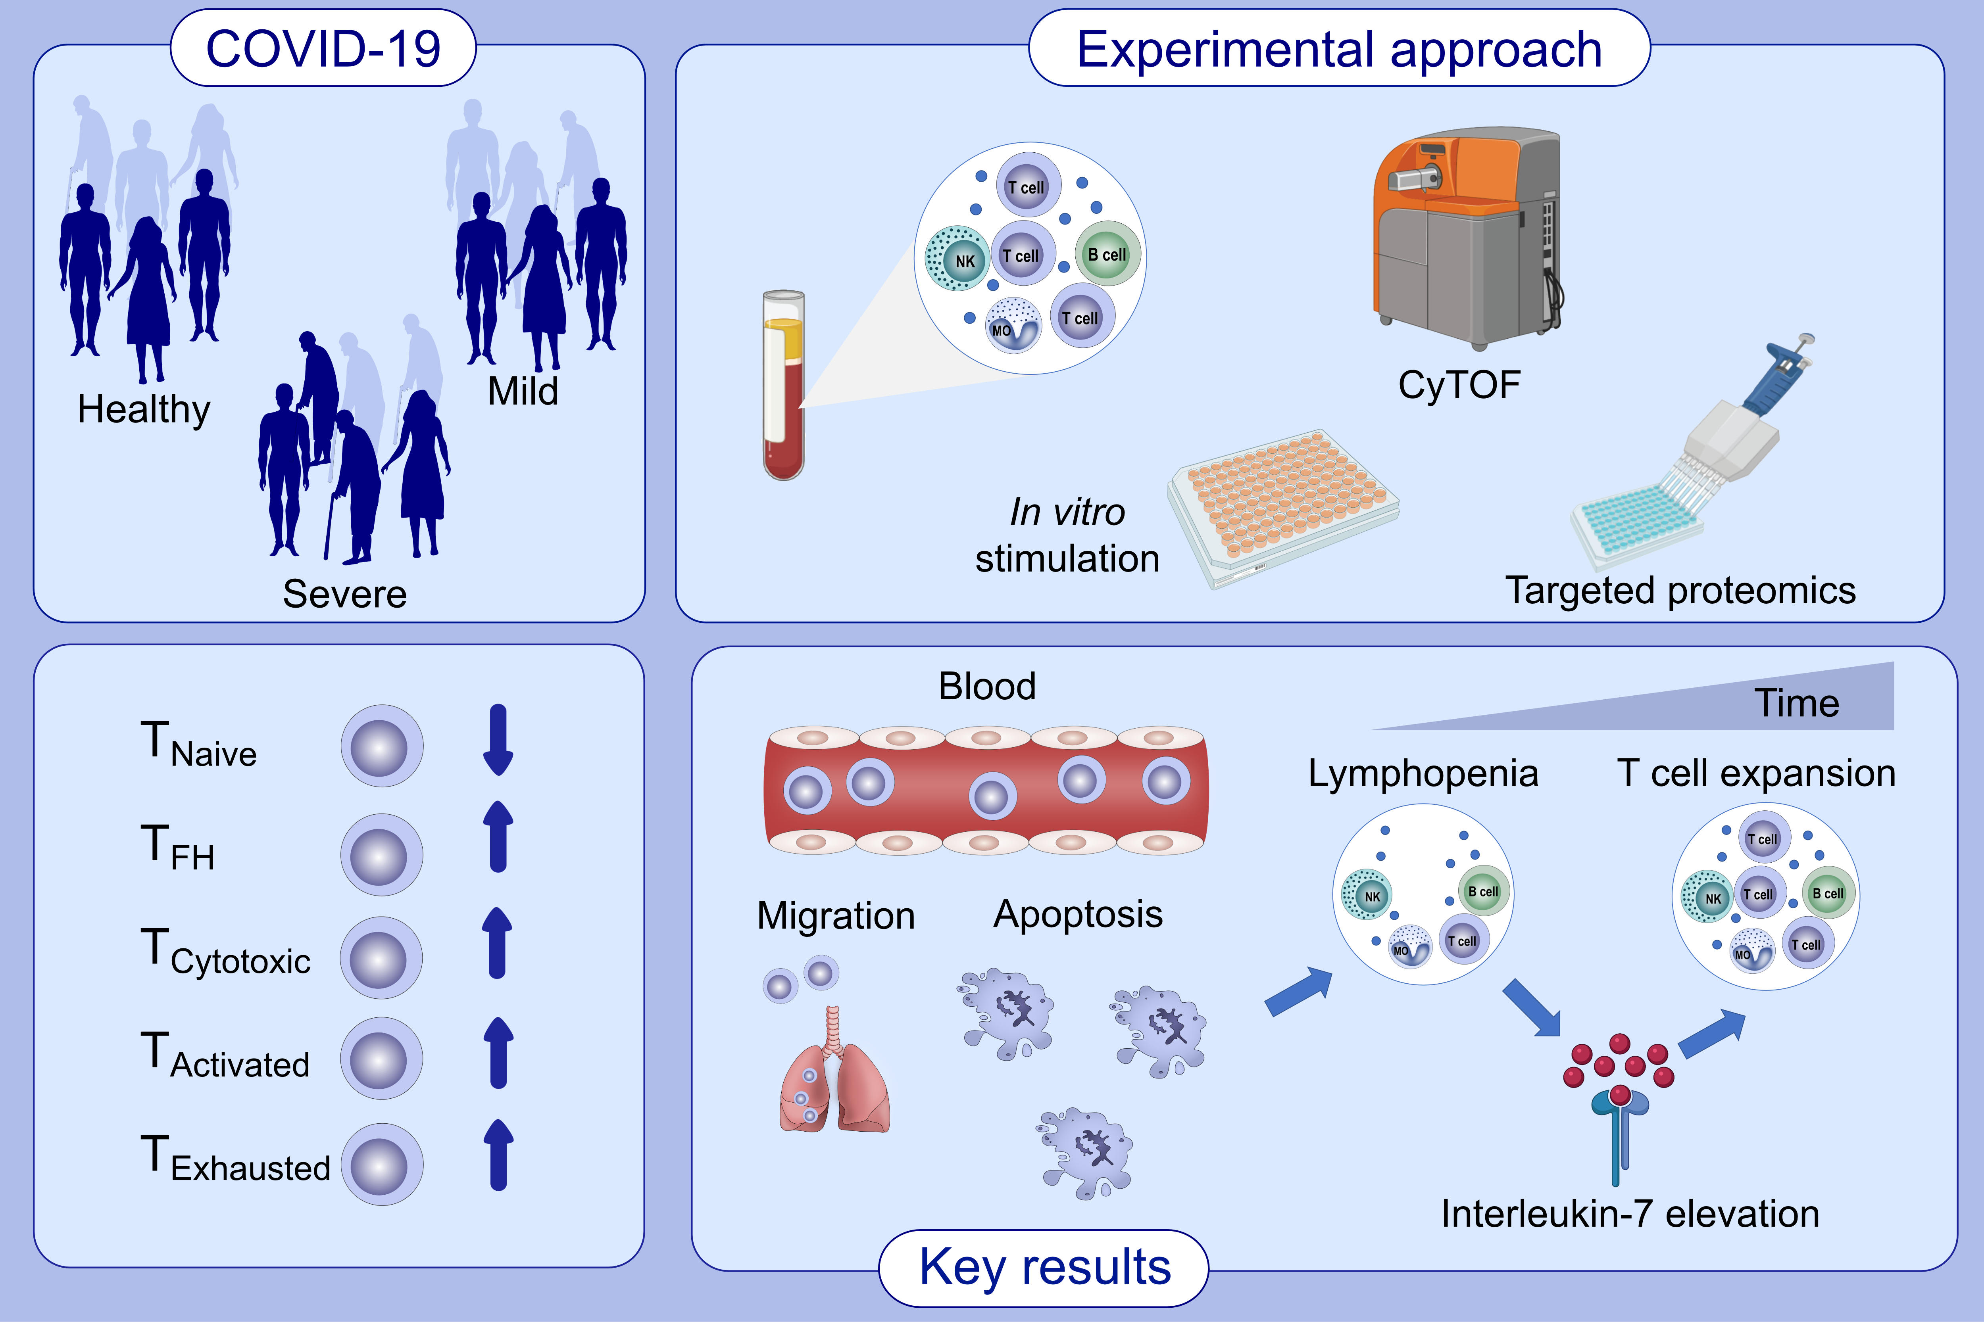
Profound dysregulation of T cell homeostasis and function in patients with severe COVID-19
Sarah Adamo,, Stéphane Chevrier,, Carlo Cervia,, Yves Zurbuchen,, Miro E. Raeber,, et al.
Allergy. 2021; 2866-2881 https://doi.org/10.1111/all.14866
© 2019 EAACI and John Wiley and Sons A/S. Published by John Wiley and Sons Ltd.
Notes:
HIGHLIGHTS
In severe COVID-19 T cell populations show perturbations, including loss of naïve T cells, CD4⁺ T cell skewing toward T follicular helper and cytotoxic phenotypes and expansion of activated and exhausted T cells.
Apoptosis and migration contribute to the lymphopenia of severe disease, which is accompanied by Interleukin-7 elevation.
Functional responses to viral antigens are reduced in severe COVID-19.
Abbreviations: COVID-19, coronavirus disease 2019; CyTOF, cytometry by time-of-flight; T_{FH}, T follicular helper cell
.

