Slide 1
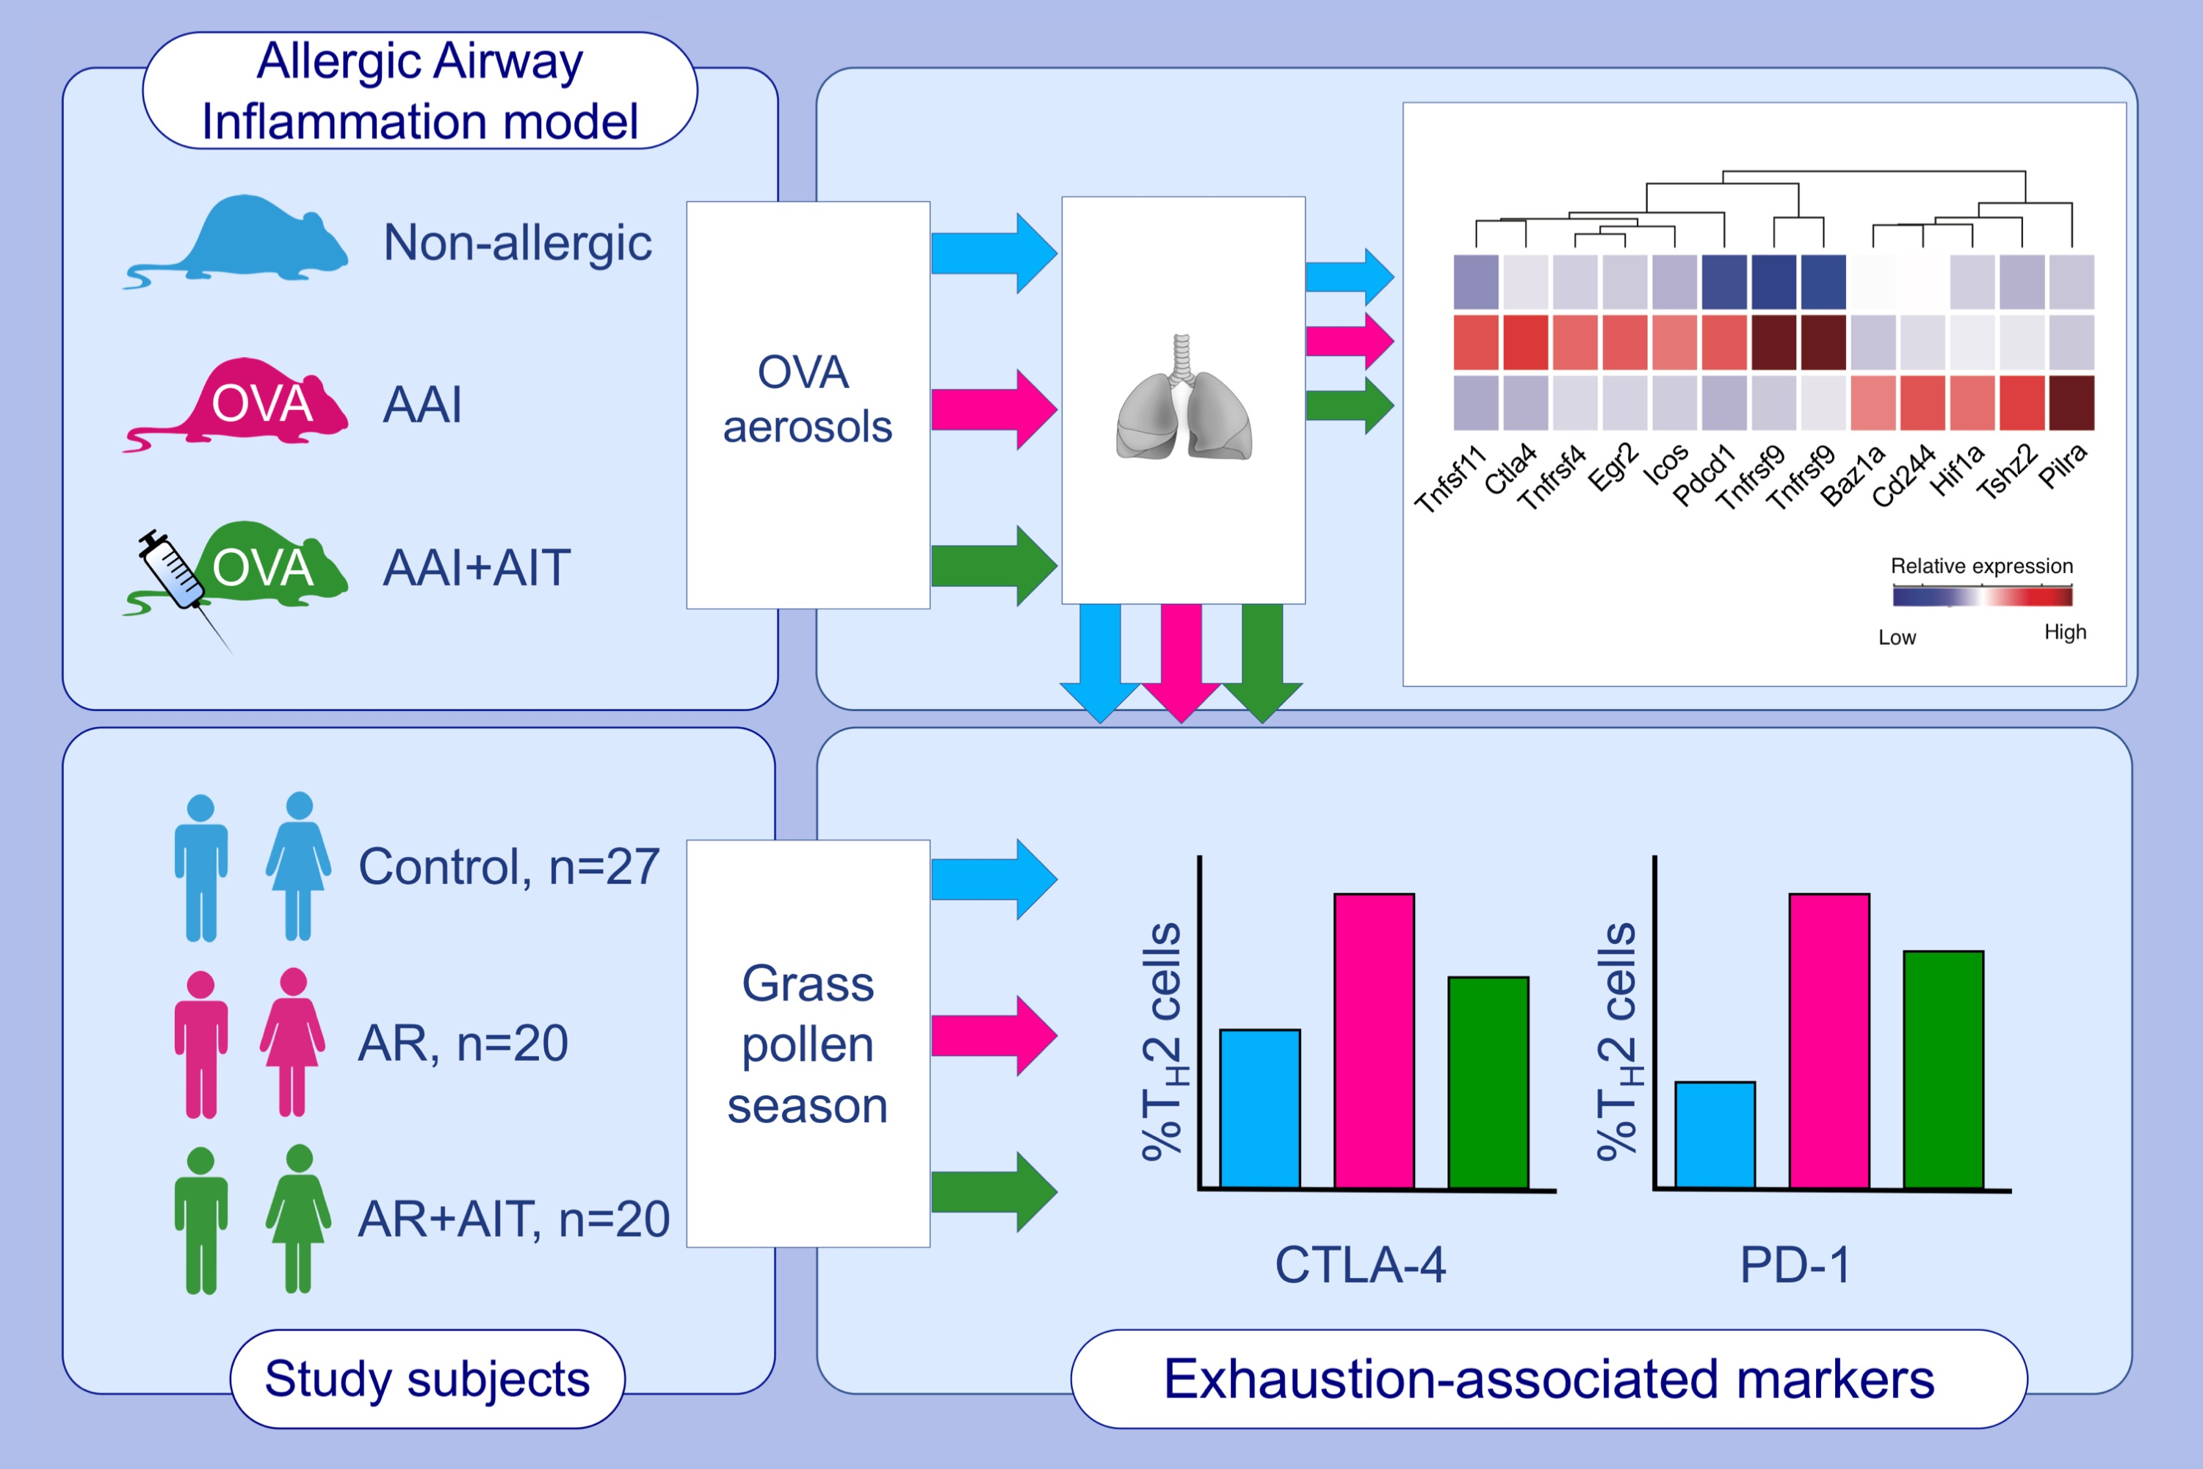
An exhausted phenotype of TH2 cells is primed by allergen exposure, but not reinforced by allergen-specific immunotherapy
Shu-Hung Wang,, Ulrich M. Zissler,, Maren Buettner,, Sonja Heine,, Alexander Heldner,, et al.
Allergy. 2021; 2827-2839 https://doi.org/10.1111/all.14896
© 2019 EAACI and John Wiley and Sons A/S. Published by John Wiley and Sons Ltd.
Notes:
HIGHLIGHTS
This study shows that T_{H}2-cells upregulate the exhaustion-associated surface markers CTLA-4 and PD-1 upon in vivo allergen exposure in OVA-sensitized mice and grass pollen-allergic patients.
This upregulation is reduced after AIT, in particular in T_{H}2-cells from local mouse lungs and AR patients with concurrent asthma.
The transcriptome of allergic mouse lungs shows enhanced expression of both markers.
Abbreviations: AAI, allergic airway inflammation; AIT, allergen-specific immunotherapy; AR, allergic rhinitis; Baz1a, bromodomain adjacent to zinc finger domain 1A; CTLA-4, cytotoxic T-lymphocyte-associated antigen-4; Egr2, early growth response 2; Hif1a, hypoxia inducible factor 1 subunit alpha; Icos, inducible T cell costimulator; OVA, ovalbumin; PD-1, program death protein-1; Pdcd1, programmed cell death 1; Pilra, paired immunoglobin like type 2 receptor alpha; Tnfsf, TNF superfamily member; Tnfrsf, TNF receptor superfamily member; Tshz2, teashirt zinc finger homeobox 2

