Slide 1
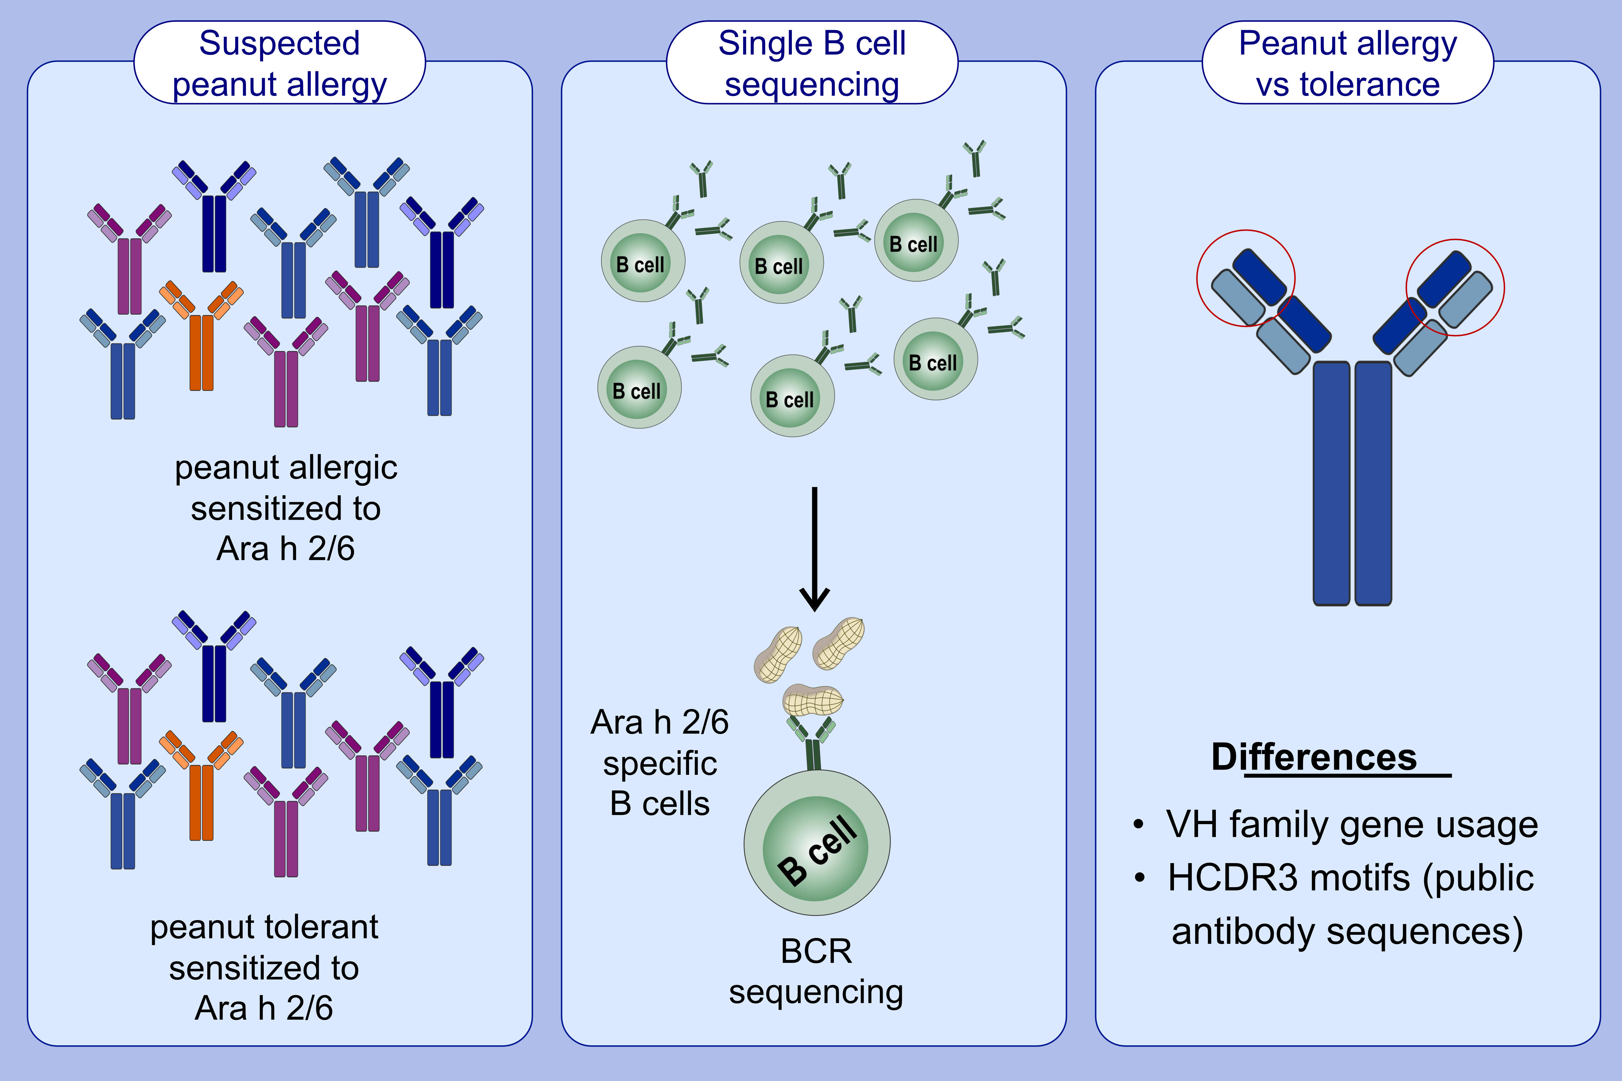
Distinction between peanut allergy and tolerance by characterization of B cell receptor repertoires
Anna M. Ehlers,, Constance F. den Hartog Jager,, André C. Knulst,, Henny G. Otten,
Allergy. 2021; 2753-2764 https://doi.org/10.1111/all.14897
© 2019 EAACI and John Wiley and Sons A/S. Published by John Wiley and Sons Ltd.
Notes:
HIGHLIGHTS
2S albumin-specific IgM+ B cells from peanut allergic patients show partly a high number of non-silent mutations.
VH3-family genes are predominantly used in 2S albumin-specific B-cells of peanut allergic patients.
Certain public antibody sequences (HCDR3 sequence motifs) are associated with peanut allergy or tolerance in patients sensitized to Ara h 2 and/or 6.
Abbreviations: BCR, B cell receptor; HCDR3, heavy chain complementarity-determining region 3; VH, variable (V) gene of the heavy chain

