Slide 1
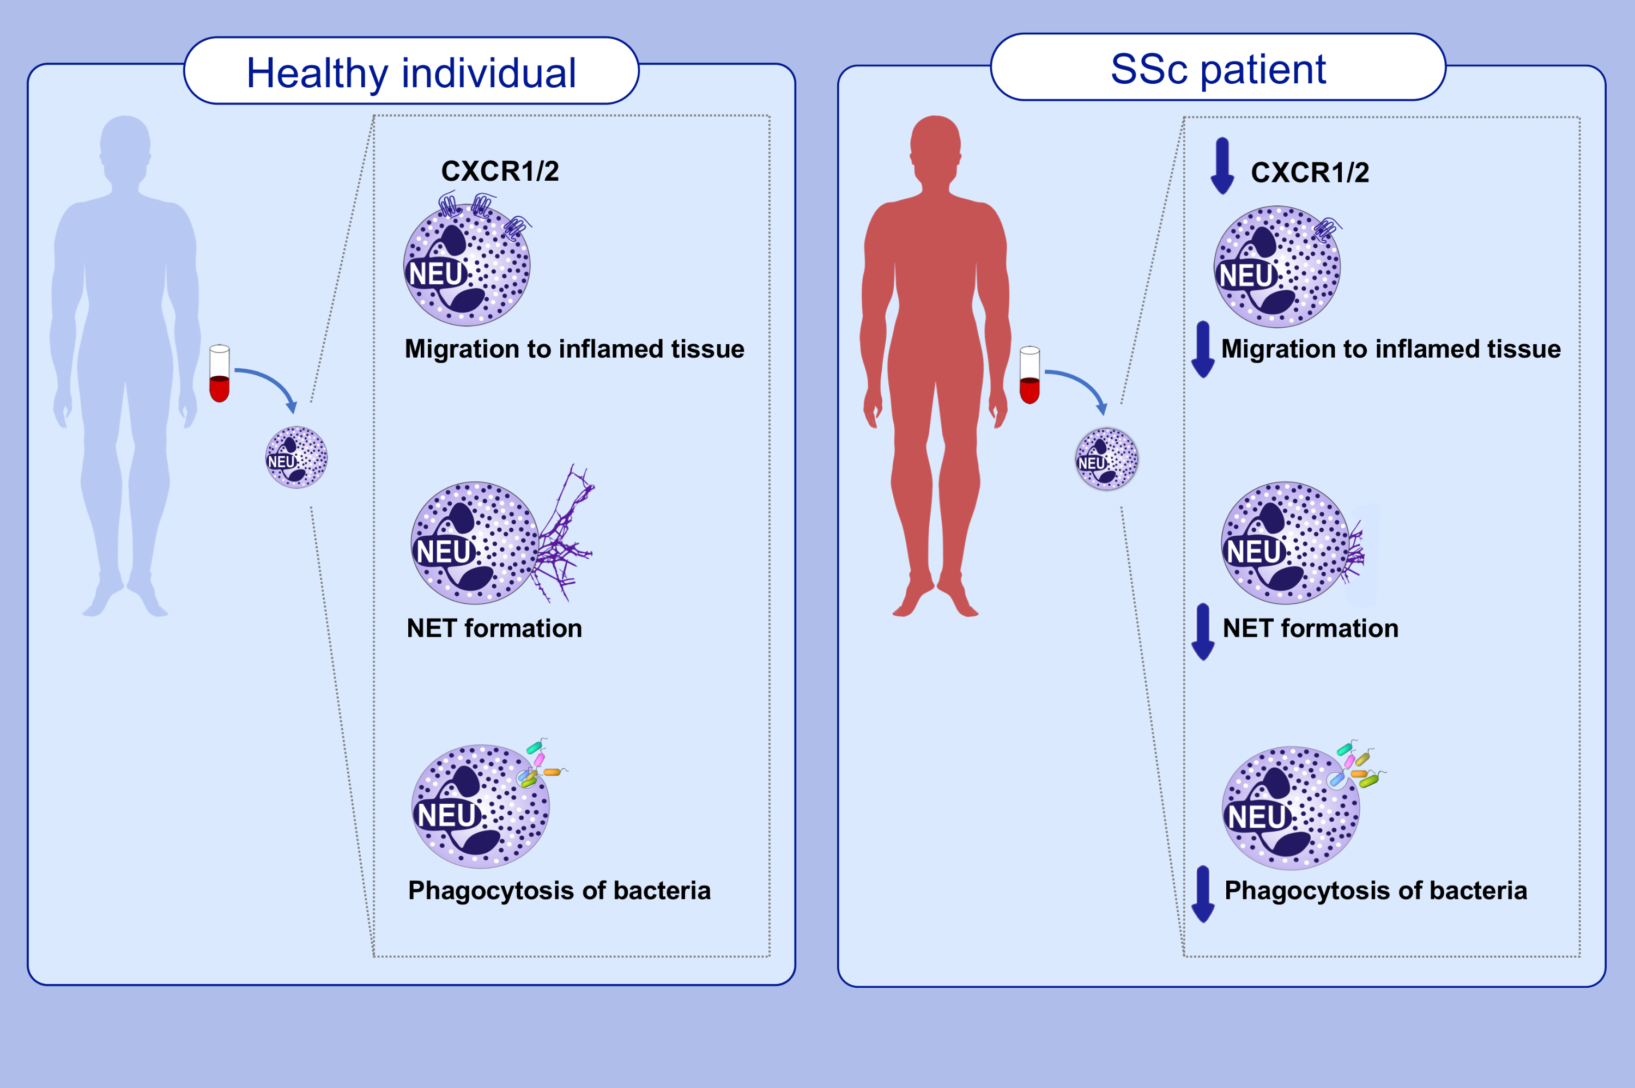
Patients with systemic sclerosis show phenotypic and functional defects in neutrophils
Daniela Impellizzieri,, Cecilie Egholm,, Alan Valaperti,, Oliver Distler,, Onur Boyman, et al.
Allergy. 2022; 1274-1284 https://doi.org/10.1111/all.15073
© 2019 EAACI and John Wiley and Sons A/S. Published by John Wiley and Sons Ltd.
Notes:
HIGHLIGHTS
Neutrophils of patients with systemic sclerosis (SSc) display a distinct phenotype.
SSc neutrophils carry reduced chemokine receptors for CXCL8, which is important for migration to inflamed tissues.
SSc neutrophils show deficient neutrophil extracellular trap formation and phagocytosis of bacteria.
Abbreviations: CXCR1/2, C-X-C motif chemokine receptor 1 and 2; NET, neutrophil extracellular trap; Neu, neutrophil; SSc, systemic sclerosis
.

