Slide 1
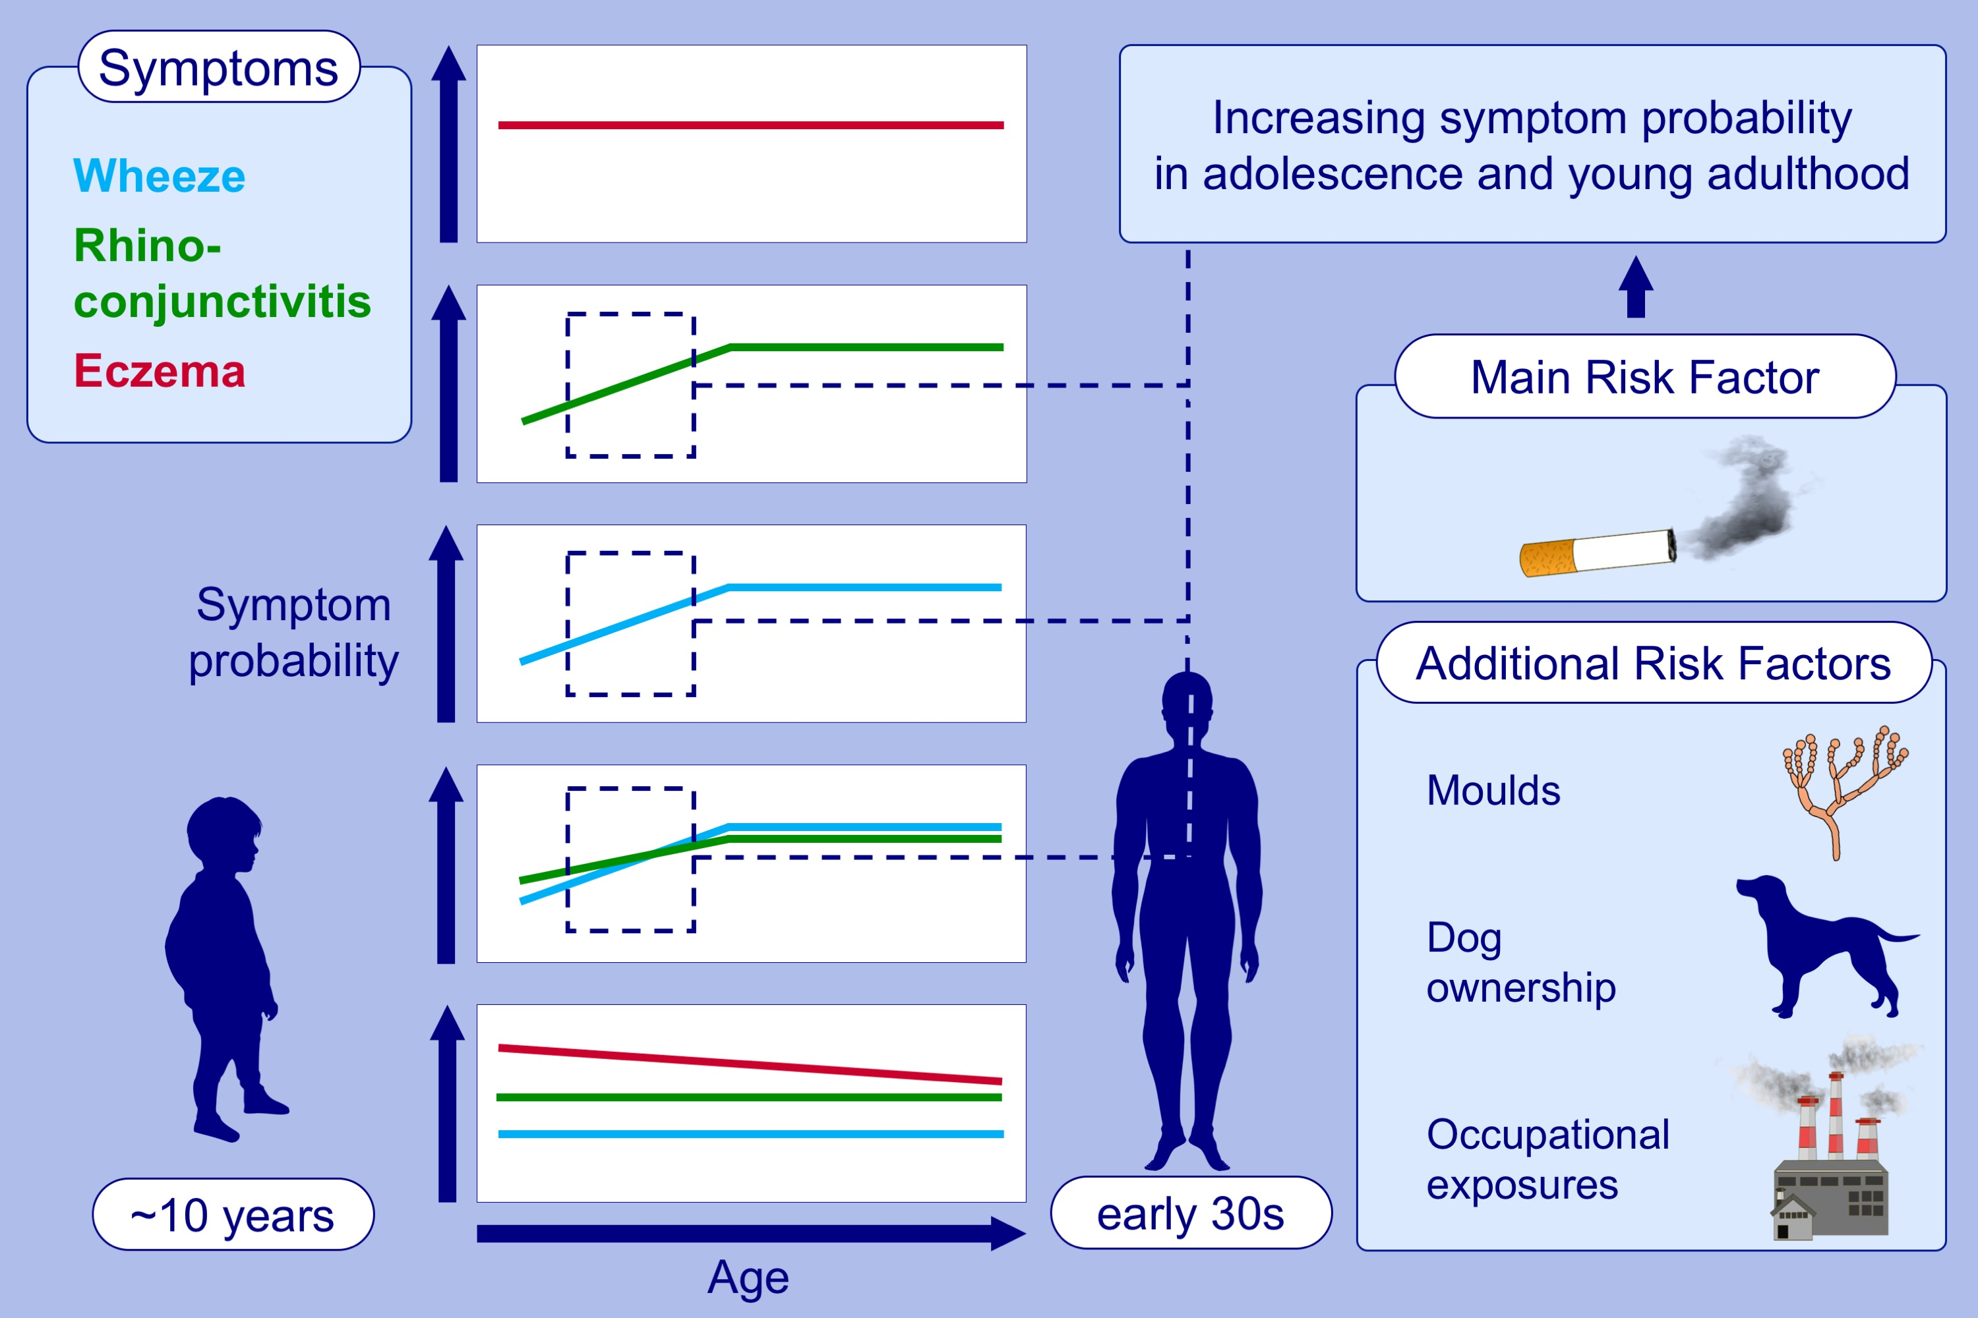
Trajectories of asthma and allergy symptoms from childhood to adulthood
Felix Forster,, Markus Johannes Ege,, Jessica Gerlich,, Tobias Weinmann,, Sylvia Kreißl,, et al.
Allergy. 2022; 1192-1203 https://doi.org/10.1111/all.15075
© 2019 EAACI and John Wiley and Sons A/S. Published by John Wiley and Sons Ltd.
Notes:
HIGHLIGHTS
We derived five symptomatic trajectories using latent class analysis in a cohort of German ISAAC participants followed-up until their early 30s.
Some trajectories showed increasing symptom probabilities during adolescence.
These trajectories showed the strongest associations with environmental exposures, especially smoking but also mould, dog ownership, and occupational exposures.
Abbreviation: ISAAC, International Study of Asthma and Allergies in Childhood

