Slide 1
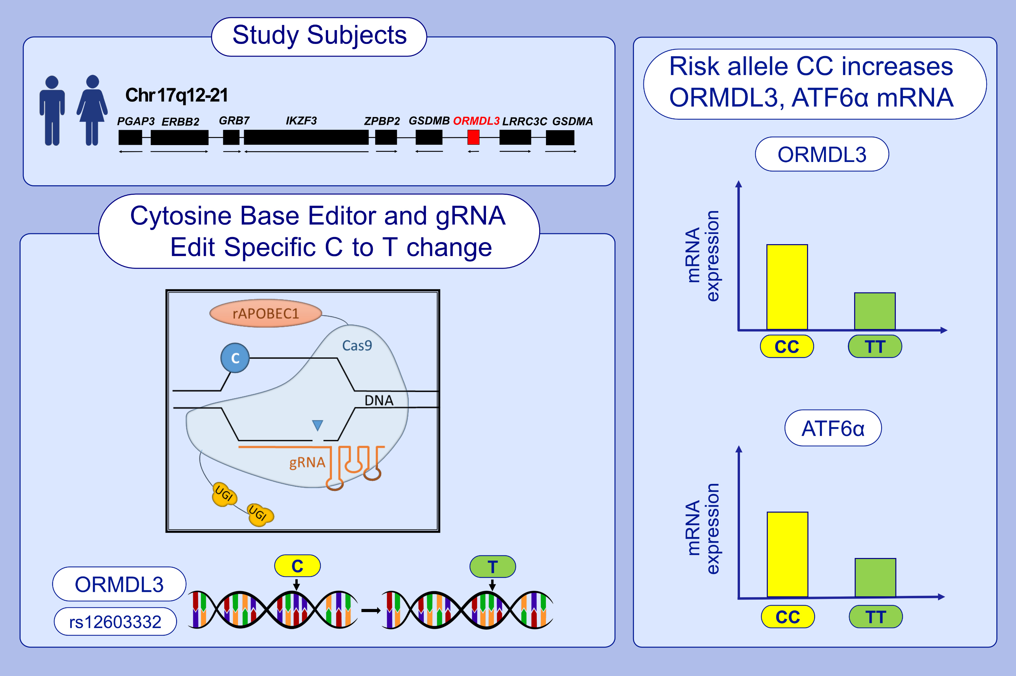
Single-base editing of rs12603332 on chromosome 17q21 with a cytosine base editor regulates ORMDL3 and ATF6α expression
Ning Weng,, Marina Miller,, Alexa K. Pham,, Alexis C. Komor,, David H. Broide, et al.
Allergy. 2022; 1139-1149 https://doi.org/10.1111/all.15092
© 2019 EAACI and John Wiley and Sons A/S. Published by John Wiley and Sons Ltd.
Notes:
HIGHLIGHTS
SNP rs12603332 on chromosome 17q21 is highly associated with the development of asthma.
Using a Cytosine Base Editor, the rs12603332 C risk allele was edited to the T non-risk allele in primary human CD4 T cells.
This change regulated the expression of ORMDL3 and ORMDL3 regulated gene ATF6α expression.
Abbreviations: ATF6α, activating transcription factor α; C, cytosine; Cas9, CRISP-associated protein 9; Chr 17q12-21, chromosome 17q12-21 region; ERBB2, erb-b2 receptor tyrosine kinase 2; GRB7, growth factor receptor bound protein 7; gRNA, guide RNA; GSDMA, gasdermin A; GSDMB, gasdermin B; IKZF3, IKAROS family zinc finger 3; LRRC3C, leucine rich repeat containing 3C; ORMDL3, ORM1 like; PGAP3, post-GPI attachment to proteins phospholipase 3; rAPOBEC1, rat apolipoprotein-B-editing enzyme, catalytic polypeptide-1; SNP, single nucleotide polymorphisms; T, thymine; UGI, uracil glycosylase inhibitor; ZPBP2, zona pellucida binding protein 2

