Slide 1
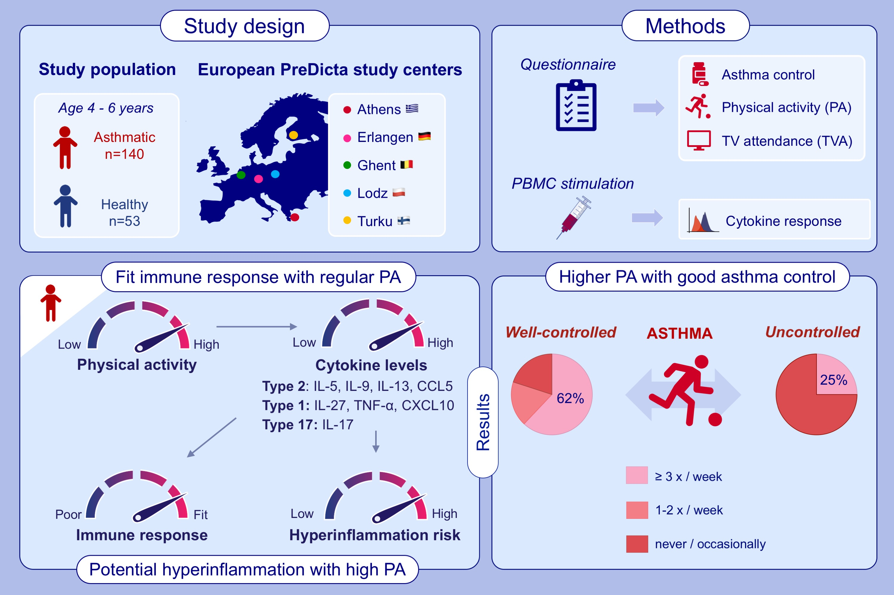
Physical activity in asthma control and its immune modulatory effect in asthmatic preschoolers
Debbie J. Maurer,, Chengyao Liu,, Paraskevi Xepapadaki,, Barbara Stanic,, Claus Bachert,, et al.
Allergy. 2022; 1216-1230 https://doi.org/10.1111/all.15105
© 2019 EAACI and John Wiley and Sons A/S. Published by John Wiley and Sons Ltd.
Notes:
HIGHLIGHTS
Asthmatic children show more sedentary behavior than healthy peers, especially those with uncontrolled asthma
Regular moderate-to-high PA is associated with elevated cytokine levels in response to viral, bacterial and fungal stimulations in asthmatics, which indicates a strong immune response and readiness to respond upon infections.
High cytokine levels associated with high PA might also indicate hyperinflammation, suggesting the need for individual assessment to find an optimum PA level
Abbreviations: PA, physical activity; TVA, TV attendance

