Slide 1
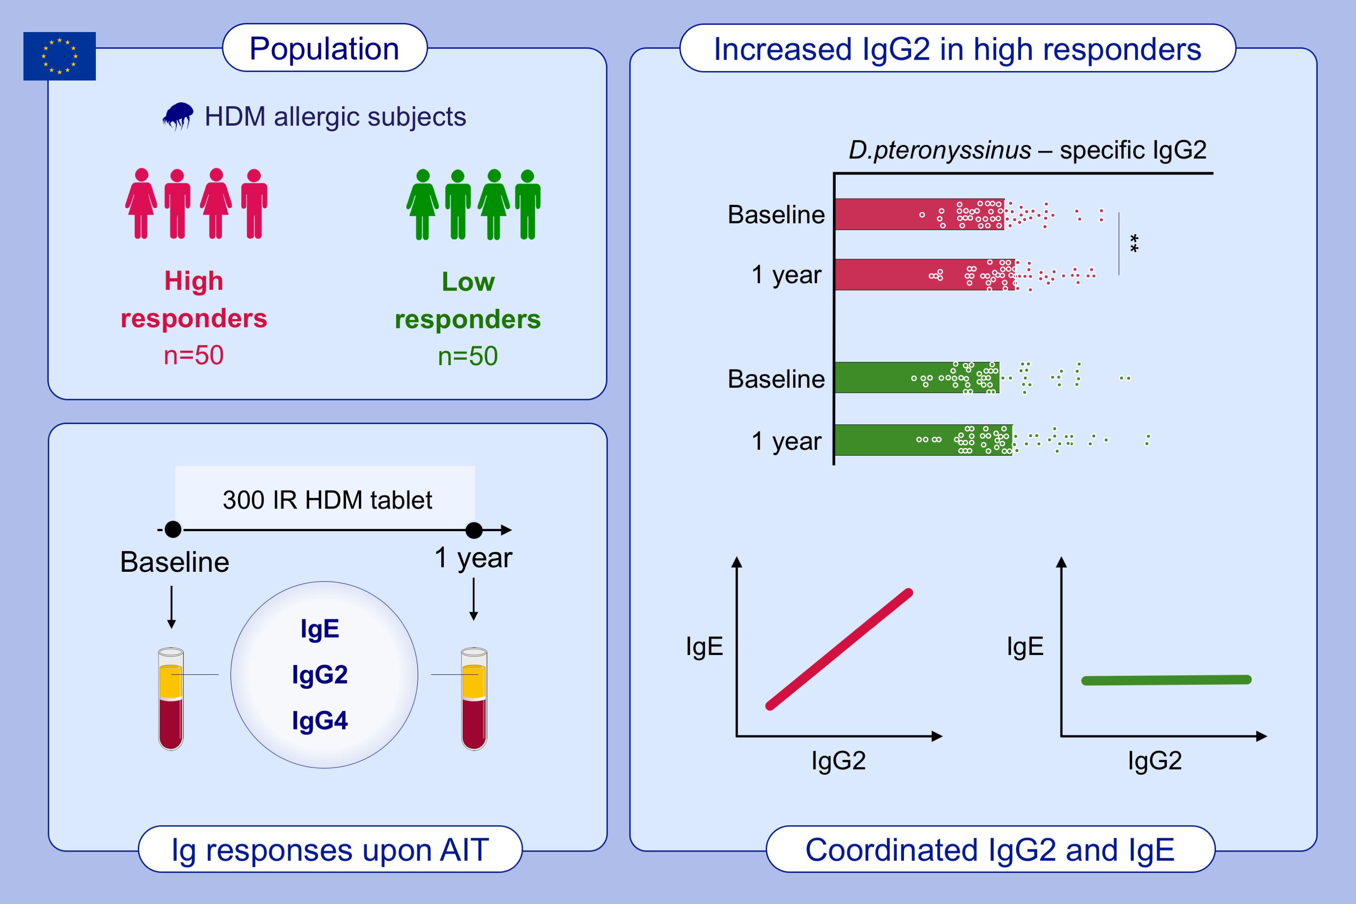
Coordinated IgG2 and IgE responses as a marker of allergen immunotherapy efficacy
Véronique Bordas-Le Floch,, Nathalie Berjont,, Thierry Batard,, Nirupama Varese,, Robyn E. O’Hehir,, et al.
Allergy. 2022; 1263-1273 https://doi.org/10.1111/all.15107
© 2019 EAACI and John Wiley and Sons A/S. Published by John Wiley and Sons Ltd.
Notes:
HIGHLIGHTS
This study assesses humoral responses in HDM-allergic individuals before and after 1-year HDM tablet sublingual AIT.
Individuals suffering from HDM allergy exhibit an increase in serum HDM-specific IgG2 following 1-year AIT.
Correlations observed between changes in IgG2 and IgE antibody levels highlight coordinated humoral responses only in high responders during AIT.
Abbreviations: AIT, allergen immunotherapy; HDM, house dust mite; IR, index of reactivity

