Slide 1
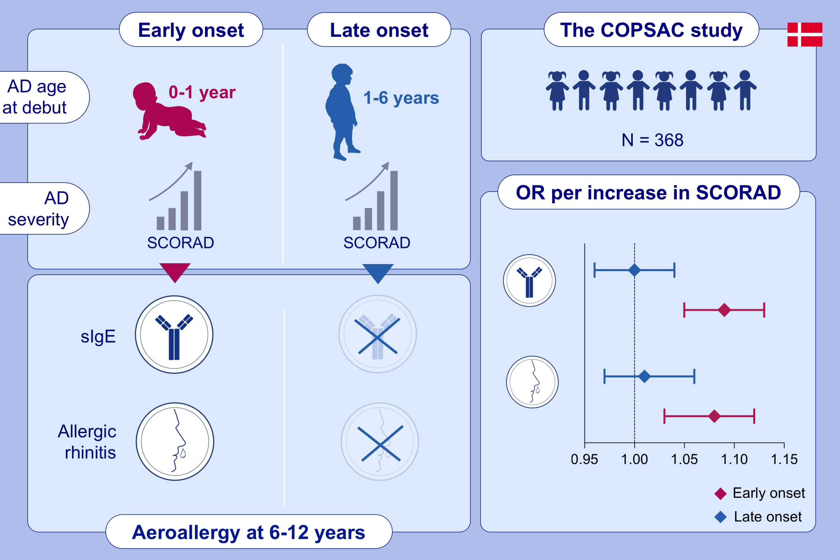
Increasing severity of early-onset atopic dermatitis, but not late-onset, associates with development of aeroallergen sensitization and allergic rhinitis in childhood
Ann-Marie Malby Schoos,, Bo Lund Chawes,, Klaus Bønnelykke,, Jakob Stokholm,, Morten Arendt Rasmussen,, et al.
Allergy. 2022; 1254-1262 https://doi.org/10.1111/all.15108
© 2019 EAACI and John Wiley and Sons A/S. Published by John Wiley and Sons Ltd.
Notes:
HIGHLIGHTS
Increasing severity of early-onset atopic dermatitis increases the risk of developing sensitization to aeroallergens and allergic rhinitis.
Increasing severity of late-onset atopic dermatitis does not alter the risk of developing sensitization to aeroallergens and allergic rhinitis.
These findings suggest that early-onset vs. late-onset debut represent different endotypes of atopic dermatitis, which may have implications for preventing respiratory allergies.
Abbreviations: AD, atopic dermatitis; COPSAC, COPenhagen Prospective Studies on Asthma; OR, odds ratio; SCORAD, scoring atopic dermatitis; sIgE, specific immunoglobulin E

